Slide 1
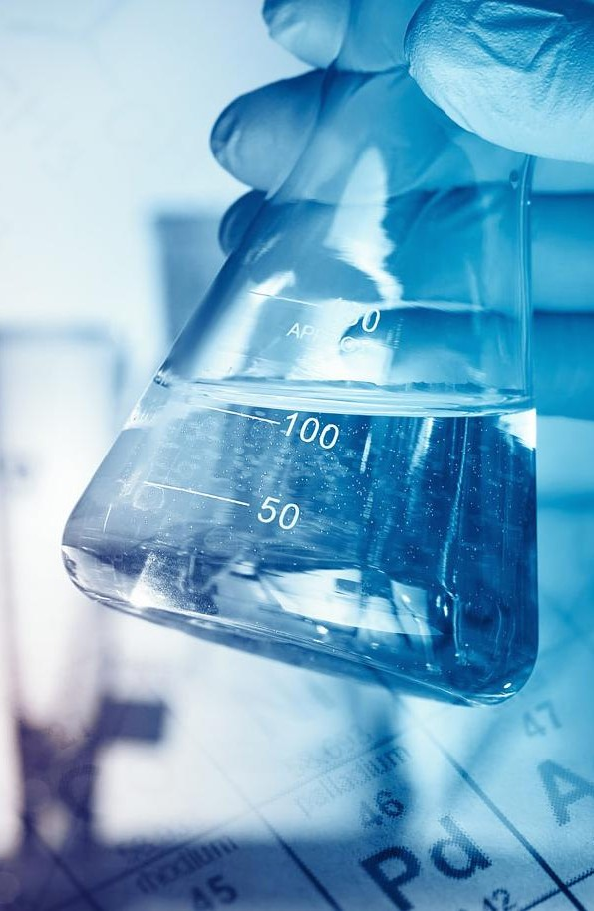
Department of Pharmaceutical Chemistry VNMU Pirogov
Elective Discipline
Theoretical Basics of Synthesis
https://www.vnmu.edu.ua/кафедра-фармацевтичної-хімії

Slide 2
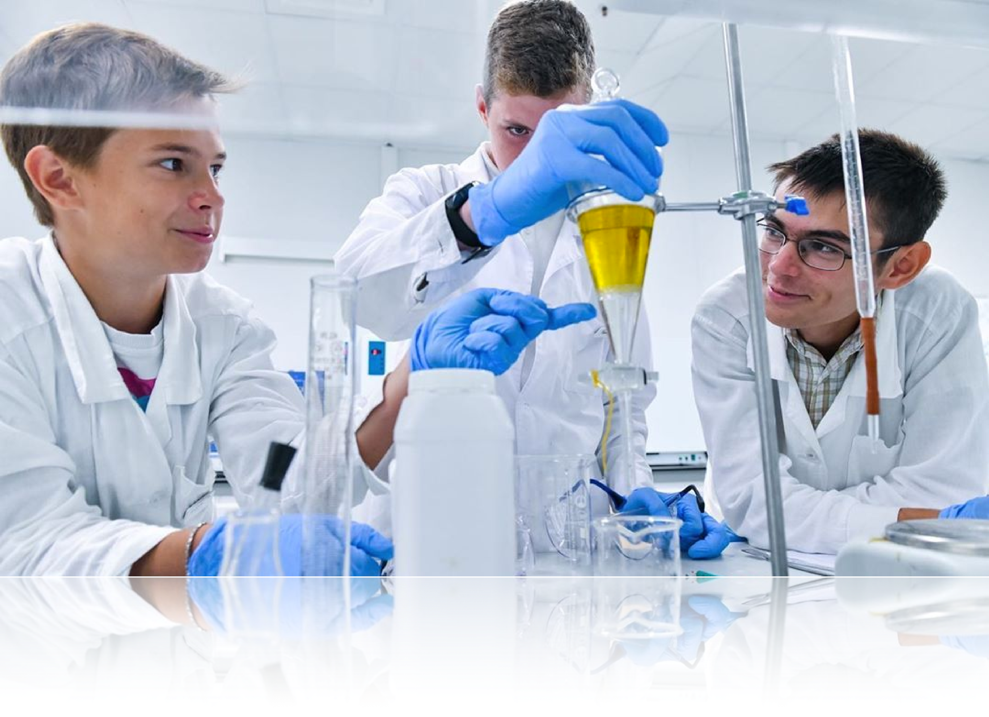
«In organic synthesis one can find both a challenge, and the audacity of adventure, and enlightenment, and the inspiration of art. It's easy to imagine how boring organic chemistry classes would be if these stimuli lost their meaning»
R.B. Woodward, American organic chemist, 1956

Slide 3
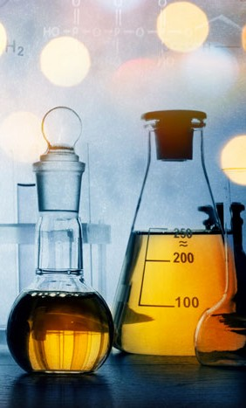
Relevance of studying the discipline
Methods of organic synthesis remain the main tool for creating drugs (drugs), because more than 80% of existing drugs belong to the so-called small synthetic molecules
Getting acquainted with new methods and approaches of organic synthesis is an important and necessary task for the formation of a competent modern specialist in the pharmaceutical field

Slide 4
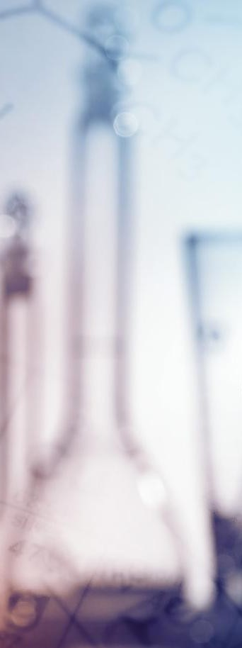
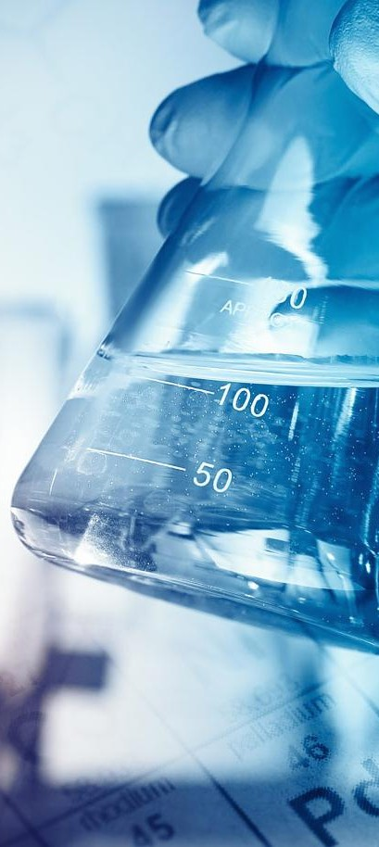
Organic chemistry
The course is designed to connect the theoretical disciplines of the second year of studyня:
Analytical chemistry
Physical and colloid chemistry

Slide 5
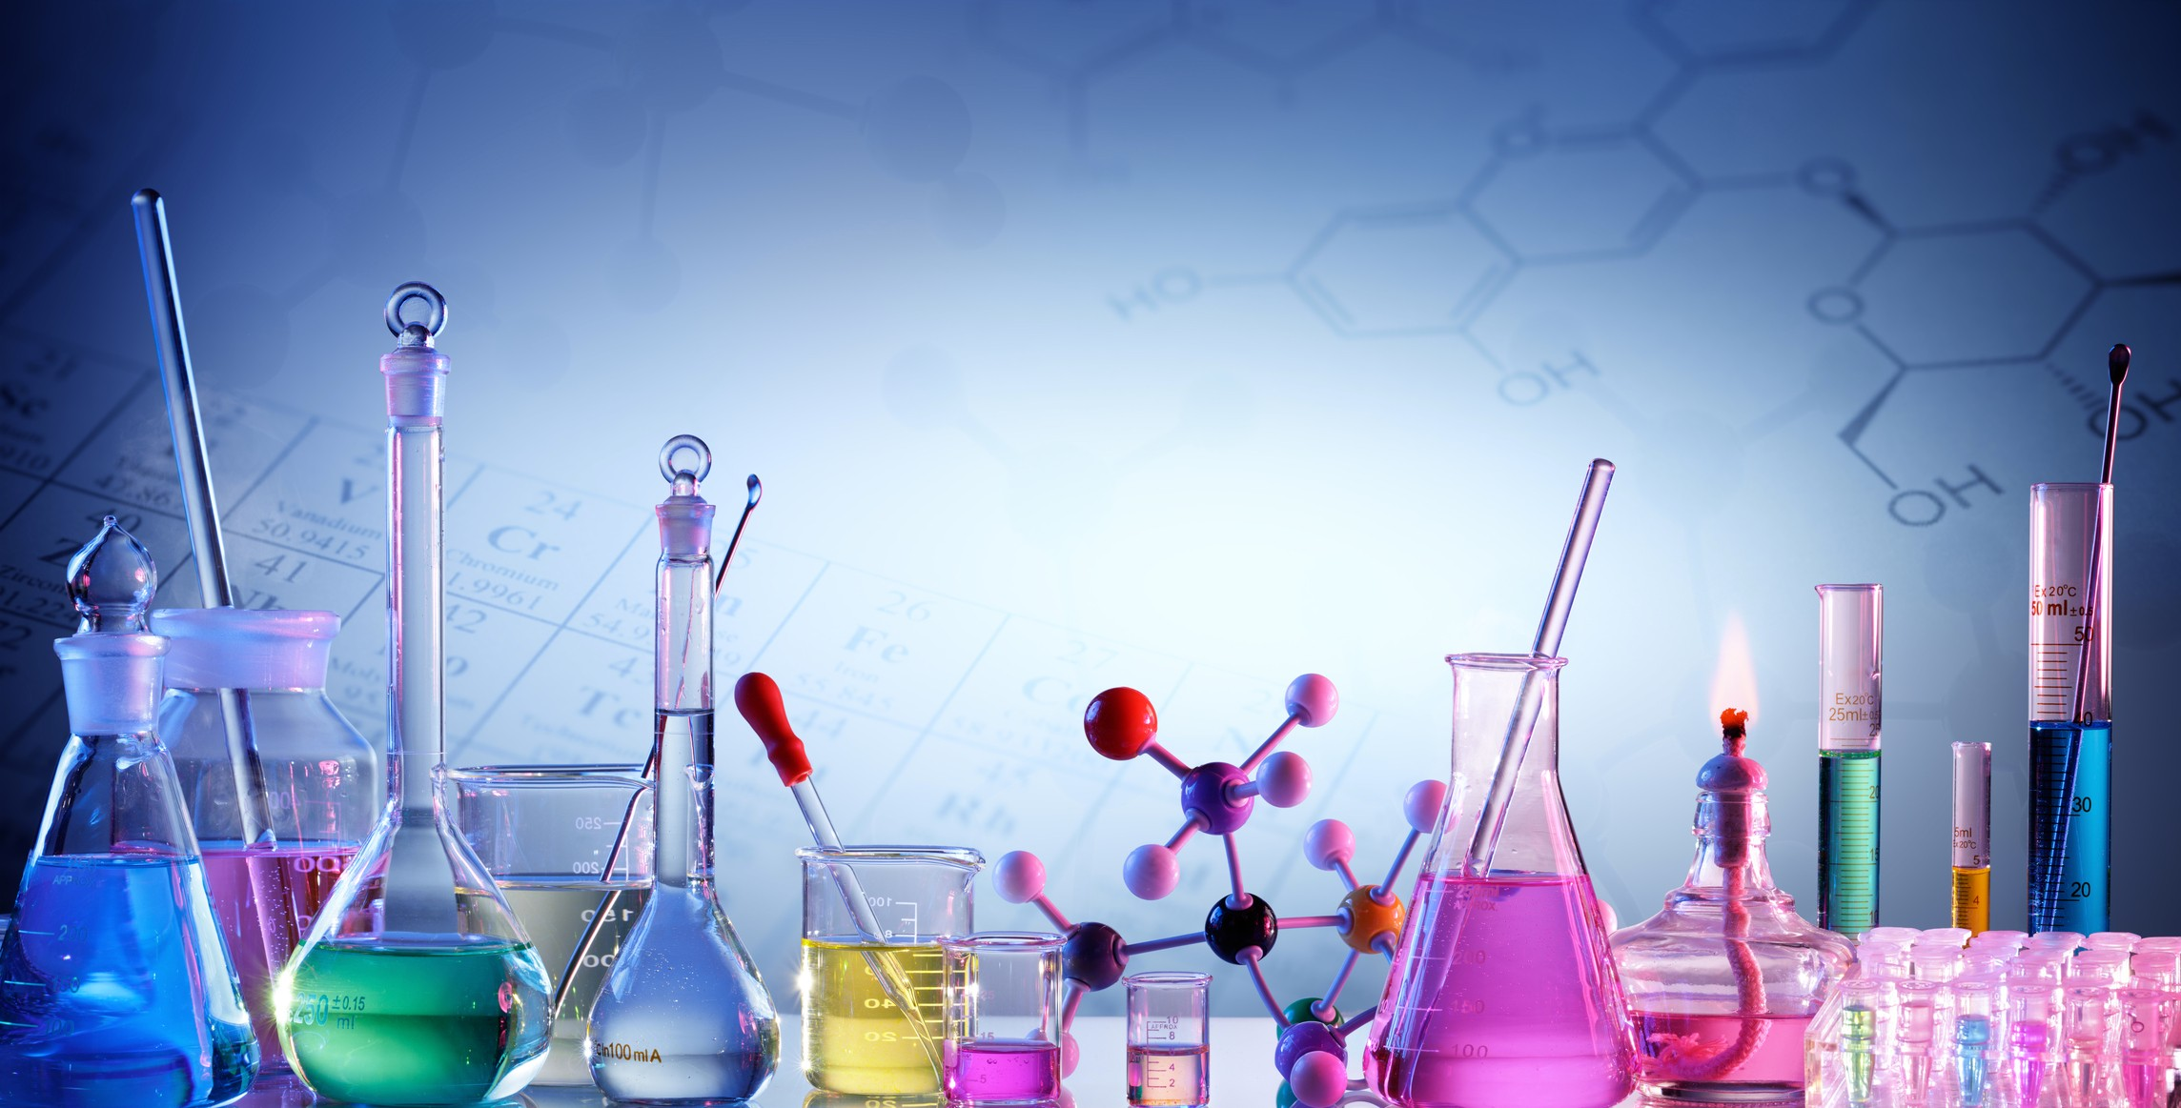
And also subjects of a cycle of professional training :
Pharmaceutical chemistry
Technology of medicines of pharmaceutical and industrial production
Quality control of medicines
Standardization
of medicines

Slide 6
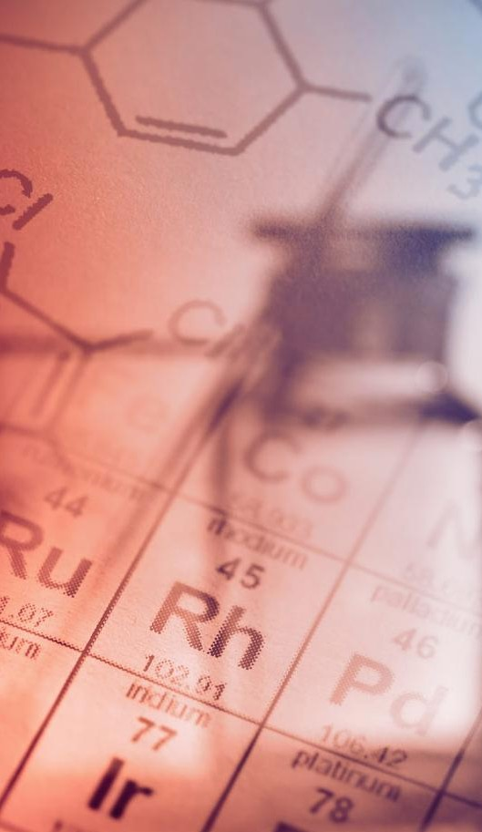
The purpose of studying the discipline
✔
acquaintance of future specialists with modern approaches to creation of medicines and biologically active compounds
✔
mastering approaches for obtaining and modifying synthetic organic molecules as drugs and biologically active compounds
✔
getting acquainted with and mastering the criteria for analyzing the "structure-activity" relationship within a certain group

Slide 7
Tasks of Discipline
✔
acquaintance and mastering of the basic receptions and approaches of organic synthesis at creation of new medicines and modification of active molecules
✔
ability to analyze the structure-activity dependencies within a certain group of compounds
✔
the use of modern technologies in the search for new drugs, the methodology of "drug design" (drug design), the theoretical foundations of organic synthesis and its main stage

Slide 8
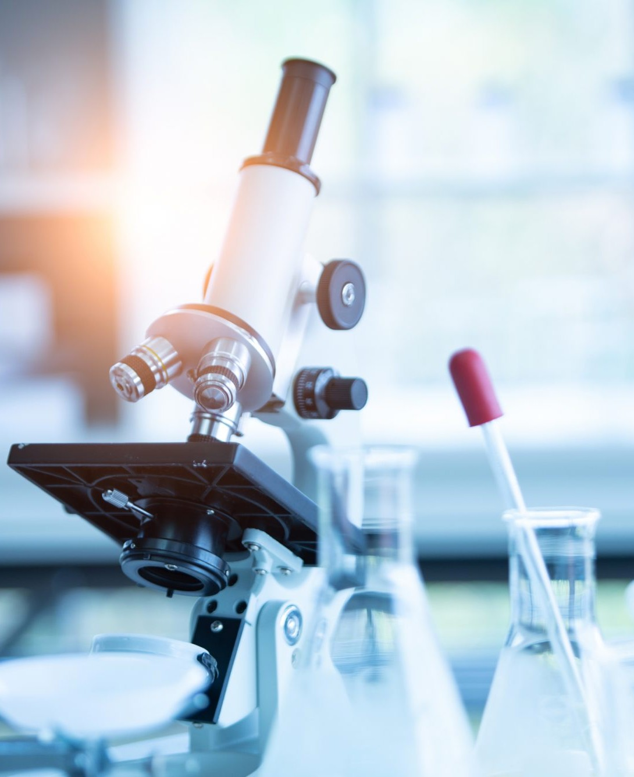
As a result of studying the discipline the student must know:
types of organic reactions and types of reaction mechanisms, intermediate active particles (carbocations, carbanions, free radicals)
catalysis in organic synthesis
retrosynthetic analysis, the concept of synthons
methods for establishing the structure of organic compounds: chemical, instrumental (IR spectroscopy, UV spectroscopy, nuclear magnetic resonance spectroscopy, mass spectrometry)
methods of introduction, replacement, protection and regeneration of functional groups
main types of rearrangement in organic synthesis

Slide 9
As a result of studying the discipline the student must be able to :
use basic laboratory chemical utensils and auxiliary devices
to carry out syntheses of organic compounds, in particular medicinal substances, to receive methods of performance, to carry out initial calculations and final calculations
apply methods of isolation and purification of substances (filtration, recrystallization, distillation, sublimation, extraction, chromatography)
perform synthesis with an understanding of the processes that take place, explain the essence of specific reactions

Slide 10
We invite you to study the course "Theoretical Basics of Synthesis"!

