Slide 1
National Pirogov Memorial Medical University, Vinnytsya
Department of Latin Language and Medical Terminology
Elective Course
Modern Stomatological Latin
(Practice-Oriented Course) for the students of specialty
«Dentistry»
sSt

Slide 2
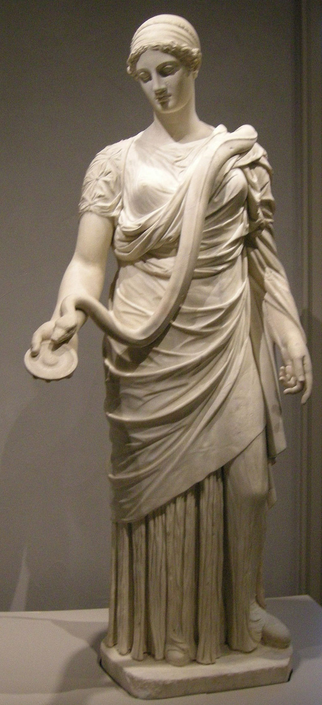
Salvete, carissimi studentes!
The elective course “Modern Stomatological Latin (practice-oriented course)”
will deepen your knowledge of the fundamentals of normative Latin grammar, Greek-Latin word-forming elements, and the principles of constructing terms in international Latin medical terminology and modern international nomenclature.

Slide 3

The subject of the elective course “Modern Stomatological Latin (practice-oriented course)” -
lexical and semantic features of language units covering the main sections of medical terminology (pharmaceutical, clinical) and international nomenclatures. A mandatory component of the elective course is the humanitarian aspect, aimed at increasing the scope of basic knowledge of Latin aphorisms and established professional medical expressions.

Slide 4
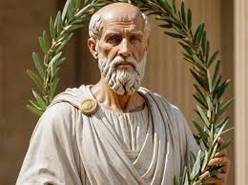
The purpose of the elective course “Modern Stomatological Latin (practice-oriented course)”
- to expand the terminological foundation and improve practical skills in mastering Latin medical terminology for its productive application during training at clinical departments and in further professional activities and professional development.

Slide 5
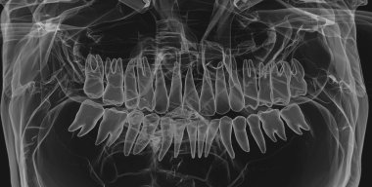
The tasks of the elective course “Modern Stomatological Latin (practice-oriented course)”
- to improve the level of practical skills and translation abilities, as well as fluency in the lexical material of modern international nomenclatures, along with its systematic updating and integration into the process of mastering professional disciplines, studying specialized literature, and carrying out professional activities.

Slide 6
Structure the course “Modern Stomatological Latin (practice-oriented course)”
Module I: Pharmaceutical Terminology
Translation of pharmaceutical nomenclature names, prescribing non-proprietary names of medicines with term-elements recommended by WHO for International Non-proprietary Names (INN), classification of dosage forms and methods of prescribing them, in-depth study of productive ways of forming pharmaceutical terms, etc.
.
Module II: Clinical Terminology
Translation and interpretation of names of diseases and pathological conditions, syndromes, symptoms, and clinical diagnoses.
.

Slide 7
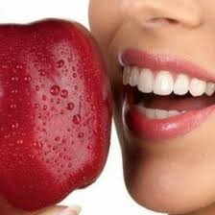
Types of educational activities:
  рractical lessons;
  independent work
  Control methods:
ongoing assessment of all types of theoretical and practical training during each practical lesson with traditional grading;
final assessment: credit awarded during the last practical lesson.

Slide 8
Upon completing the course “Modern Stomatological Latin (practice-oriented course),” the student should be able to:
Carry out translation, lexical and semantic analysis of medical terms from modern international nomenclatures.
Apply the acquired knowledge in oral and written professional communication, using a modern terminology database in accordance with the standards of skilled discourse.
Search, systematize and critically process specialized information from electronic and printed sources in order to improve the quality of experienced activities.
Work effectively in an interdisciplinary team, communicate conclusions and justifications for decisions to professional and non-professional audiences within the framework of skilled activities.
Be aware of the need for further continuous experienced development, demonstrate the ability for independent learning, self-reflection and self-improvement.

Slide 9

Invia est in medicina via sine Lingua Latina
There is no way into medicine without the Latin
We look forward to welcoming you to our department, dear students!

