Slide 1

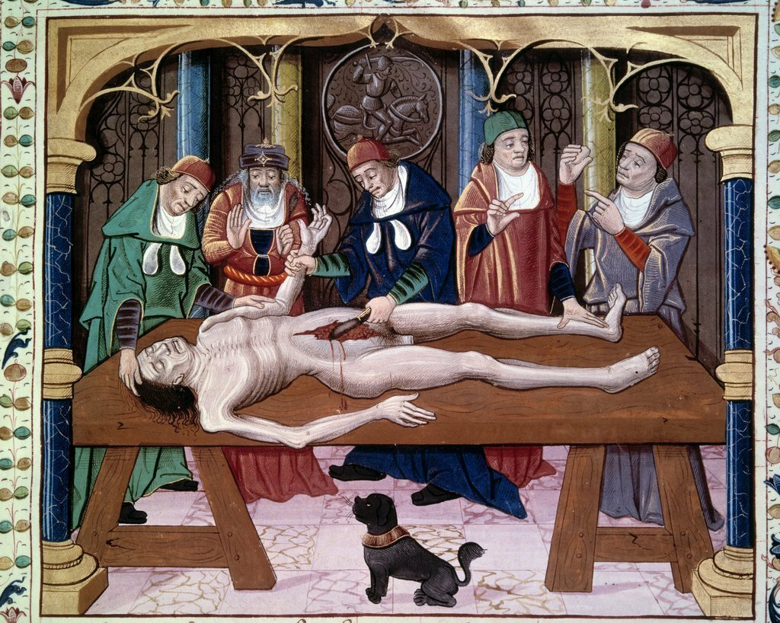
National Pirogov Memorial Medical University
Biopsy and sectional course
(an elective course)
Vinnytsia 2023

Slide 2
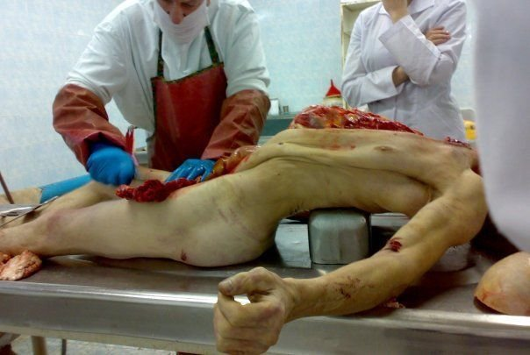
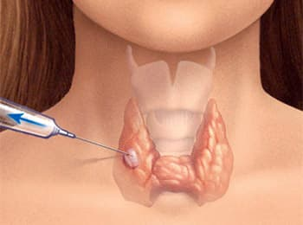
Introduction
The main task of the pathological service is to improve medical and diagnostic work. It is solved using two main methods of clinical and anatomical analysis:
Autopsy of the dead persons.
Biopsy examination for lifelong diagnosis of diseases by studying biopsies, surgical material.

Slide 3
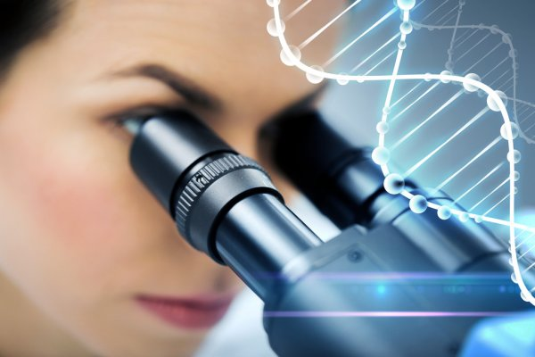
The purpose and objectives of the discipline
The main purpose of the biopsy and sectional course is for students to master the method of clinical and anatomical analysis of biopsy, surgical and sectional material and the principles of diagnosis, technique of autopsy and preparation of pathological documentation. During the course, students
get acquainted with the structure of the
pathology service, which is an integral part
of the health care system in Ukraine.

Slide 4
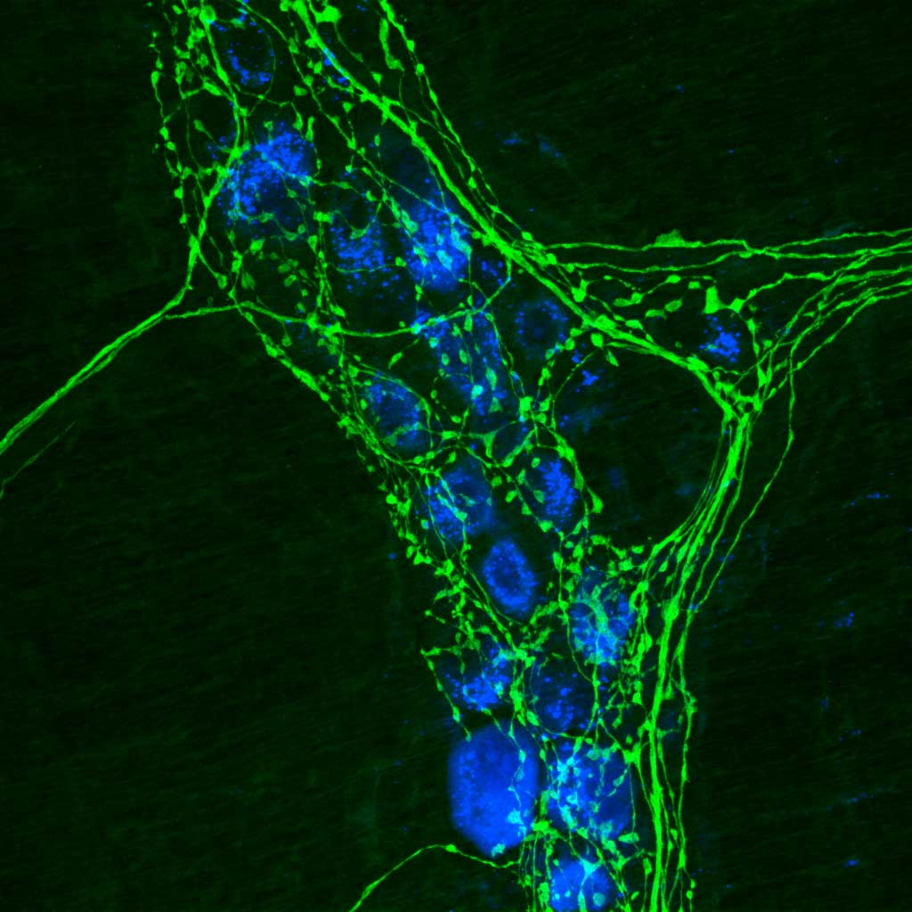
Learning outcomes for the discipline:
Determining the main tasks of the pathological service of Ukraine.
Mastering of the basics of postmortem examination: from the appearance of the corpse, the technique of its autopsy to the formulation of the final diagnosis.
Study of biopsy and surgical material using modern morphological methods.
Defining the role of medical control commissions, clinical and anatomical conferences and commissions for the study of deaths.
Insight into the relevant documentation for completing of the medical certificate of death, medical certificate of perinatal death, as well as referrals for pathological examination of surgical and biopsy materials.

Slide 5
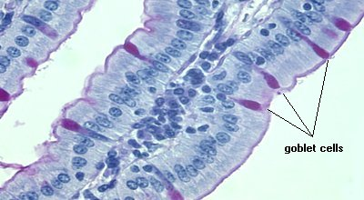
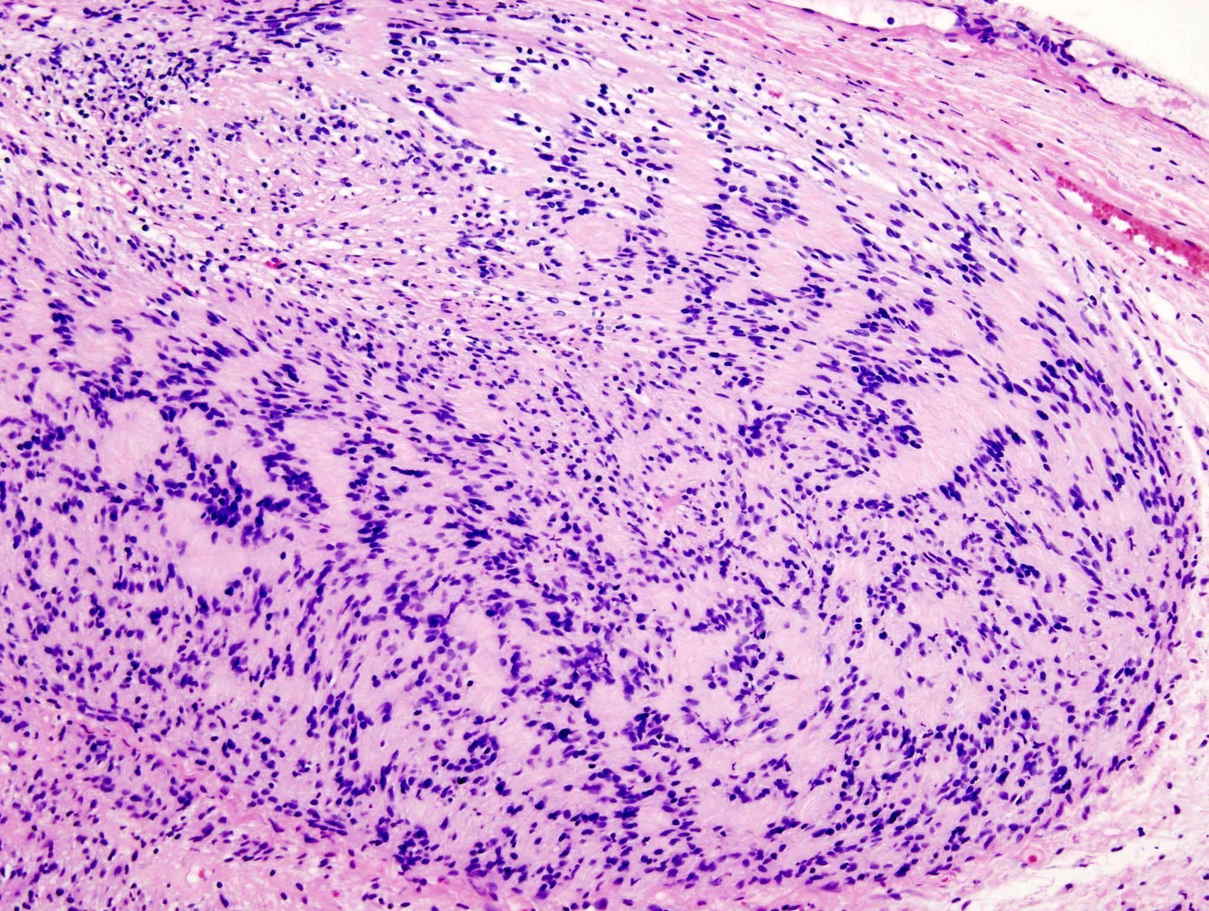
Topics of practical classes
TOPIC
Tasks and methods of the pathological service and its place in the health care system of Ukraine (order №81 of 12.05.1992 of the Ministry of Health of Ukraine "On the development and improvement of the pathological service in Ukraine", as well as order 9179 of 29.03.2006 "On approval instructions for determining the criteria of the perinatal period of live births and stillbirths. Procedure for registration of live births and stillbirths"). Basic pathological documentation.
Method of biopsy and surgical examination of the material. Rules of research of biopsy, operative and cytological material. Basic documentation. Molecular and genetic methods in the diagnosis of tumors.
Structure of pathological diagnosis. Comparison of pathological and clinical diagnoses. Rules of registration of the medical certificate. Categories of discrepancies in diagnoses.
Autopsy (clinical and anatomical analysis). Work with ICD X revision (1995) according to the pathological diagnosis after autopsy.
Registration of pathological anatomical documentation: autopsy report with writing of pathological anatomy and histological evaluation of necropsy material.
Requirements for conducting a clinical and pathological conference. Preparation and holding of a meeting of the medical control commission, the commission for the study of fatal consequences. Definitions of pathomorphosis, iatrogenic (second disease).
Concluding lesson.

