Slide 1


National Pirogov Memorial Medical University, Vinnytsya
Paediatric department 2
Head of the department: prof. Dudnyk V.M.
Selected questions of pediatric cardiology
(elective discipline for 5 years students)
Field of knowledge 22 «Health care»
Speciality 222 «Medicine»

Slide 2

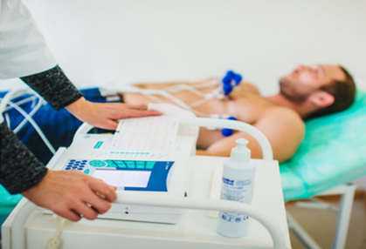
Purpose of the study discipline
Improvement of the theoretical knowledge of students through the study of the topics dedicated to pathology of the cardio-vascular system in children that where not involved to the standard programme of the discipline
Improvement and assimilation of the practical skills, achievement of the professional skills of the general practitioners for the individual work and intime diagnosing of cardiological pathology in children

Slide 3

Description of the discipline
Topics of the practical classes
Name of the topic
1. Complicated rhythm and conduction disorders in children. Emergencies in cases of paroxysmal tachycardias and Adams Stokes syndrome
2. Critical congenital heart diseases: clinical signs, diagnostic approach, treatment and transporting. Algorithms of action when congenital heart disease is suspected, detecting of the heart murmur, cyanosis in new-borns. Emergencies in congenital heart diseases.
3. Primary and secondary arterial hypertension in children. Differential diagnose, treatment, further check in. Emergencies in hypertensive default.
4. Differential diagnose of the arthritis in children. Juvenile idiopathic arthritis, diagnostic and treatment approach.
5. Final class – topical discussion of the clinical cases.

Slide 4
Description of the discipline
Topics for individual work
Name of the topic
1. Instrumental investigations in paediatric cardiology.
2. Ultrasonography of the cardiac system in kids.
3. Inflammatory diseases of the heart of rheumatic origin. Acquired heart diseases. Congenital diseases of the cardio-vascular system.
4. Inflammatory diseases of the heart of nonrheumatic origin. Infectious endocarditis.
5. Congenital heart diseases with enriched pulmonary blood flow.
6. Congenital heart diseases with bleached pulmonary and systemic blood flow.
7. Primary and secondary cardiomyopathies. Cardiac tumors.
8. Cardio-vascular failure.
9. Differential diagnose of the systemic diseases. Differential diagnose of the systemic vasculitis.

Slide 5



Results of the leaarning
Ability to use in professional activity knowledge and skills of paediatric cardiology and accurate evaluation of the cardiac problems in children
Possibility to integrate knowledge from the different medicine fields into differential diagnose of the cardiac pathology
Analyse of the modern medical publications through the usage of its qualified search

Slide 6

Methods of the study
Visual methods:
Demonstration of the thematical patients in departments of VRCH
discussion of the situational tasks
evaluation of the paraclinical study results

Slide 7



Methods of the study
Practical:
Subjective and objective methods of the clinical examination
Conducting of the most common emergency algorithms of cardiac arrest, paroxysmal tachycardia and bradycardia
Performing of the standard ECG
Measurement of the blood pressure and evaluation of the results while using charts

Slide 8

Material supplies of the course
Materials to control basic knowledge:
Tests
Materials for methodical support of the class
- manikins, phantoms, medical devices
cardiomonitors
Patients discharges, tables, results of the paraclinical investigations
Materials for final control:
Collection of the tests, paraclinical investigations
Materials for individual self-preparation:
- methodical materials for students
Algorithms of the stabilization of a critically ill child will be performed at the simulation center

Slide 9

#cardiologymaybeintresting

