Slide 1
Digital technologies of prosthetics
Department of Orthopedic Dentistry
The course of the choice for the training of students (specialists of the second (master's) level of higher education) 5 course
specialty 221 “Dentistry"

Slide 2
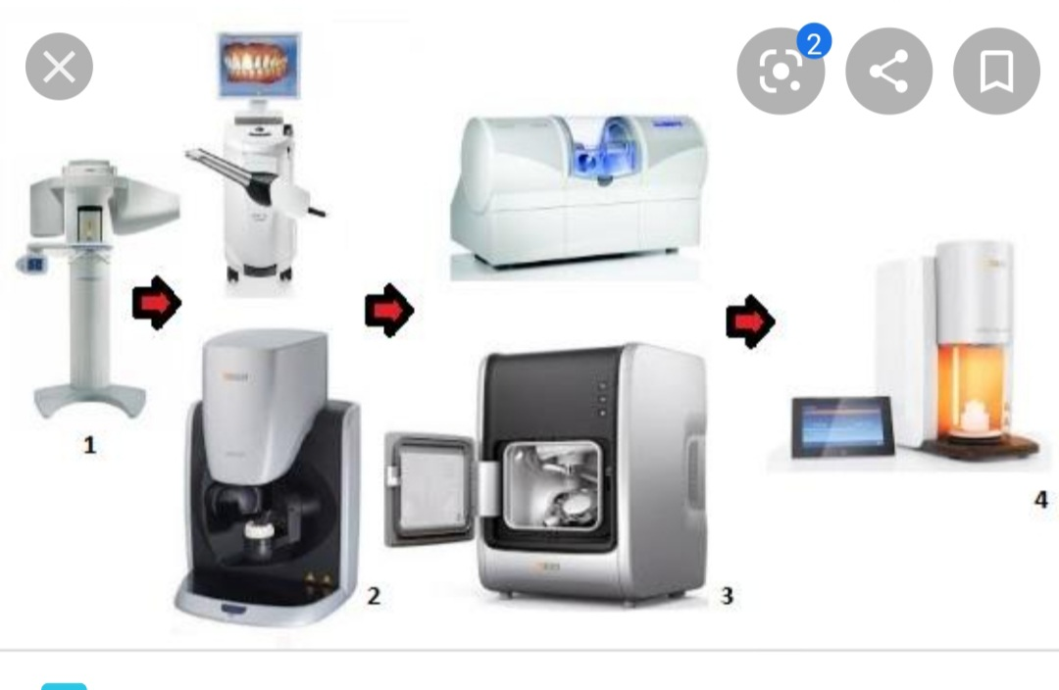
From diagnosis to manufacturing

Slide 3
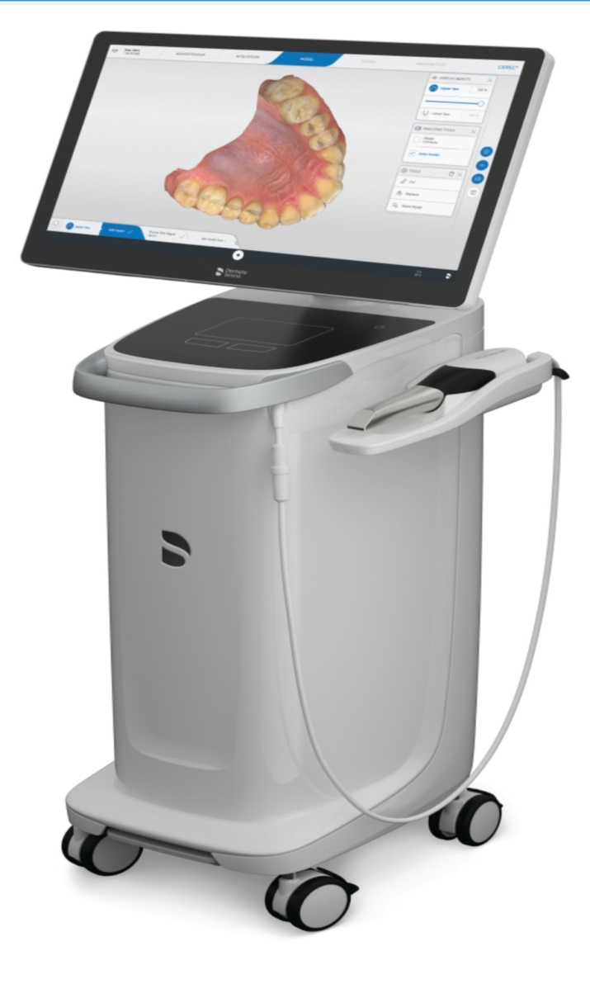
Scanning technology

Slide 4
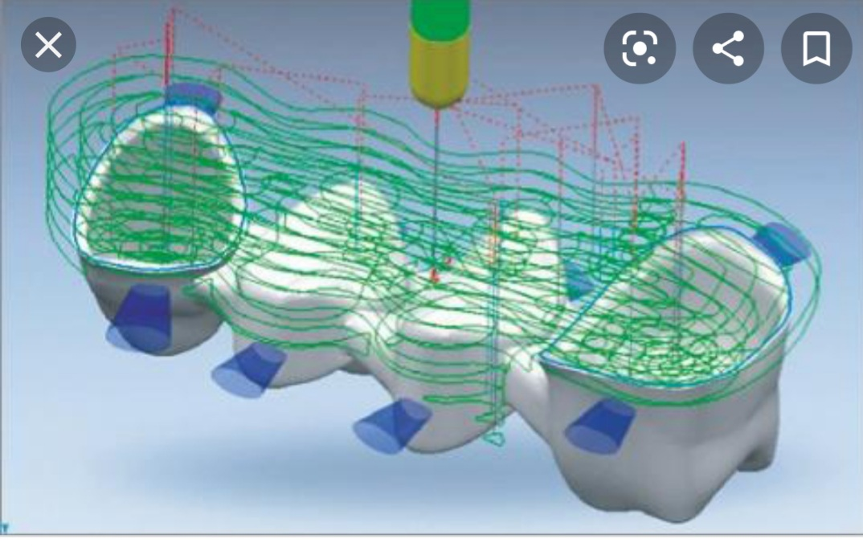
Computer designing

Slide 5
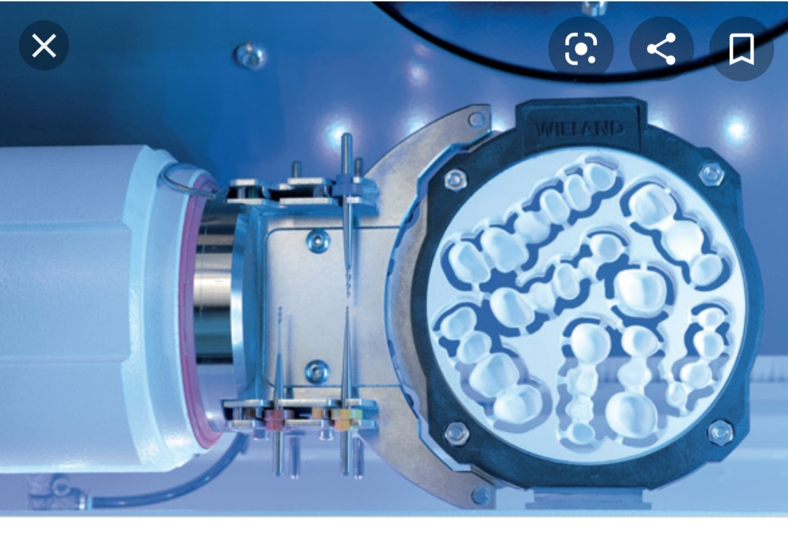
Manufacturing

Slide 6
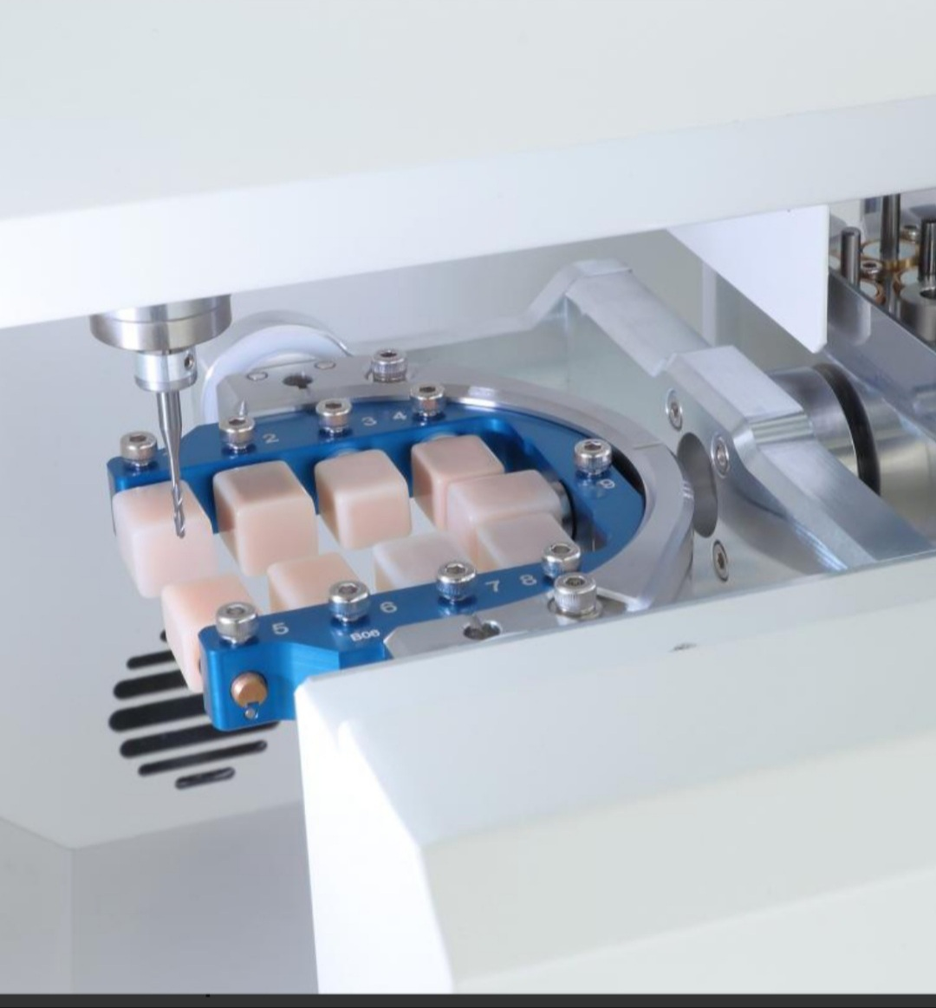
Grinding

Slide 7
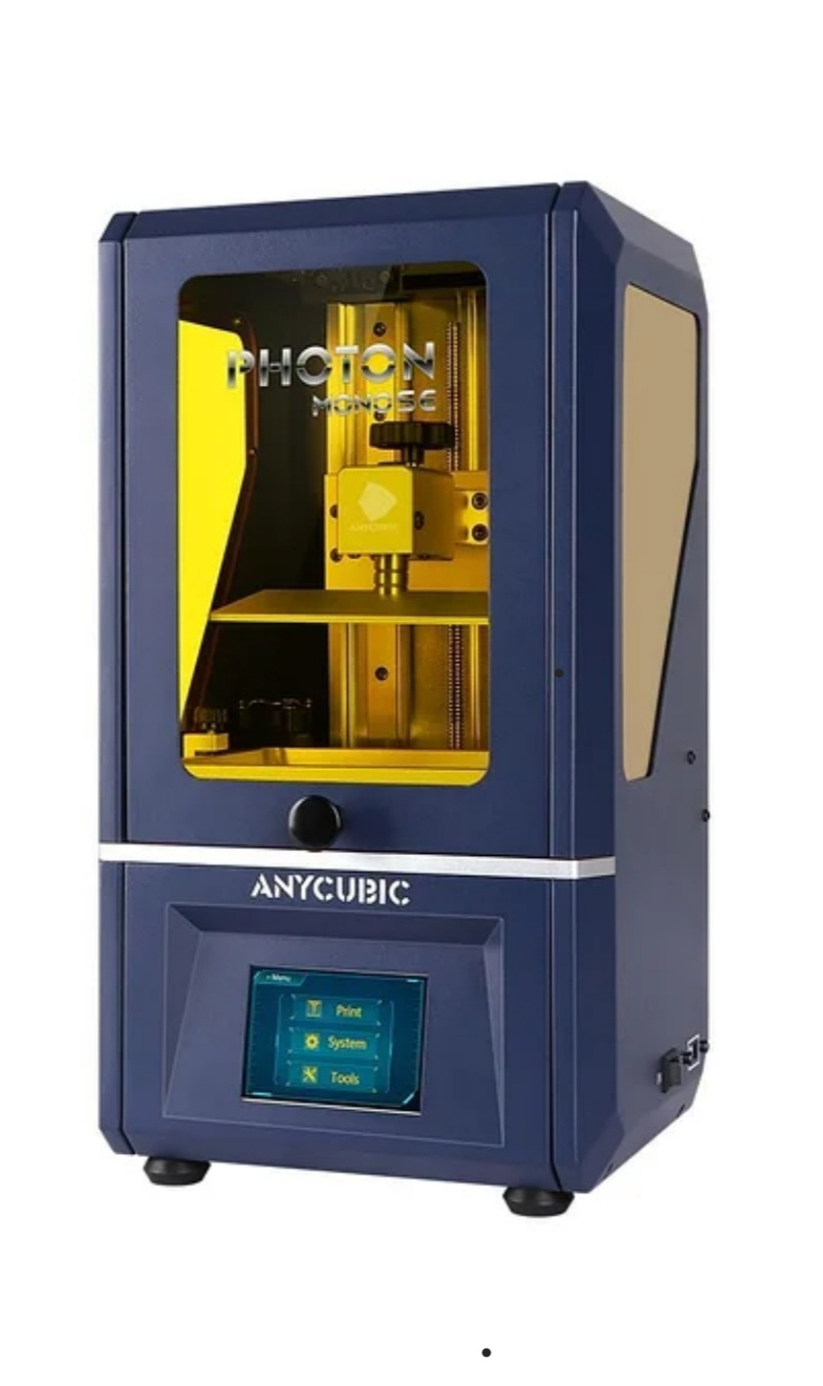
3D printing

