Slide 1
Methods of X-ray diagnostics in the clinic of orthopedic dentistry
Department of Orthopedic Dentistry
The course of the choice for the training of students (specialists of the second (master's) level of higher education) 4 course
specialty 221 “Dentistry"

Slide 2
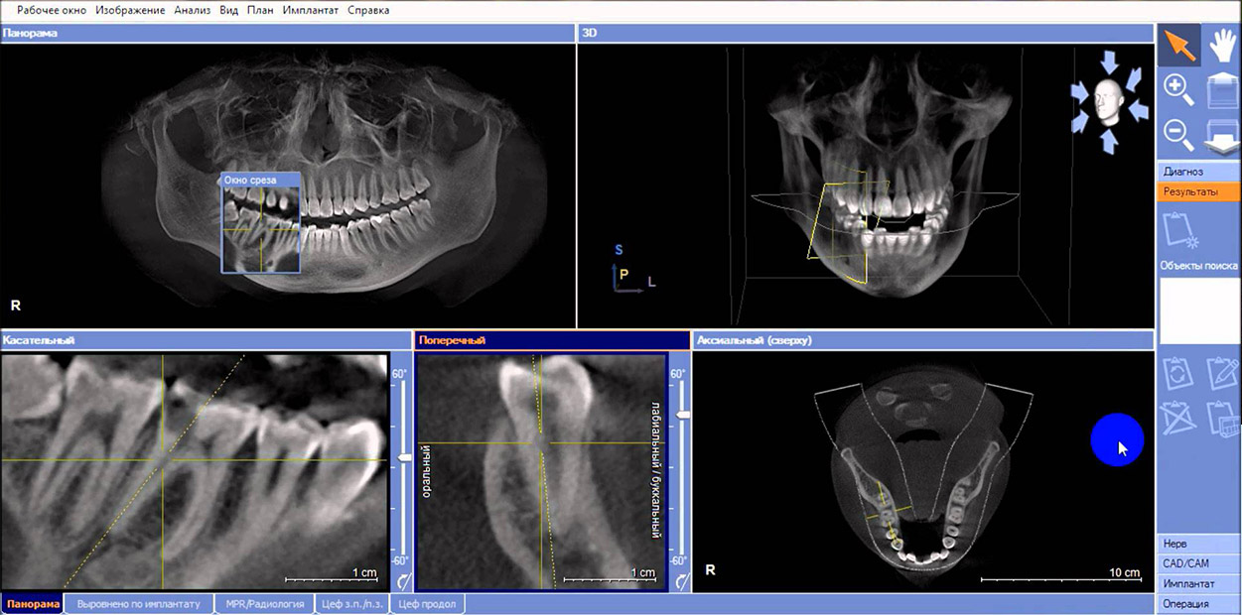
Relevance :
X-ray examination is the leading method of diagnosis in dental practice. Without its usage it is difficult to imagine the recognition and treatment of various diseases of the maxillofacial area, because it is publicly available, simple, relatively inexpensive, highly informative.

Slide 3
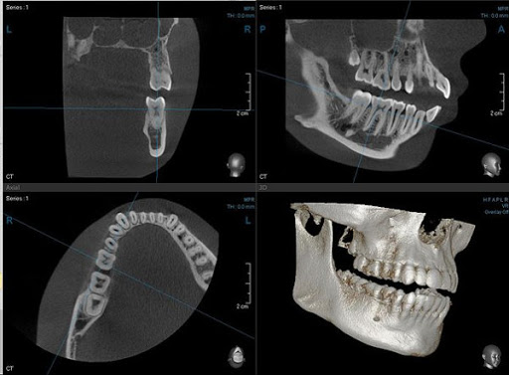
AIM:
Mastering theoretical knowledge and practical skills in the diagnosis of dental pathologies using modern methods of X-ray examination to make a correct plan for the preparation of the patient's oral cavity for prosthetics.

Slide 4
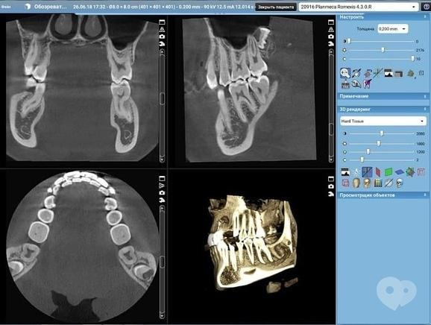
Tasks of X-ray diagnostics in the clinic of orthopedic dentistry:
detection of proximal and subgingival carious lesions, secondary caries under fillings and crowns;
diagnosis of complications of caries - pulpitis and periodontitis;
diagnosis of periodontal diseases, the nature and severity of the process in its tissues, the degree of bone resorption;
predicting of dental implantation.

Slide 5
Course content :
Indications for X-ray examination in orthopedic dentistry.
Study of the main methods of X-ray examination (internal and extraoral radiography);
Study of additional methods of X-ray examination (radiovisiography, tomography, computed tomography, teleradiography, electroradiography and others).
Detailed analysis of X-rays;
Features of X-ray examination of pregnant women, children and patients with severe comorbidities.

