Slide 1
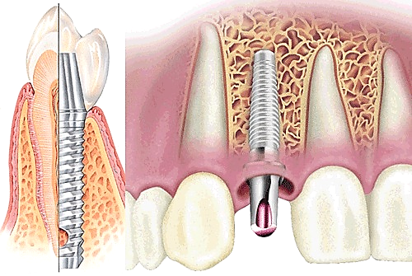
DENTAL IMPLANTOLOGY
Department of Orthopedic Dentistry
The course of the choice for the training of students (specialists of the second (master's) level of higher education) 4 course
specialty 221 “Dentistry"

Slide 2

Dental implantology is a branch of practical dentistry that combines the principles of surgical and orthopedic dental treatment and studies the installation of biocompatible with the human body, artificially created foreign bodies (dental implants) in the tissues of the maxillofacial area for further dental prosthetics.

Slide 3
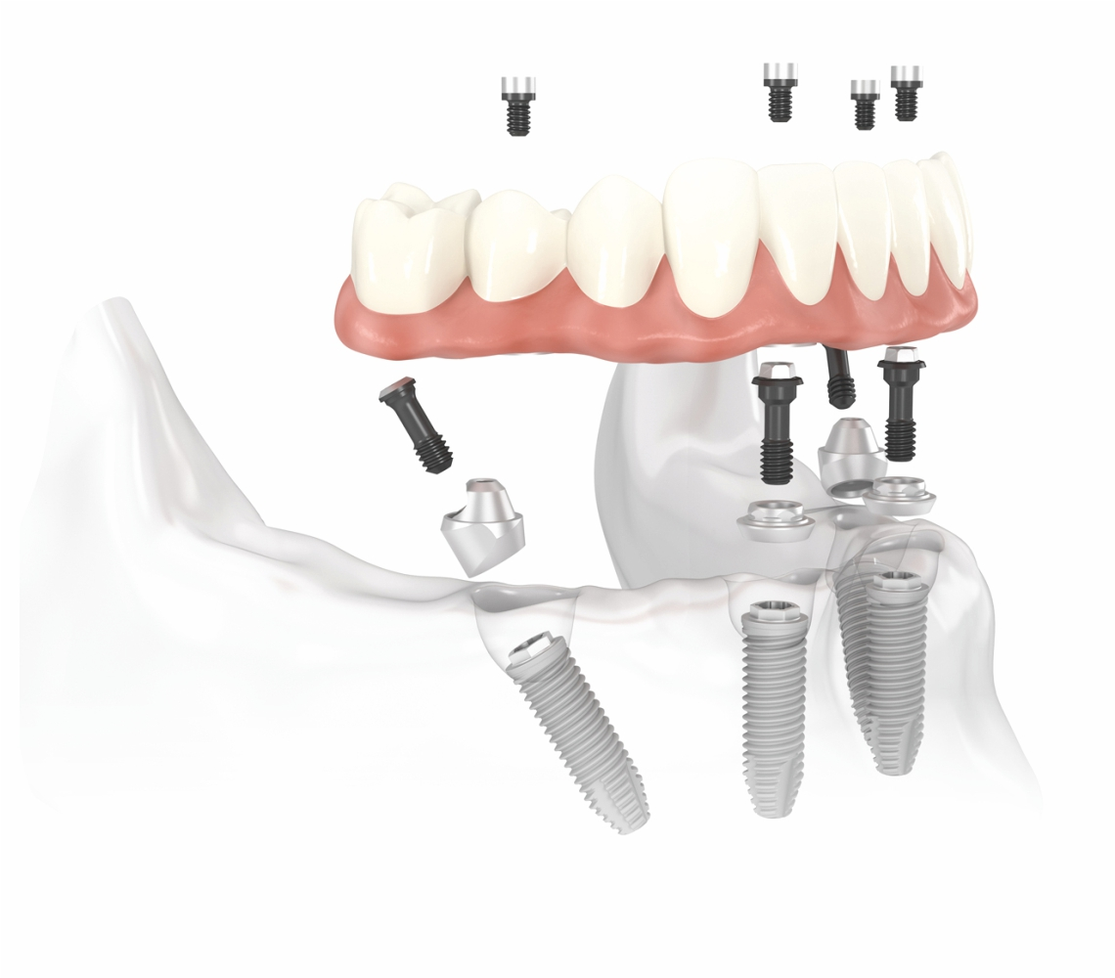
Dental implantology is a modern, progressive and promising branch of practical dentistry that is developing dynamically. Provides maximum physiological and social rehabilitation of dental patients, improves quality of life.

Slide 4
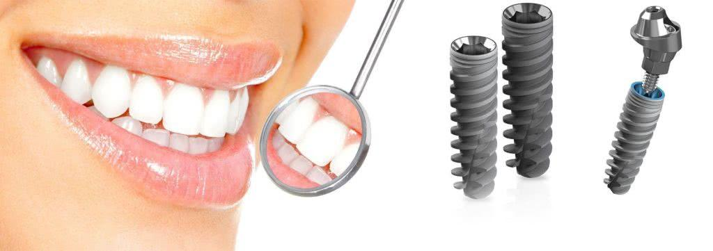
Objectives of the discipline:
• To form the volume of basic, fundamental medical knowledge that forms the professional competencies of a dentist, orthopedist-implantologist.
• Provide a solid theoretical foundation for the future dentist-orthopedist to acquire the basic skills needed in individual professional activities.
• To form skills in mastering new technologies and methods in the field of dental implantology and orthopedic dentistry.
• Prepare a specialist for long-term professional activity based on the principles of continuous professional training and the principles of evidence-based medicine

Slide 5
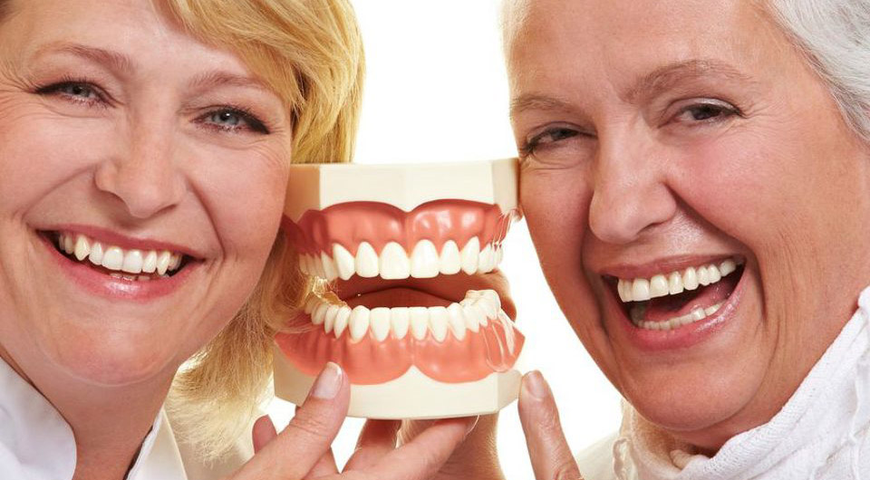
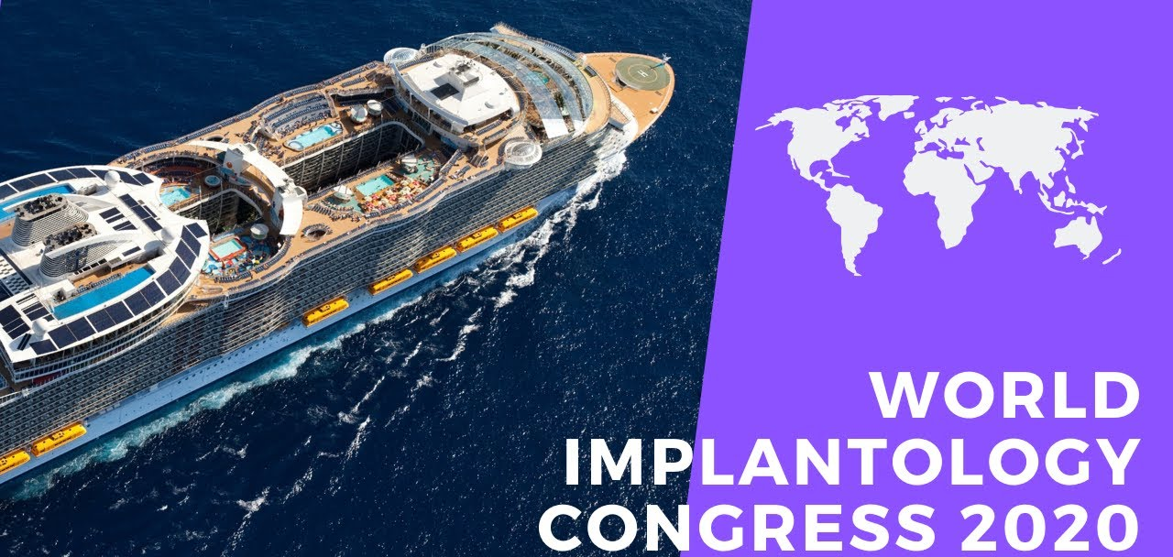

Dental implantation is:
pleasure from the opportunity to give people the joy of life and the pleasure of professional communication with representatives of the elite medical division!

