Slide 1
The Basic Technologies of Dentures Producing
Department of Orthopedic Dentistry
The course of the choice for the training of students (specialists of the second (master's) level of higher education) 3 course
specialty 221 “Dentistry"

Slide 2
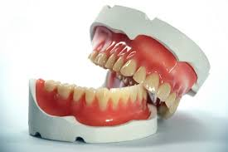
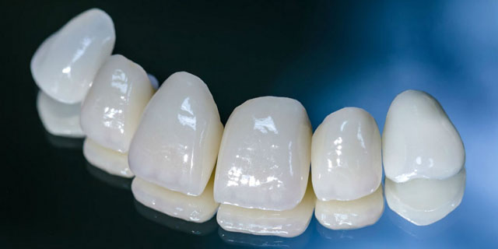
Relevance:
The development of orthopedic dentistry is aimed at improving of treatment methods and increasing of the efficiency of dental care. Therefore, the knowledge and skills that students acquire when studying the discipline "The basic technologies of dentures producing" is a necessary component of the formation of professional competencies of a modern doctor.

Slide 3
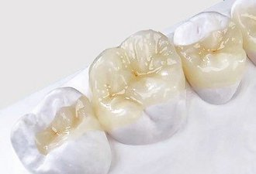
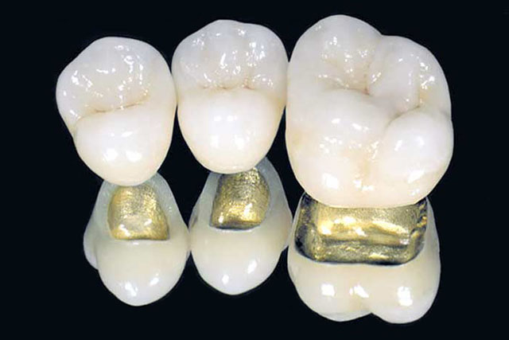
AIM:
Formation of students' system of knowledge about modern technologies of manufacturing non-removable and removable dentures

Slide 4
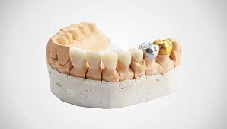
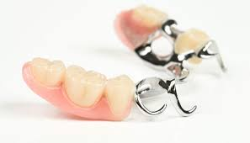
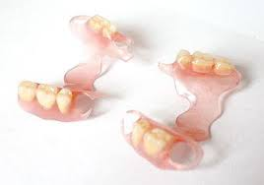
Tasks:
Studying the types of fixed and removable dental prostheses
Determination of technological stages of manufacturing of orthopedic dentures
Interpretation of features of technology of production of fixed and removable dental prostheses
Demonstration on phantoms the clinical and laboratorical stages of manufacturing of non-removable and removable dentures
Justification of the choice of materials for the manufacturing of different types of dentures.

Slide 5
Course content :
Technology of inlays manufacturing
2. Technology of artificial crowns manufacturing
3. Technology of manufacturing of pin constructions
4. Technology of metal-ceramic crowns manufacturing
5. Technology of manufacturing of metal-plastic bridge
6. Technology of manufacturing of metal-ceramic bridge
7. Basic materials for the manufacturing of fixed dentures
8. Technology of manufacturing of a partial removable denture
9. Technology of manufacturing of a complete removable denture
10. Technology of manufacturing of an arched removable denture.

