Slide 1
«methods of examination in the clinic of orthopedic dentistry»
Department of Orthopedic Dentistry
The course of the choice for the training of students (specialists of the second (master's) level of higher education) 3 course
specialty 221 “Dentistry"

Slide 2
Systematic examination of the patient is the most effective method of detecting of pathology in the oral cavity and surrounding tissues.
The first initial stage of the dentist's work at the orthopedic clinic is the collection of factual material, detection of deviations during the examination. Further the received information is specified and the diagnosis is made.
Survey plan:
patient survey (complaints, medical history, life history);
examination of the patient;
palpation;
instrumental examination (probing, percussion);
assessment of indices of periodontal condition;
physical methods of examination (thermometric, electrical,radiological);
laboratory methods of examination (biochemical, cytological,bacteriological);
special diagnostic tests (allergic test, etc.).

Slide 3
Additional methods of examination.
The purpose of these studies is to establish and confirm the final diagnosis.
- Hardware (X-ray examination, electromyography, extraoral recording of mandibular movements (axiography), electromyography, computerized analysis of occlusion (T-SKAN) and joint noise (JVA), galvanometry, instrumental examination of tooth mobility (Periotest), electroodontodiagnostic
- Instrumental (anthropometric measurements of diagnostic models, analysis of models in the articulator, intraoral recording of movements of the mandible (functionography), gnatodynamometry, galvanometry, densitometry
- Laboratory (blood test, spectral analysis of oral fluid composition, immunological and allergy tests)
- Index (index assessment of masticatory efficiency, the state of periodontal tissues, the state of the TMJ)
- Functional tests (chewing tests)

Slide 4
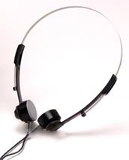
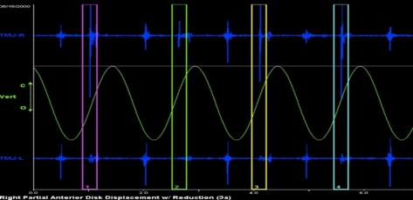
Analysis of sound vibrations of the temporomandibular joint JVA (Joint Vibration Analysis)
JVА - an additional method of assessing the structural and functional state of the TMJ, based on the recording and analysis of sound vibrations that occur during joint movements.
General view of the BioJVA device and graphic recording of sound vibrations of the TMJ

Slide 5
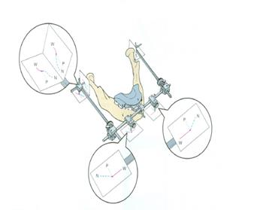
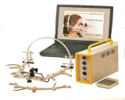
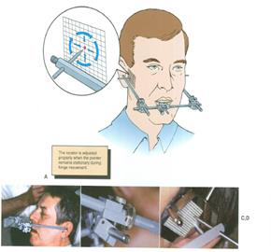
Mechanical axiograph
Electronic axiograph (AXIOQUICK system)

Slide 6
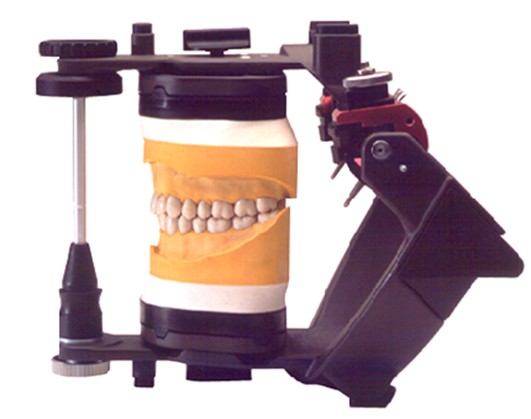
Studying of diagnostic models of jaws

