Slide 1



EC 5.4 Emergencies in cardiology
National Pirogov Memorial Medical University, Vinnytsya
Department of Internal medicine №1
Educational discipline (elective course) for training (master's)
second level of higher education
educational qualification "Master of Medicine"
professional qualification "Doctor"
field of knowledge 22 "Health"
specialty 222 "Medicine
Course -5
Notes:
Невідкладні стани в кардіології

Slide 2

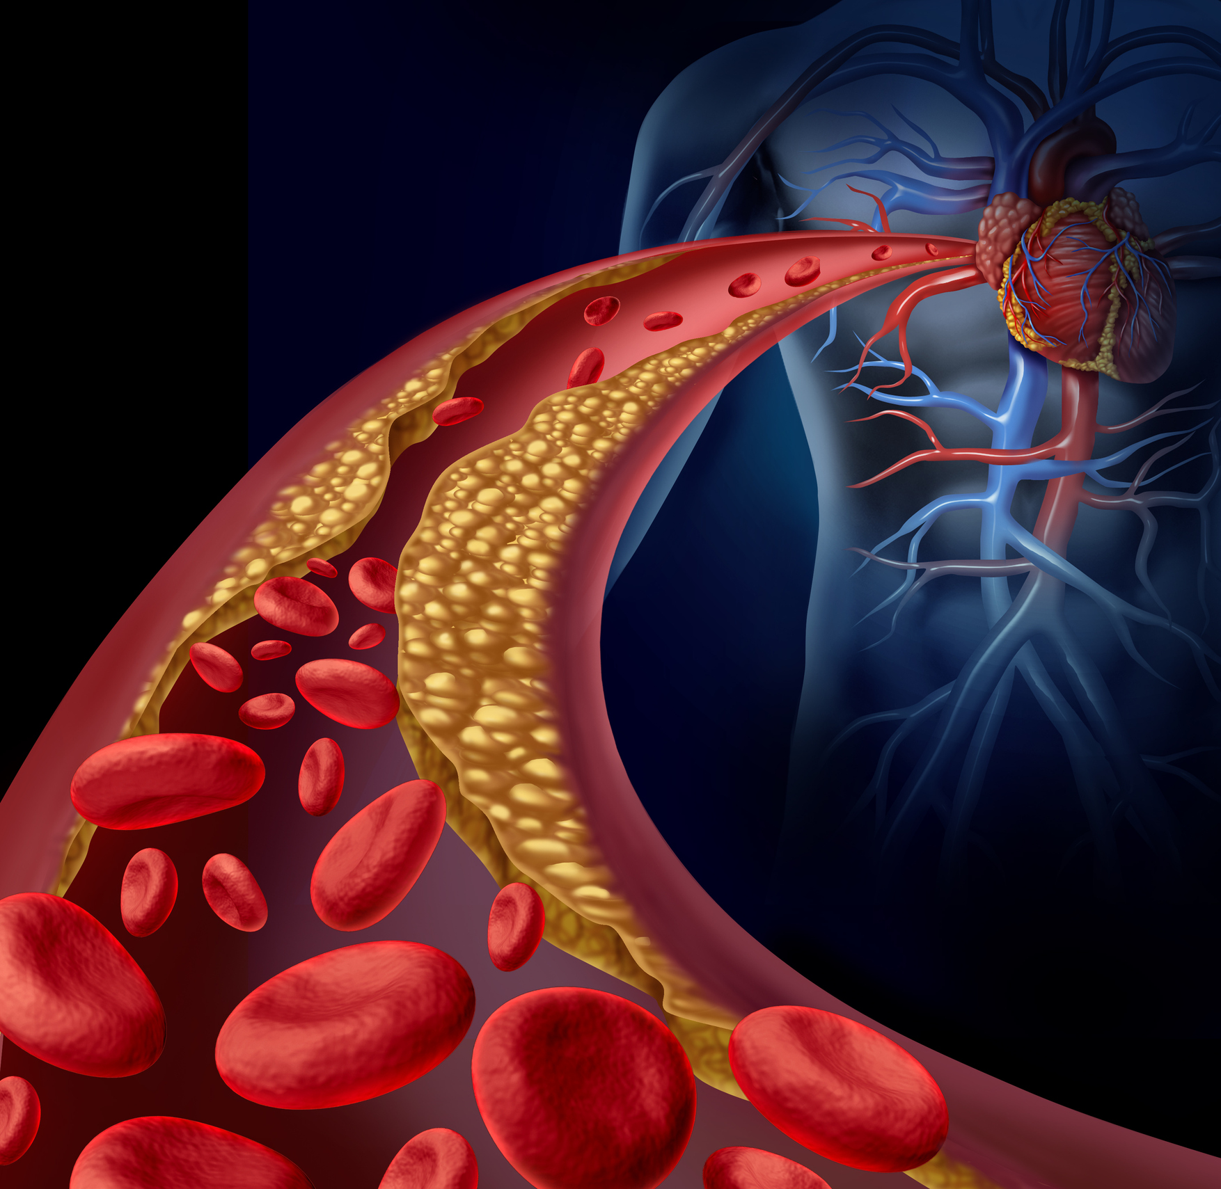
relevance
Heart disease represents the no. 1 cause of death for both men and women.
Cardiovascular diseases (CVDs) cause approximately 33% of deaths worldwide - according to the WHO -17.9 million deaths in the world in 2019.
85% of all CVD deaths are caused by heart attacks and strokes worldwide.
Cardiovascular emergencies and symptoms are one of the most common reasons for patients’ attendance in any emergency department.
Notes:
Актуальність

Slide 3
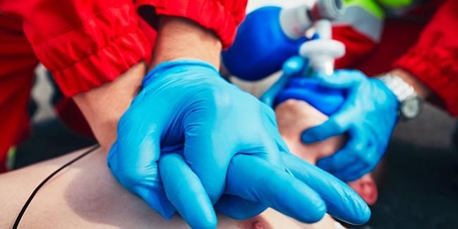
Course of subject - Emergencies in cardiology
We will cover the diagnostics and management of the most common emergencies in cardiology, such as:
Acute Coronary syndrome –
  Unstable Angina
  Myocardial Infarction
Arrhythmias -
  Atrial Fibrillation
  Atrial Flutter
  Paroxysmal Tachycardia
  Ventricular Tachycardia
  Ventricular Fibrillation
  Sudden Cardiac Death
  Heart Blocks – SA and Atrioventricular Block
Hypertensive Emergencies
Acute Aortic Dissection
Cardiac Tamponade
Cardiogenic Shock
Acute Heart Failure – Pulmonary Edema
Pulmonary Embolism

Slide 4
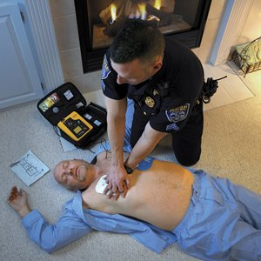

Aim of the discipline
You will acquire and deepen the ability to diagnose, differentiate and treat major emergencies in cardiology according to professional program of the specialist.
Notes:
Ви маєте здобути та поглибити вміння та навички ставити діагноз, проводити диференційний діагноз та лікувати основні невідкладні стани в кардіології, що є необхідним у професійній діяльності лікаря-спеціаліста.

Slide 5
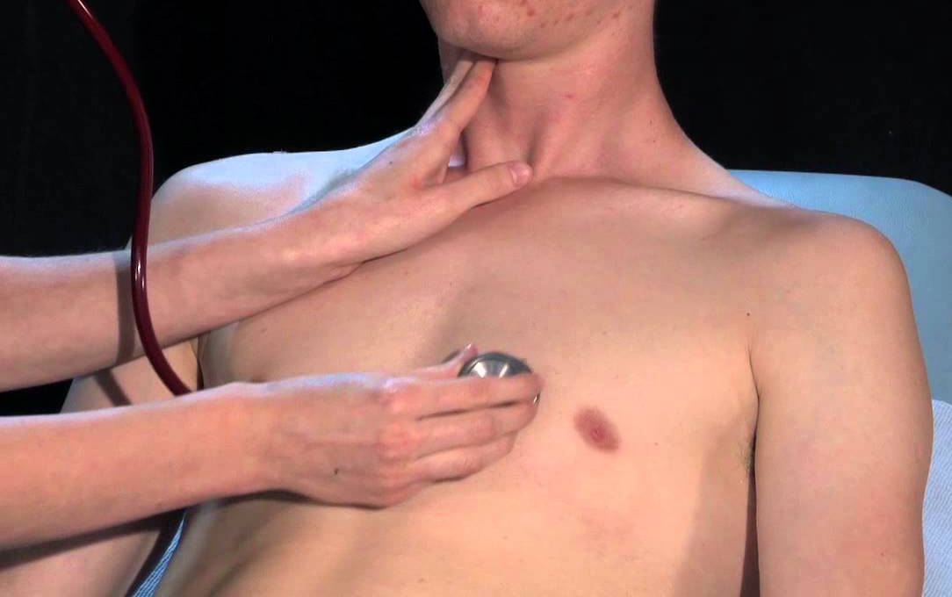

Tasks of the discipline
Determine the etiological and pathogenetic factors of cardiovascular emergencies;
Analyze the clinical signs and symptoms of cardiovascular emergencies;
Identify the leading syndromes and symptoms of cardiovascular emergencies;
Identify different clinical variants and complications of cardiovascular emergencies;

Slide 6
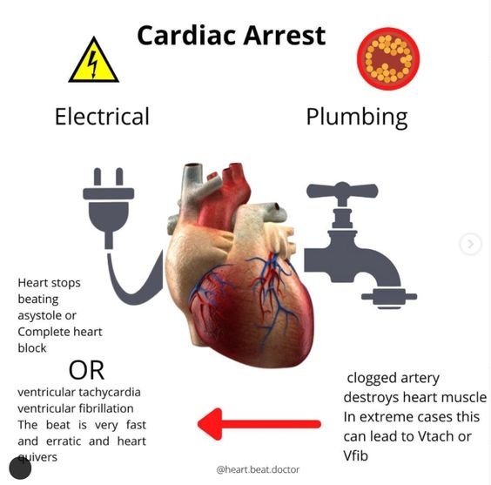
Tasks of the discipline
Carry out differential diagnosis of cardiovascular emergencies;
Determine tactics and provide emergency medical care in conditions of a limited time in accordance with existing clinical protocols and treatment standards.
Notes:
Визначати тактику та надавати екстрену медичної допомогу при невідкладних станах в умовах обмеженого часу згідно з існуючими клінічними протоколами та стандартами лікування.

Slide 7

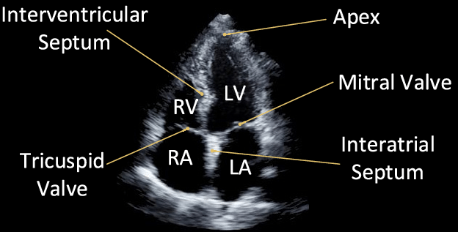
Tasks of the discipline
Make a plan for examination of the patient;
Interpret the results of laboratory and instrumental investigations – ECG, Echocardiography;
Determine the tactics of the medical care and prescribe modern treatment of Cardiovascular emergencies;
Determine the prognosis of patients with cardiovascular emergencies

Slide 8

Form of study – off-line
Types of training sessions:
Practical training
Lectures
Individual student work

Slide 9

learning methods
Visual:
examination of a patient in a practical lesson;
demonstration of methods of functional investigation;
overview of medical documentation: case history, laboratory study and functional investigation of the patient.
Practical:
physical methods of examination of cardiologic patient (inspection, palpation, percussion, auscultation, cardio-pulmonary resuscitation);
evaluation of laboratory and instrumental investigations of a patient with cardiovascular emergency;
differential diagnosis of cardiovascular emergency;
decide on the tactics of treatment of the patient.

Slide 10

Learning outcomes
Integral competence:
After completing of the course you will be able to:
    solve complex problems in emergencies in cardiology, using a standard procedure as well as research and innovation in medicine;
    continue learning with a high degree of autonomy.
Notes:
Здатність розв’язувати складні задачі, у тому числі дослідницького та інноваційного характеру у сфері медицини. Здатність продовжувати навчання з високим ступенем автономії.

Slide 11


Logistics of the discipline
The clinical base of the Department of Internal Medicine №1 is located on the basis of Cardiology department KNP "Vinnytsia Regional Clinical Hospital M. Pirogov VOR";
The clinical base is equipped for modern instrumental and laboratory research;
The classrooms are equipped with computers with high-quality and high-speed Internet, which allows quick access to modern online calculators (clinical methods of disease assessment).

Slide 12


