Slide 1
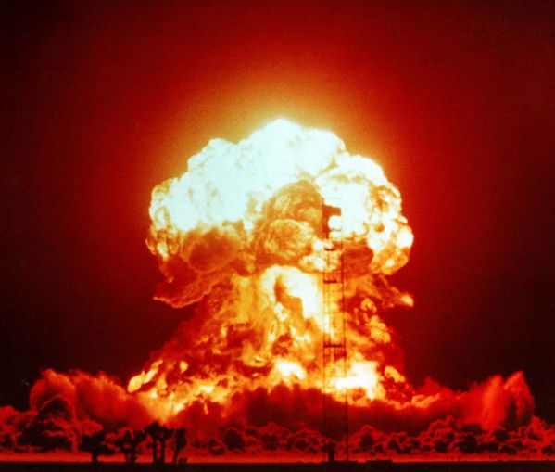
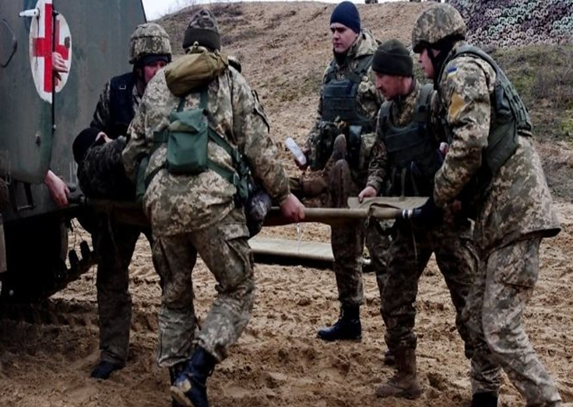
Elective course
Military field therapy Specialty "Dentistry" Faculty of Medicine No2 Department of Internal Medicine Medical Faculty No2

Slide 2
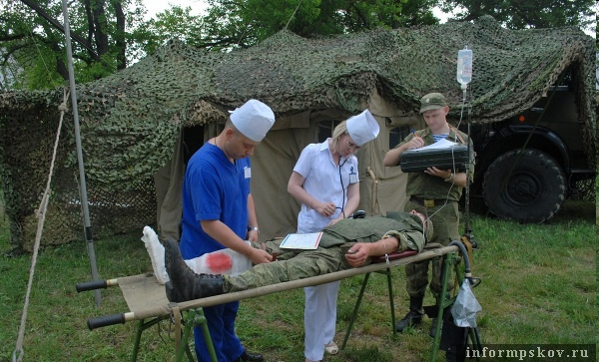
Relevance
The civilizational community will matter more in the future and the state of the world will largely be determined by the interaction of seven or eight major civilizations: Western, Confucian, Japanese, Islamic, Hindu, Slavic-Orthodox, Latin American and possibly African.

Slide 3
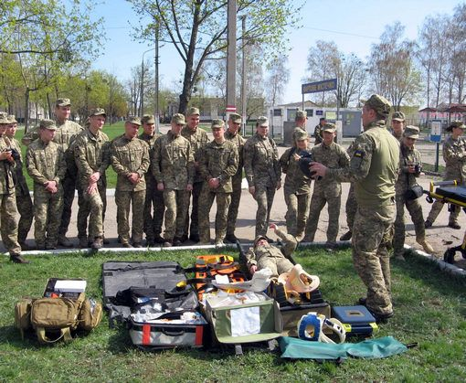
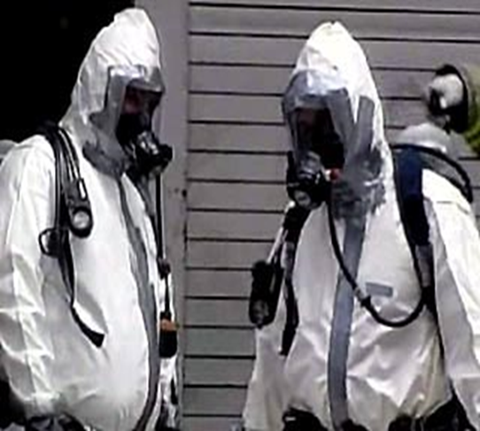
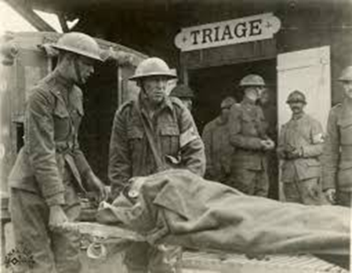
The purpose of the discipline The purpose of teaching the discipline "Military Field Therapy" is to obtain and deepen knowledge, skills and other competencies in military therapy necessary in professional activities, which are established on the basis of the educational and professional program of a specialist.

Slide 4
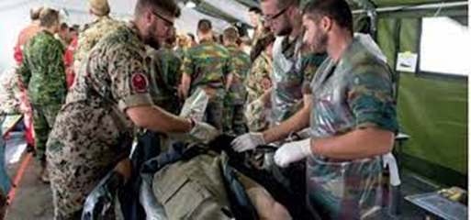
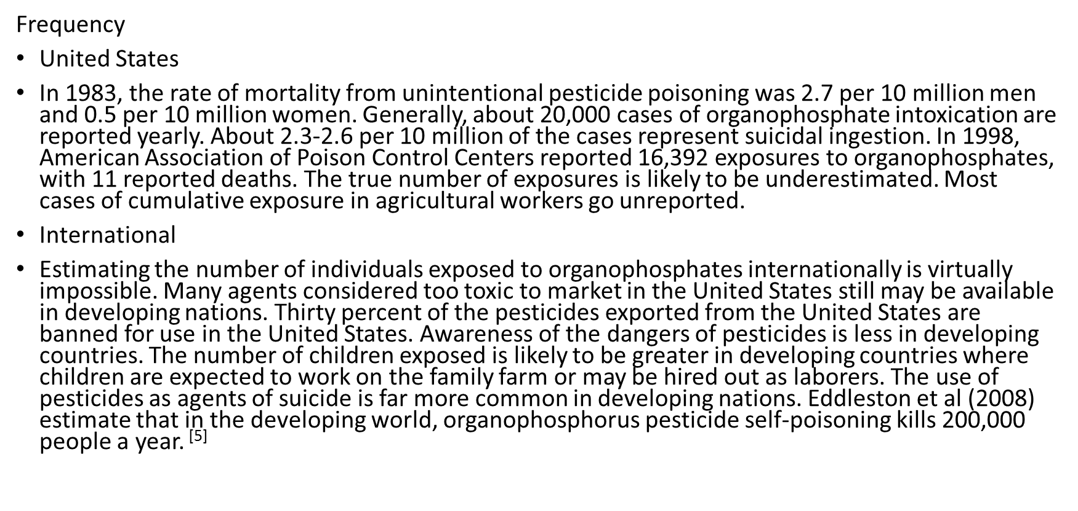
History

Slide 5
The main tasks of studying the discipline "Military Field Therapy" Determine the peculiarities of the organization of therapeutic assistance in wartime, the characteristics of modern combat therapeutic pathology. Know the types of ionizing radiation, units of their measurement and dosimetry, features of radiation lesions of peacetime. Know the classification of pathological changes in internal organs in the wounded, general syndromes of the gunshot wound, features of diseases of internal organs (digestion, respiration, blood circulation, kidneys) in the wounded at the stages of medical evacuation. Know the general characteristics of lesions with toxic substances, classification, volume of medical care. Know the types of thermal damage that is diagnosed in wartime and in peacetime emergencies and be able to provide medical care, according to the evacuation stages. Determine the general characteristics of combat mental trauma, its features of the course, distant consequences principles of diagnosis and provision of emergency medical care at the stages of medical evacuation in wartime and in peacetime emergencies.

Slide 6
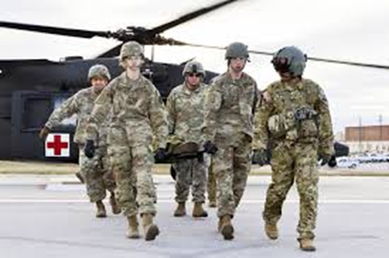
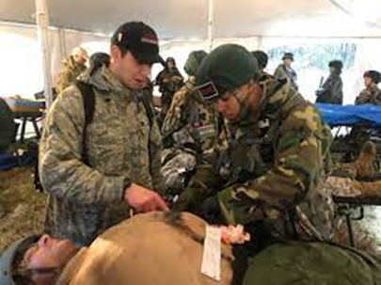
Evacuation, medical care

Slide 7
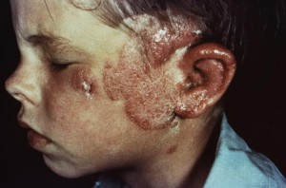
Teaching methods
Visual: demonstration of thematic patient in practical lesson demonstration of the history of the disease, laboratory and functional studies of the patient video method demonstration of medicines Practical: physical methods of examination of the patient (examination, palpation, percussion, auscultation, pulmonary-cardiac resuscitation). evaluation of laboratory and functional studies of the patient. formulation of the diagnosis, writing a plan for examination and treatment of the patient, writing recipes.

Slide 8
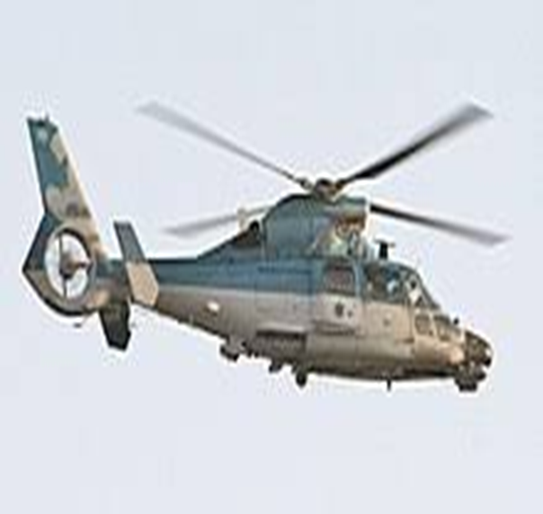
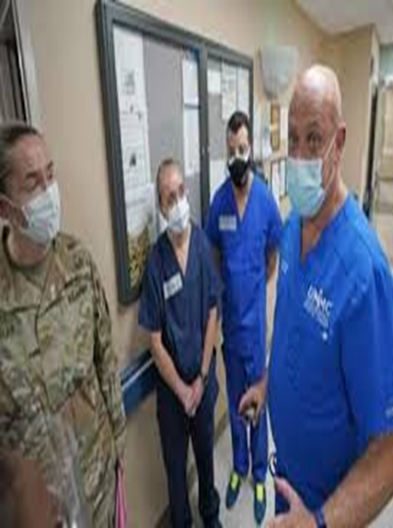
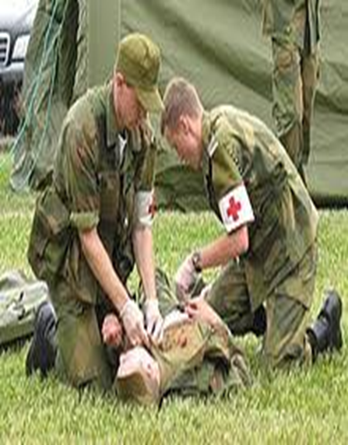
Thank you for your attention

