Slide 1


National Pirogov Memorial Medical University, Vinnytsya
Department of Internal medicine №1
EС 4.7 Selected issues of clinical nephrology
Educational discipline (elective course) for training
(master's) second level of higher education
educational qualification "Master of Medicine"
field of knowledge 22 "Health"
specialty 222 "Medicine"
Course 4

Slide 2
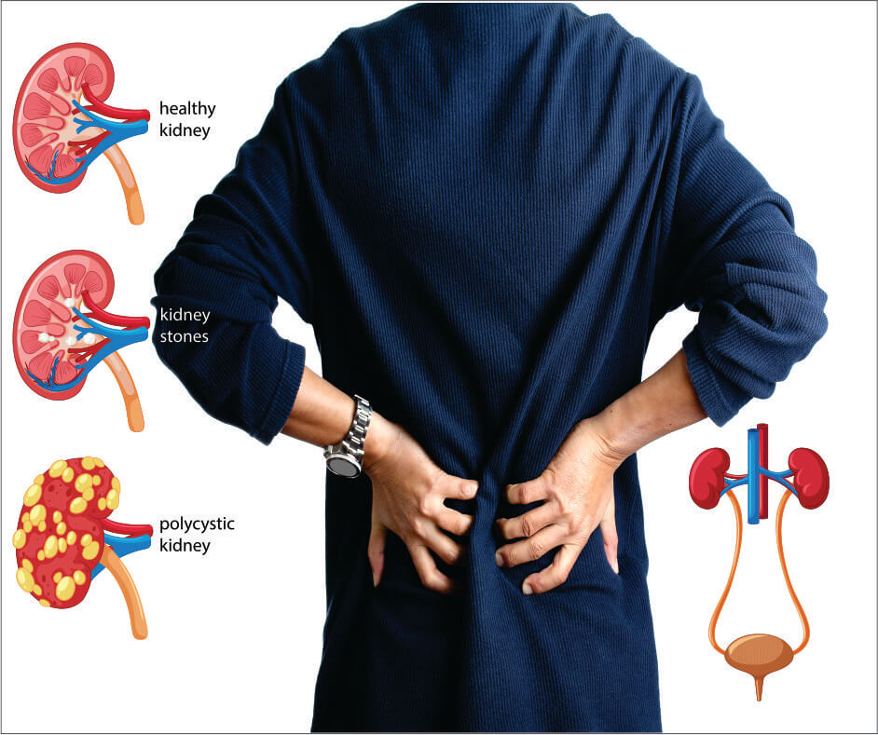
Actuality
The burden of Chronic Kidney Disease (CKD) is increasing worldwide.
According to Global, regional, and national burden of chronic kidney disease, 1990–2017: a systematic analysis for the Global Burden of Disease Study 2017 ¹ data globally, in 2017, 1.2 million people died from CKD. In 2017, 697.5 million cases of all-stage CKD were recorded, for a global prevalence of 9.1%.
Early detection and treatment of CKD using readily available, inexpensive therapies can slow or prevent progression to end-stage renal disease (ESRD).
¹ https://www.thelancet.com/article/S0140-6736(20)30045-3/fulltext

Slide 3
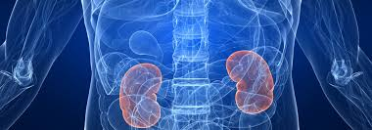
The purpose of the discipline
The purpose of teaching the discipline is to acquire and deepen knowledge, skills, abilities and other competencies in nephrology, necessary in professional activities based on the educational and professional program of the specialist.
The subject of the discipline
Kidney disease

Slide 4


Discipline tasks
Development of clinical thinking.
Deepening knowledge of the epidemiology, etiology, pathogenesis and features of primary and secondary kidney diseases, new methods of treatment and prevention of nephropathy according to the recommendations of the standards of evidence-based medicine.
Improving practical skills and mastering modern methods of examination of patients with kidney disease, interpretation of clinical, laboratory, instrumental and morphological diagnostic methods.
To determine the tactics of the patient, to prescribe modern treatment for kidney disease, to form a medical route; determine the prognosis and efficiency of patients with kidney disease.

Slide 5


Learning outcomes
Integral competence:
ability to solve complex problems, including research and innovation in medicine,
ability to continue learning with a high degree of autonomy.
Program learning outcomes:
collect medical information about the patient and analyze clinical data of a patient with kidney disease, evaluate information about the diagnosis using a standard procedure based on laboratory and instrumental studies, determine the diagnostic and therapeutic approach to kidney disease management.

Slide 6
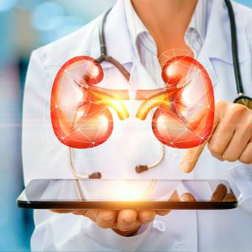
Types of training sessions:
Practical training
Lectures
Independent work of student
Individual student work
Study form - full-time

Slide 7

Teaching methods
Visual:
demonstration of a thematic patient on a practical classes;
demonstration of medical history, results of laboratory and functional investigation;
video method;
demonstration of drugs.
Practical:
physical methods of examination of a patient with kidney disease (examination, palpation, percussion, auscultation, conducting cardiopulmonary resuscitation);
evaluation of laboratory and functional investigation of the patient;
formulation of the diagnosis, writing of the plan of investigation and treatment management of the patient;
writing recipes.

Slide 8
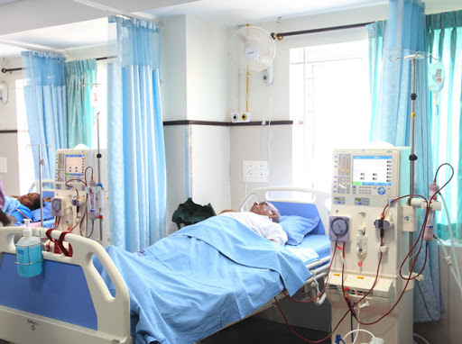
Logistics
Practical classes are held in classrooms on the basis of the Center of Nephrology and Dialysis "Vinnytsia Regional Clinical Hospital named after M.I.Pirogov", where the internal medicine chair №1 is based
  Department of Nephrology with peritoneal dialysis
  Department of chronic hemodialysis
- To implement the educational process, classrooms are equipped with computers with video cameras and microphones and have access to high-quality and high-speed Internet, which allows quick access to modern online GFR calculators, cardiovascular risk calculators and the latest international guidelines.

