Slide 1
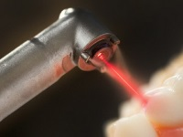
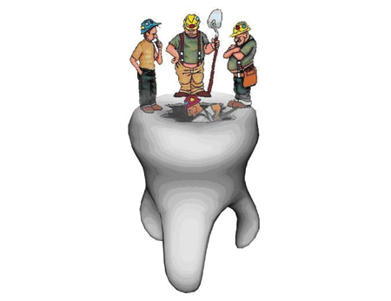
methods of odontopathology treatment
Elective course

Slide 2
Treatment of dental caries is currently one of the main problems of dentistry.
Despite numerous studies aimed at solving this problem, the topic of caries treatment has not lost its relevance, but, on the contrary, its importance is constantly growing.

Slide 3
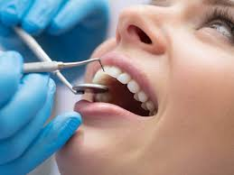

Slide 4
Aim
The purpose of teaching the elective course "Modern methods of odontopathology treatment " in the third year of study is to train a dentist who can diagnose, treat and prevent dental caries, taking into account current trends in therapeutic dentistry.
4

Slide 5
Tasks
To teach students:
to examine a dental patient with dental caries, to identify the leading syndromes and symptoms, to substantiate and formulate a preliminary diagnosis;
to examine a dental patient with dental caries, to identify the leading syndromes and symptoms, to substantiate and formulate a preliminary diagnosis;
formulate a final diagnosis;
determine the nature and principles of treatment of dental caries;
to carry out primary and secondary prevention.

Slide 6
The content of the discipline
The course will consider the main aspects of recent trends in the treatment of dental caries:
the problems of preparation of carious cavities are analyzed;
modern developments in the field of improvement of devices for photopolymerization and dental burs are presented;
an algorithm of actions based on the assessment of the severity of the "carious disease" in the patient;
6

Slide 7
The content of the discipline
reflected new trends in the development of therapeutic dentistry (minimally invasive therapy of dental caries, fissurotomy, etc.);
special attention is paid to the properties and clinical prospects of self-adhesive composite materials for direct tooth restoration;
describe new restoration materials from leading manufacturers:«Filtek Ultimate», 3M ESPE, «Estet X HD», Dentsply, «Charisma Opal», Heraeus, «Estelite Σ Quick», Tokuyama, «Amaris Gingiva», VOCO і т.п.
7

Slide 8
The results of the study
The elective course "Modern methods of t odontopathology treatmen" promotes:
creation of special competencies in the learning process and in professional activities;
treatment of dental caries, in accordance with modern world achievements.

Slide 9
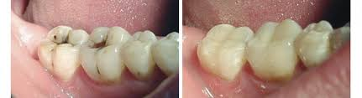
Before treatment
After treatment

Slide 10
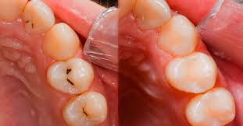
Before treatment
After treatment

Slide 11
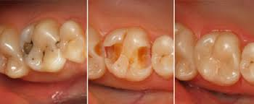
Before treatment
After treatment

Slide 12
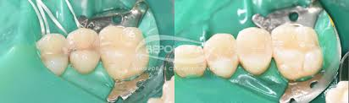
Before treatment
After treatment

