Slide 1


NUTRITION AND BROMATOLOGY
Elective
discipline

Slide 2
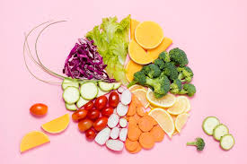
NUTRITION – is a science that studies the issues of nutrition, food, nutrients and other components contained in foods, their effects and interactions, consumption, absorption, loss and excretion, their impact on various types of metabolism and importance in maintaining health or the occurrence of diseases.
BROMATOLOGY– it is a science that studies the chemical composition of food products, their changes under the influence of various factors (chemical, physical, biochemical); deals with food quality control, including raw materials, intermediate products and related materials; and studies the interaction of food with drugs

Slide 3

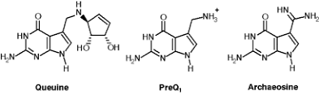
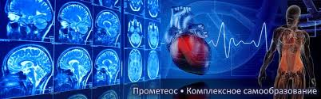
With all the achievements of modern medicine, the role of nutritional support in the prevention and treatment of various diseases, as well as to maintain their own health, plays a major role in the life of modern Human.
Today's trends dictate changes in professional terms. The specialist must have a comprehensive in-depth knowledge to meet the needs of the labor market.

Slide 4
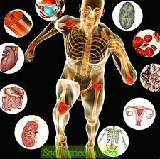
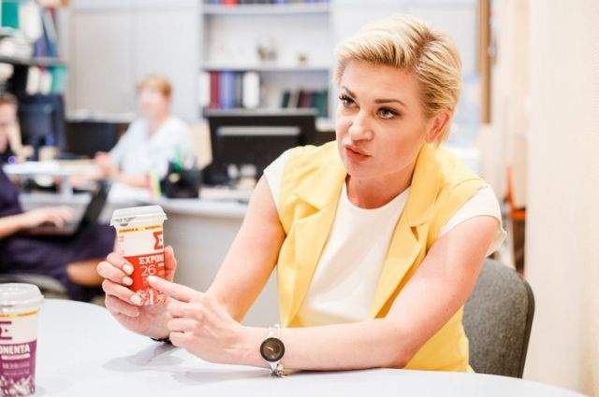



One of the most important areas in the field of health is nutrition.
A specialist with basic knowledge of physiology, pathophysiology, biochemistry, pharmacology, pharmacognosy, pharmaceutical chemistry will be able to approach the issues of proper nutrition more thoroughly and professionally than the average person who received this knowledge without proper medical education.
Therefore, this course will give you the opportunity to learn the basics of such a specialty as a nutritionist and expand your knowledge as a pharmacist.

Slide 5
Course purpose:
- to study the laws of the influence of food and the process of consumption on human health and life;
- to study the role of nutrition in ensuring the normal functioning of organs and systems of the body;
- learn to analyze and advise on the interaction of drugs with food, assess the risks of drug-food interactions, compatibility, indications and contraindications based on data on the health of a particular patient, taking into account biopharmaceutical, pharmacokinetic, pharmacodynamic and physicochemical characteristics of the drug and food;
- provide a balanced diet in accordance with the specifics of the disease and pharmacotherapeutic treatment regimens

Slide 6
.
COURSE TASKS
- use appropriate terms in the study of professional literature;
- apply theoretical foundations and acquired skills in the study of specialized disciplines;
- identify the components of nutrients and non-nutrients in the diet that interact with selected drugs; - assess the risks of drug interactions with food;
- provide recommendations on avoiding / preventing unwanted drug interactions with food;
- use knowledge of pharmacological effects, the mechanism of action of drugs and the principles of their rational dosing in order to ensure their effective and safe use

Slide 7
Dear students!
While studying the course of nutrition and bromatology, you will receive information that will provide an opportunity to expand your knowledge of pharmacists and gain theoretical and practical foundations of the profession of nutritionist.
Good luck!

