Slide 1


ANTOTATION OF THE ELECTIVE COURSE
EC 6.6. Practical course of forensic histology
for 6th year students
222 "Medicine"

Slide 2
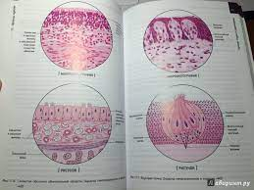
WHY THIS COURSE?
Haven't you worked on a microscope yet?
Are you tired of studying incomprehensible drawings?
Do you want to recognize organs under a microscope?
Want to surprise your colleagues and doctors with the ability to make diagnoses with microscopic examination?

Slide 3
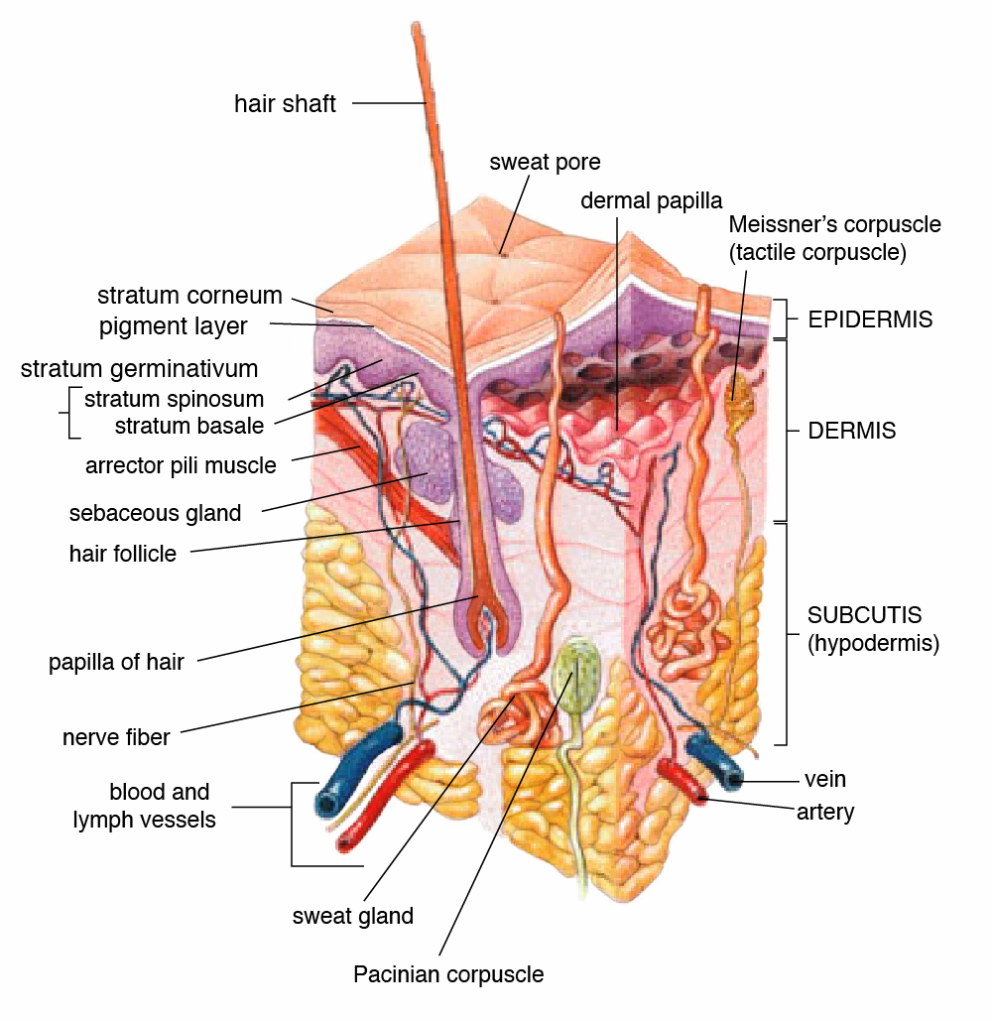
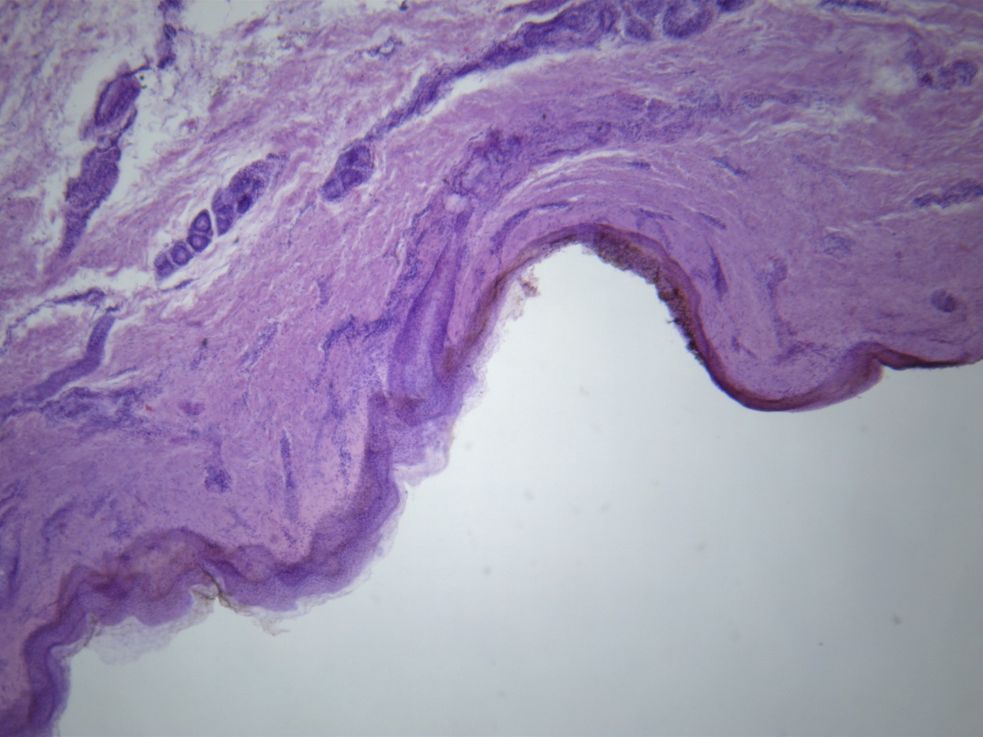
EXPECTATIONS REALITY

Slide 4
COURSE OBJECTIVE
mastering practical skills in microscopic identification of human organs, which are most often selected for forensic histological examination;
formation of a sufficient amount of practical skills and knowledge in order to identify the leading pathological conditions found in forensic thanatology;
acquisition of skills to describe the detected microscopic changes, stages and elements of the study of histological specimens.

Slide 5
WAYS TO ACHIEVE THE GOAL
In case of resumption of classroom training: classes are conducted using a microscope connected to a projector; archival histological preparations are used; archival photos..
In the case of continuing distance learning: classes are conducted on the basis of recommended free educational programs (Microsoft Times, etc.) by showing a picture from a microscope in real time; archival histological specimens are used.

Slide 6
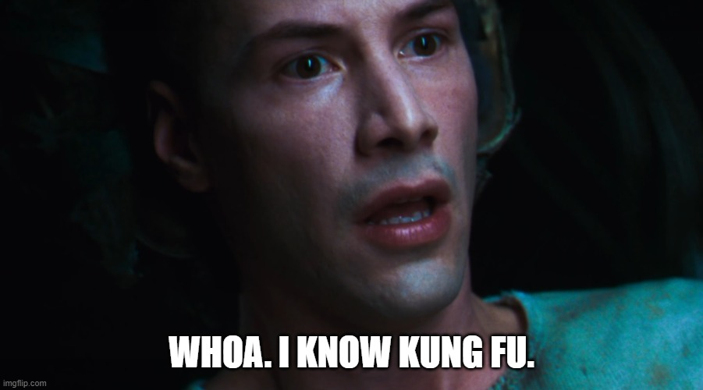
EXPECTED RESULTS
Mastering skills such as:
microscopic identification of the brain, lungs, heart, liver, kidneys, pancreas, skin;
identification of the main staining methods used in forensic histology (HE, Sudan III, Van Gizon);
formation of preliminary conclusions on the most common pathologies found in forensic histology;
you will become as cool as Shahrukh Khan

Slide 7
Discipline developer:
Gunas Valery
Course lecturers:
Gunas Valery
Bondarchuk Hanna

