Slide 1
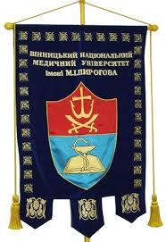
National Pirogov Memorial Medical University, Vinnytsya
Department of Physical Education and Exercise
Elective course :
«Basics of a healthy lifestyle»
Responsible for implementation:
Head of the Department, Ph.D., Prof. Sarafinyuk LA;
Associate Professor Yakusheva YI;
Senior lecturer Romanenko OI.

Slide 2
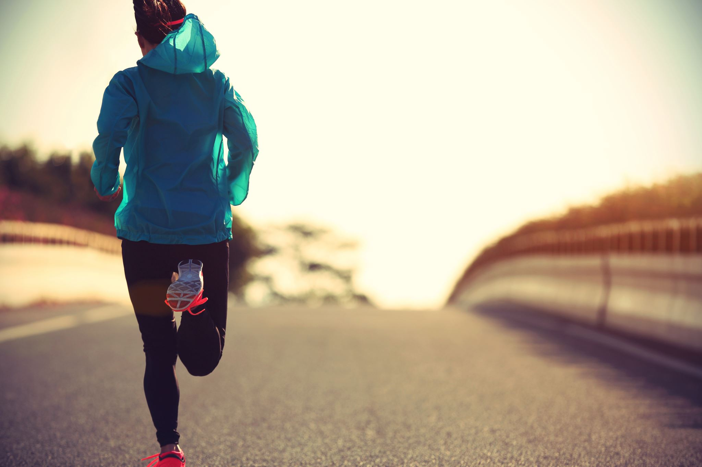
Relevance of the topic at the present time
Decreased motor activity in students
Emotional and learning loads
Bad Habits
Reducing responsibility for one's own health
Insufficient physical development and functional condition
Irrational nutrition

Slide 3
Goals of the basics of a healthy lifestyle:
rational nutrition;
optimal motor mode;
rational nutrition;
Personal Care;
absence of bad habits;
absinthe of bad habit;
absinthe of bad habit;
moral and spiritual development;
formation of the development of volitional qualities.

Slide 4
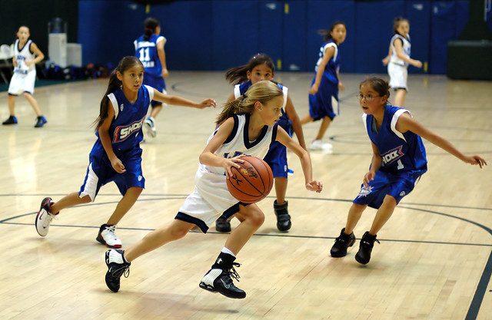
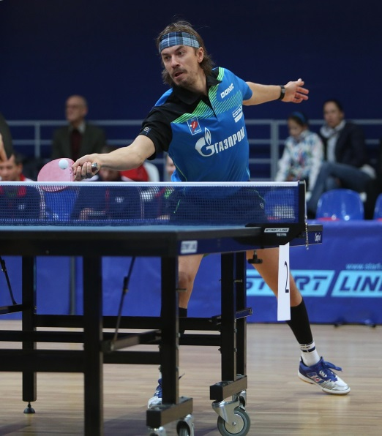
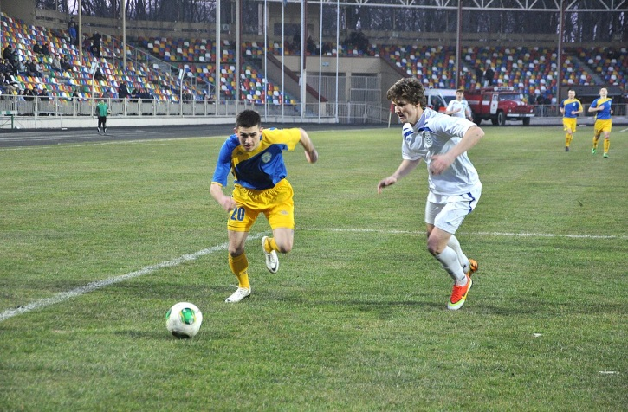
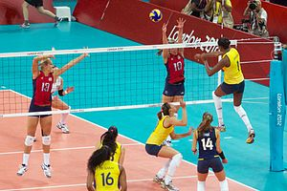
Moving and sports games as part of the foundations of a healthy lifestyle
Basketball
Football Volleyball Tennis

Slide 5
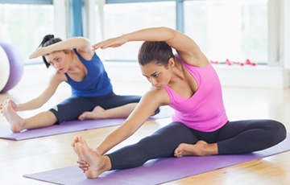
Health-improving types of gymnastics
Wellness fitness
Aerobic gymnastics
Athletic gymnastics
Stretching
Therapeutic and preventive types of gymnastics

Slide 6
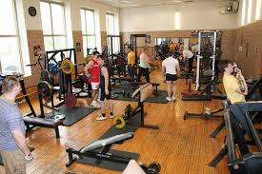
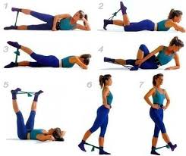
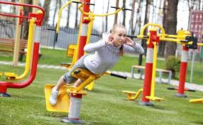
Health gymnastics with the use of simulators
- Athletic Gymnasium
- Street simulators
-Classes with rubber loops

Slide 7
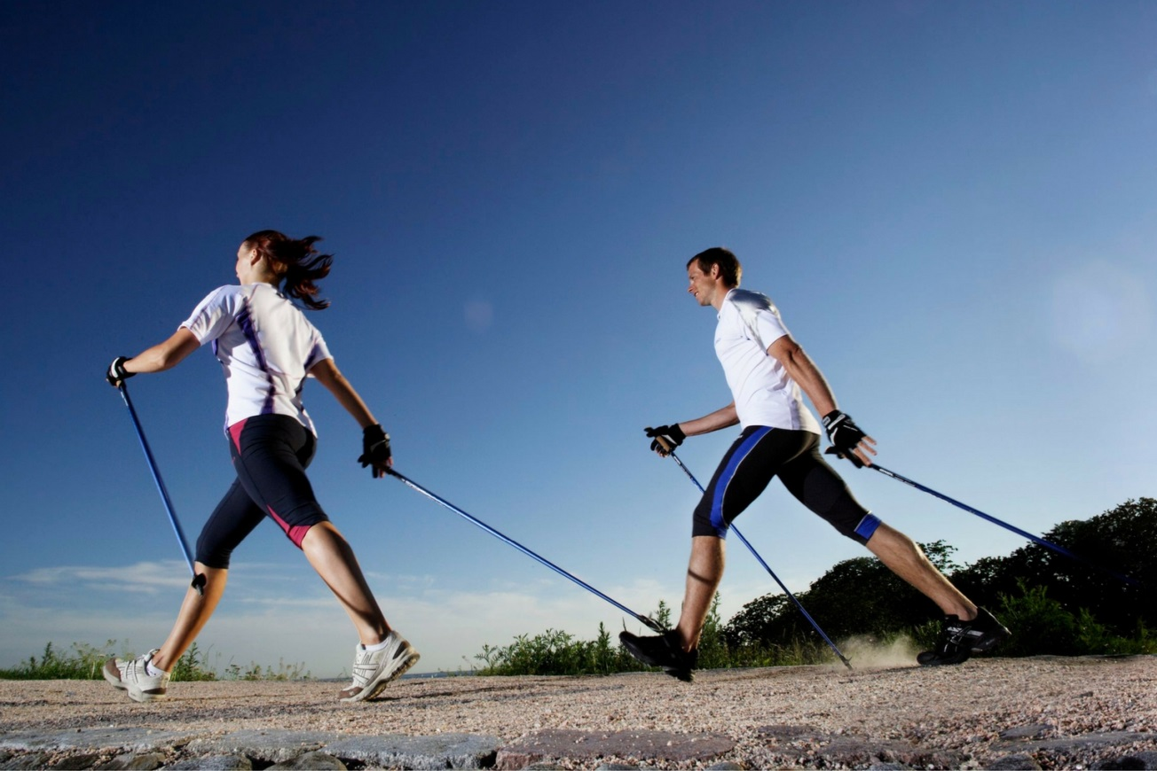
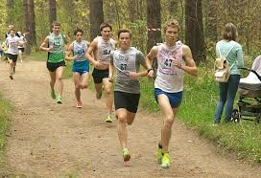
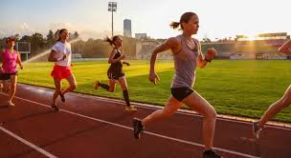
Running and walking as an element of hardening

Slide 8
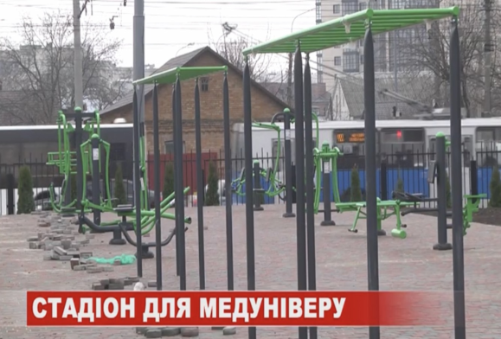
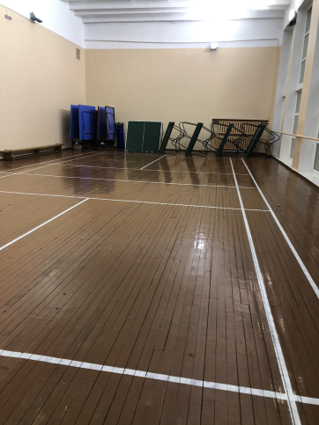
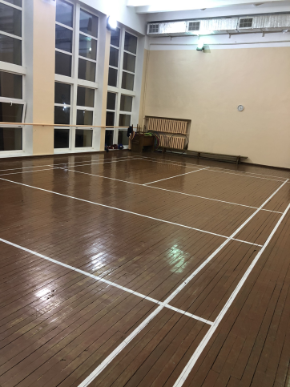
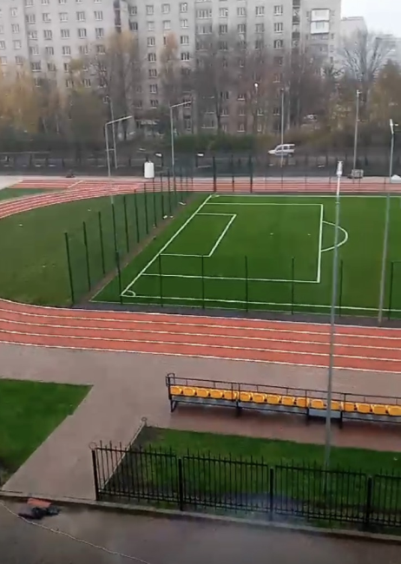
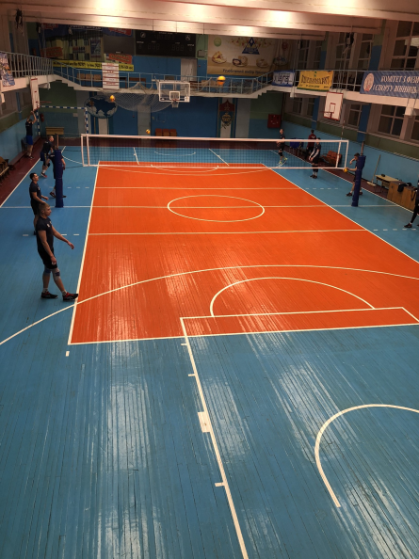
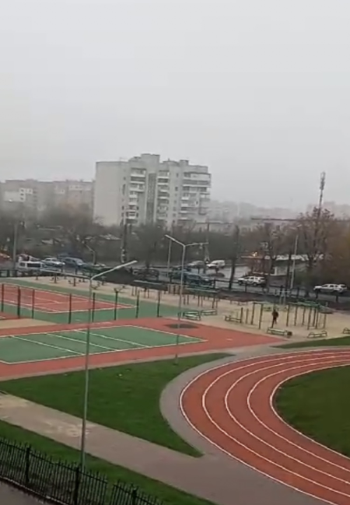
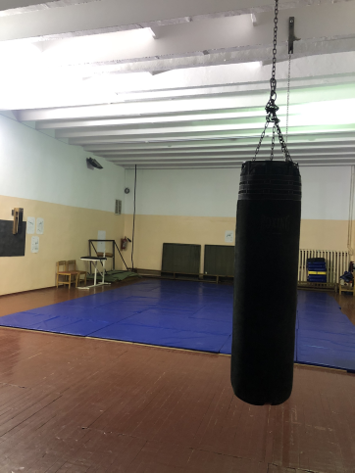
Material-technical base
The sports and educational building is one of the most difficult objects of the university. Its powerful sports base fully meets the main task of this unit: conducting scheduled physical education classes 1 and 2 courses, improving students' sportsmanship, conducting training sessions with students 1-6 courses and interns, mass sports and health events. The sports base has:
Hall for playing sports.
Gym.
Martial arts and exercise hall.
Also new at the university is the Multifunctional Sports Complex designed for physical education and training in volleyball, basketball, tennis and athletics. There is a playground for physical education and mini-football training. They have a special coating of artificial grass, fenced with mesh. A gymnastic complex has been installed, which includes nine vertical support pillars, a handrail, four crossbars, a pair of gymnastic rings and sports bars. There are also 8 outdoor exercise machines for outdoor exercise: rowing machine; orbitrek; hyperextension; for leg press; for chest press, upper thrust; for the press with an emphasis on hands; for the abdominal press; butterfly.
The sports complex is made of a special bulk rubber coating, which is easy to move and it has optimal functional characteristics, including high strength and durability, non-slip surface, which reduces the risk of injury during physical education and training.

