Slide 1
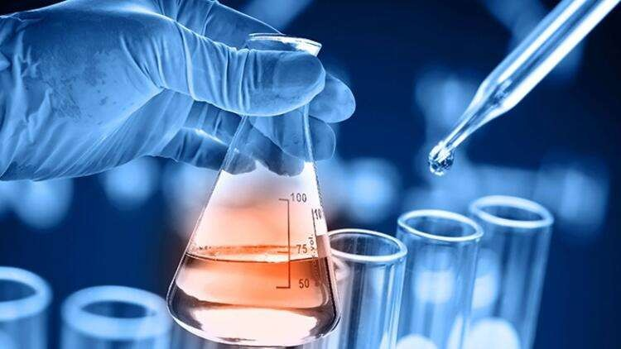
Ecotoxicology
Department of Pharmaceutical Chemistry
https://www.vnmu.edu.ua/кафедра-фармацевтичної-хімії#

Slide 2
Every day a person is exposed to exogenous toxicants, which are poisons for living organisms and can, depending on many factors, cause poisoning.
Ecological toxicology (ecotoxicology) - a branch of toxicology that studies the effects of toxic substances on ecosystems and their cycle in the biosphere, especially in food chains.

Slide 3
One of the main biological objects in the study of ecotoxicology is human.
In contrast to traditional, modern ecotoxicology studies toxic effects not only at the level of the organism, but also mainly at the population and biocoenotic levels.

Slide 4
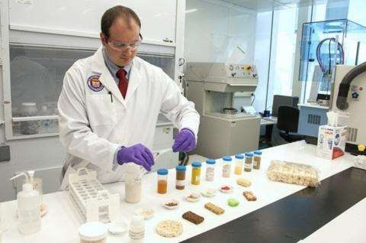
Goals and objectives of ecotoxicology
study of types of ecotoxicity,
their mechanisms and consequences

Slide 5
Subject of study of the elective discipline "Ecotoxicology”
the effect of harmful chemicals in the environment on living organisms and their populations that are part of the ecosystem;
physicochemical and toxic characteristics of the pressure of the main groups of ecotoxicants;
assessment of the degree of danger of ecotoxicant effects on living organisms;
consequences, mechanisms of restoration of biological systems and their protection from exposure to toxic substances;
methods of bioindication of heavy pollutionmetals, pesticides, polycyclic hydrocarbons and oil;
methods of bioindication of air, soil and water pollution;
toxicometric parameters.

Slide 6
The purpose of teaching the elective discipline "Ecotoxicology”
preparation of students for the development of medical-biological and special disciplines, for which on the basis of modern scientific ideas to form in students the necessary knowledge, skills and abilities in the field of toxicological chemistry.

Slide 7
The main tasks of studying the selective discipline "Ecotoxicology”
формування у студентів знань і умінь, практичних навичок з
токсикології, яка є
загальнотеоретичною дисципліною в системі підготовки провізора;
підготовка оволодіння
спеціальною фармацевтичною дисципліною –
студентів для
токсикологічної хімією,
також знань,
отримання основних токсикологічних необхідних для розуміння і засвоєння
ряду медико-біологічних і хімічних дисциплін, що вивчаються на фармацевтичному факультеті.

Slide 8
The main tasks of studying the selective discipline "Ecotoxicology”
formation of students' knowledge and skills, practical skills in toxicology, which is a general theoretical discipline in the system of pharmacist training;
preparation of students for mastering a special pharmaceutical discipline - toxicological chemistry,
as well as obtaining basic toxicological knowledge necessary for understanding and mastering a number of medical-biological and chemical disciplines studied at the Faculty of Pharmacy.

Slide 9

The course is based on the knowledge, skills and abilities acquired by students in the study of such disciplines :
Toxicological and forensic chemistry, General and inorganic chemistry, Organic chemistry,
Analytical chemistry,
Physical and colloid chemistry, Pharmaceutical Chemistry, Pharmacology

Slide 10
The structure of the discipline
Ecotoxicology as a science. The current state of the environment. Toxic substances in different environments
Principles of classification of toxic substances.Characteristics of pollutants and parameters of toxicity assessment.
Ecotoxicokinetics.
Ecotoxicodynamics.
The mechanism of action of xenobiotics in the body. Regularities of formation of toxicity of poisons.
The main toxicants in agricultural products.
Food contamination.
Anthropogenic pollution of the natural environment. Modern ideas about chemical carcinogenesis.
Consequences of pollution of aquatic ecosystems. Biomonitoring.
Population ecological toxicology. Ecotoxicants and a human.

Slide 11
As a result, the student will know :
subject, tasks and main sections of ecotoxicology, its branchesapplication;
theoretical foundations of ecotoxicology;mechanisms of adaptation of an organism to changes of environment;conditions and factors that affect the atmosphere, hydrosphere andlithosphere;
main characteristics of changes in the external material compositionenvironment due to human activities;
basic principles for assessing the negative impact of toxicants on liveorganisms (ecological diagnostics);
basic principles of preventing the negative effects of toxicants onliving organisms (environmental prevention);
basic principles of improving the environmental condition of the environmentenvironment (ecosalvation);
methods of toxicological studies of biological systems and their biomonitoring;basics of mathematical processing of ecotoxicological resultsresearch;
main literature sources and reference literature fromecotoxicology.

Slide 12
As a result of training the student will be able to :
work with regulations on chemical and toxicological analysis;
take and prepare samples for analysis;
to offer methods of isolation and analysis of poisons, proceeding from their nature, the nature and condition of the object of study;
make a plan and choose the optimal course of chemical and toxicological analysis of data from educational and special literature in solving professional problems related to ecotoxicological research;
predict the main mechanisms of ecotoxic activity of substances based on themchemical structure;
anticipate possible types of ecotoxicity of substances based on their chemical structure;
assess the quality of water, air and soil for various needs;
perform appropriate calculations, final calculations usingstatistical processing of analysis results;
use specialized software in ecotoxicologyresearch;
work independently with educational and reference literature on ecotoxicology;
apply the theoretical foundations of ecotoxicology and acquired experimentalskills in studying profile disciplinary research;
to carry out the release of toxic substances and their metabolites from biological objectsorigin (isolation, purification, concentration)draw the right conclusions in combined poisoning.

Slide 13
Prospect
The course will prepare the student to study the discipline of the cycle of professional training - "Toxicological and forensic chemistry", which is basic in the direction of training a forensic toxicologist.
The practical part of the course is taught in the Department of Forensic Toxicology Regional Bureau of Forensic Medicine.

