Slide 1
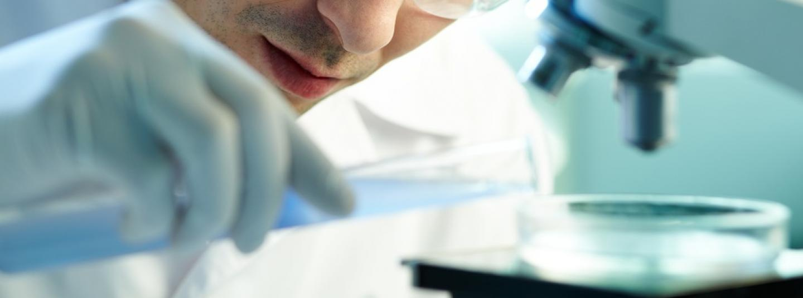
Modern analytical laboratory practice
Department of Pharmaceutical Chemistry https://www.vnmu.edu.ua/en/department/department/8

Slide 2
There are special requirements for the quality of medicines, as they are designed to guarantee the effectiveness and safety of the drug, and therefore the health of each person and society as a whole.
An important component of ensuring the quality of drugs is pharmaceutical analysis - a set of methods that allow you to assess the quality parameters of chemicals at all stages of the existence of the drug.
In the process of production step-by-step control is carried out by the analytical laboratory.

Slide 3
Modern analytical laboratory practice is a training course that includes mastering a set of criteria that provide a basis for the proper organization of laboratory tests and evaluation of results and conclusions obtained during the analysis.

Slide 4
The aim of the course is to teach students the basics of modern methods of analysis and mastering the practical skills of its implementation, the formation of scientific worldview, skills and abilities to apply chemical laws in practical activities, the development of logical thinking and ability to analyze phenomena.

Slide 5
The discipline allows to improve the knowledge gained in previous courses and promotes better mastering of programs of disciplines of the following courses "Pharmaceutical chemistry", " Technology of drugs", "Toxicological and forensic chemistry", "Pharmacognosy", "Standardization of medicines", "Physico-chemical analysis in creating drugs.

Slide 6
The result of studying the discipline is:
• Ability to organize and control the quality of medicines in accordance with the requirements of the current State Pharmacopoeia of Ukraine and good pharmacy practices, identify sampling methods for control of medicines and standardize them in accordance with current requirements, prevent the spread of counterfeit medicines.
• Ability to develop Quality Control Methods of drugs, including active pharmaceutical ingredients, medicinal plant raw materials and excipients using physical, chemical, physicochemical, biological, microbiological, pharmacotechnological and pharmacoorganoleptic control methods.

Slide 7
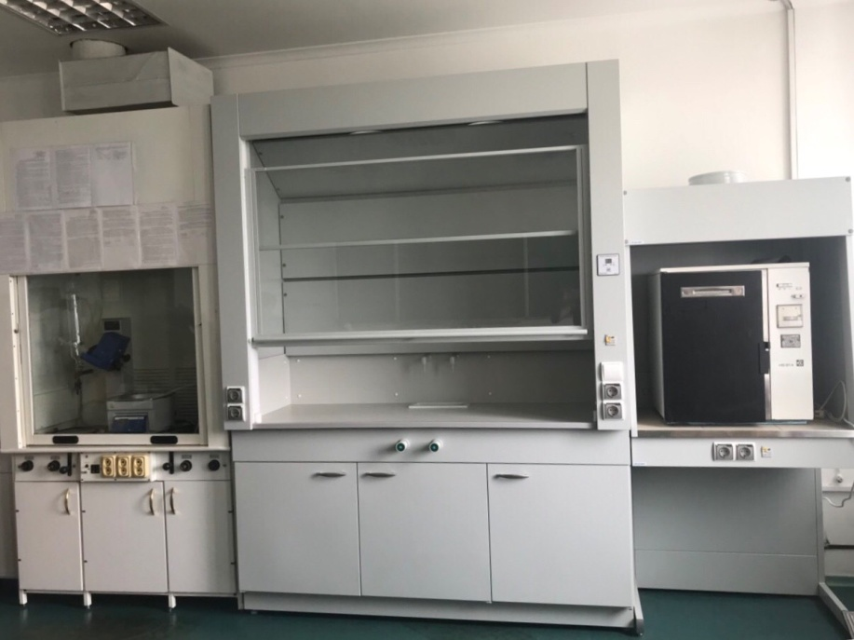
In 2017, with the assistance of the university administration at the Department of Pharmaceutical Chemistry was established educational and research laboratory of chemical and pharmacognostic research.
During the practical classes students have the opportunity to get acquainted with the organization of work in the laboratory, as well as to conduct analytical research.

Slide 8
The laboratory is equipped with modern devices:
• Spectrophotometer Agilent Cary 60;
• Rotary evaporator RV8c;
• Binocular microscope LeikaDM750;
• ABBE laboratory refractometerAR4;
• Aquadistillator electric DE-10M;
• Analytical scales VIBRA series HTR-220CE;
• Drying cabinet;
• Muffle furnace;
• Colorimeter photoelectric concentration KFK-2.

Slide 9
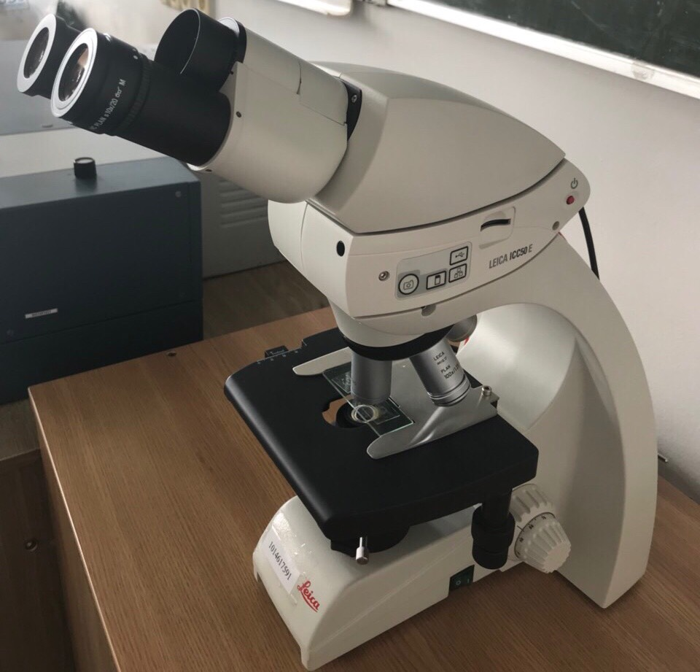
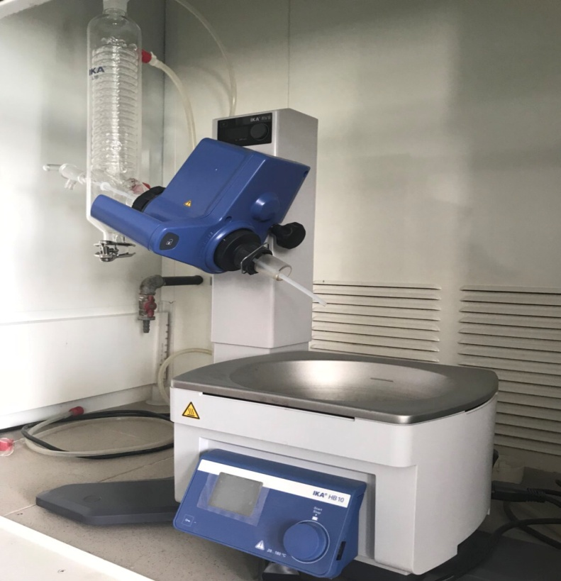
Research methods offered by the laboratory:
- extraction of biologically active substances from medicinal plant raw materials with subsequent removal of the extractant under vacuum;
- microscopic analysis;

Slide 10
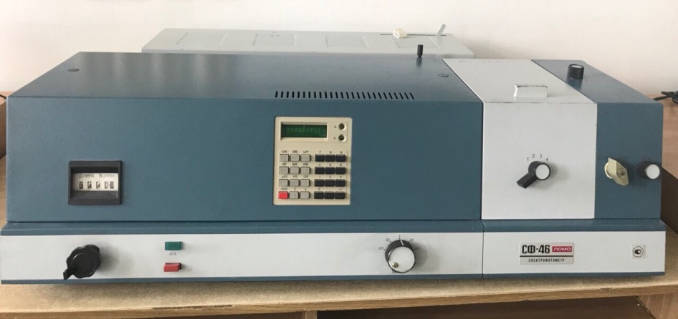
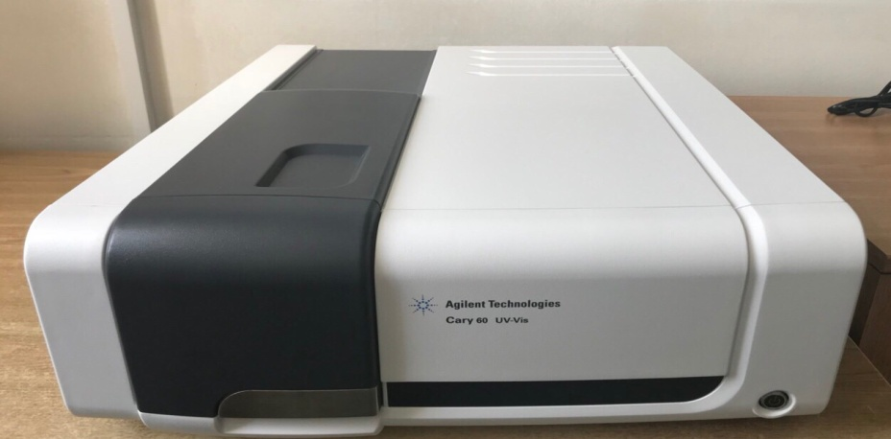
- spectrophotometric studies (spectral range 190-1100 nm);
- photoelectrocolorimetry;

Slide 11
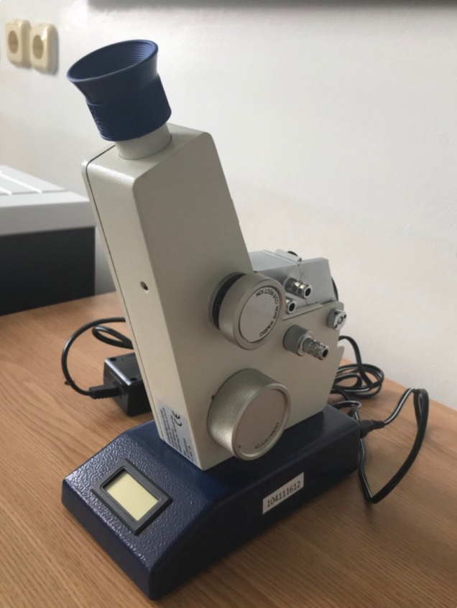
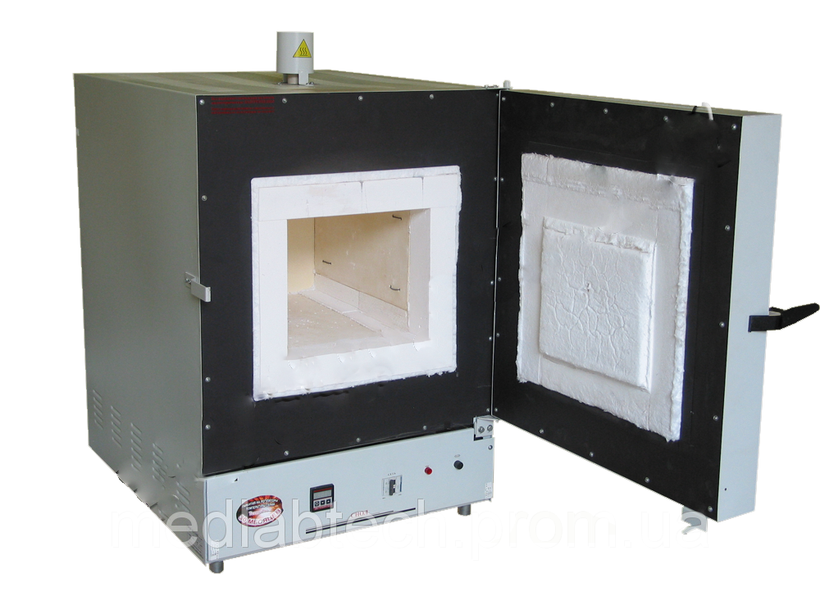
- refractometry;
- determination loss in mass during drying;
- dry ashing.

Slide 12
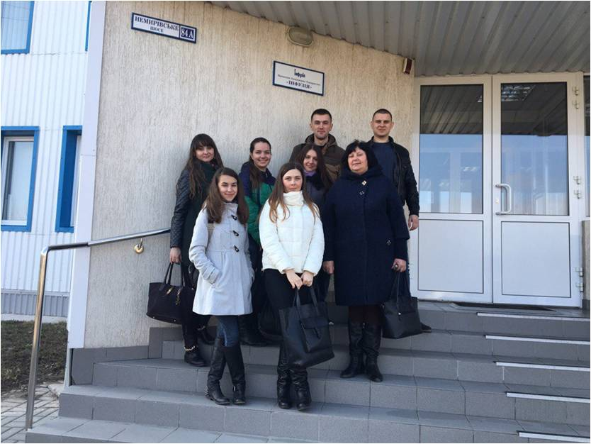
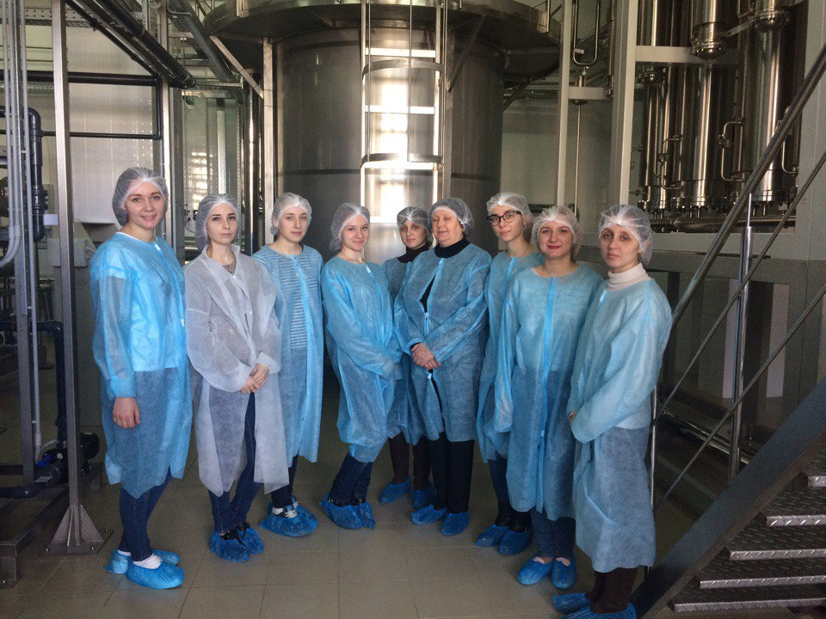
During the study of the discipline students have the opportunity to visit the enterprise Private Joint Stock Company "Infusion" (Vinnytsia).

Slide 13
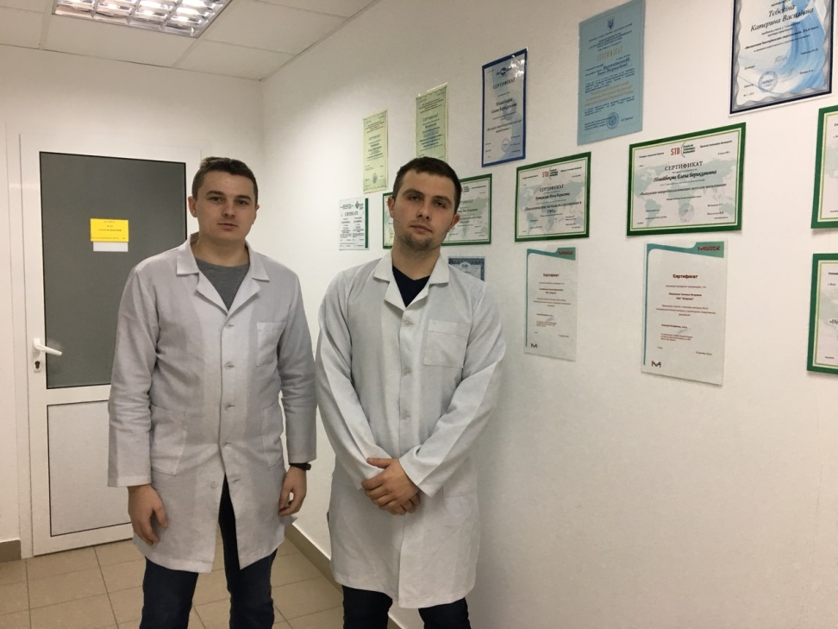
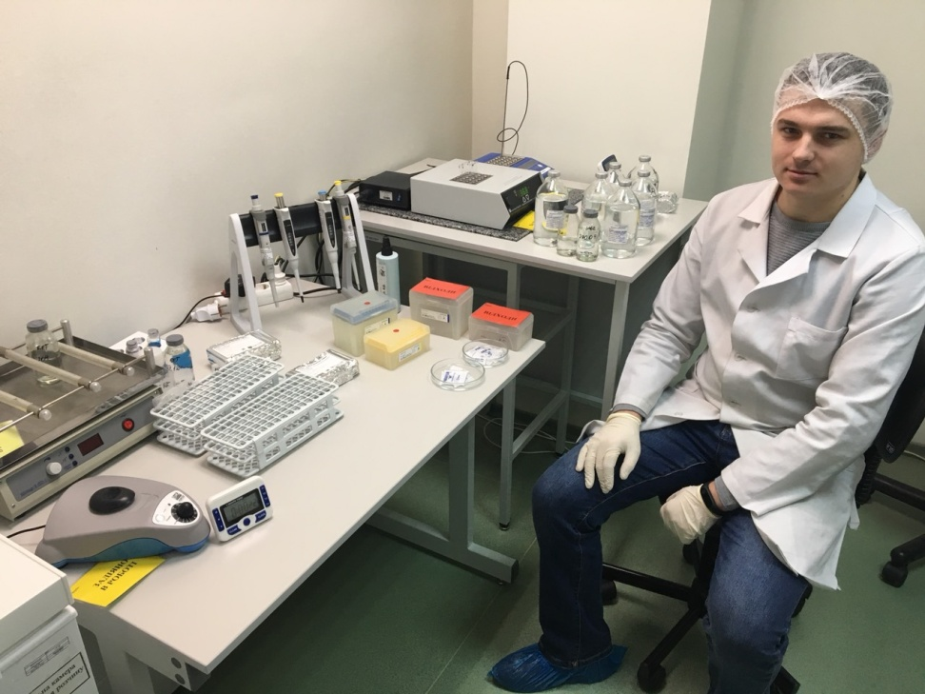
At the production plant, students can get acquainted with modern methods used by analytical and microbiological laboratories of quality control PJSC "Infusion".

Slide 14
The study of the discipline "Modern analytical laboratory practice" helps students to master the basic principles of organization and equipment of chemical analytical laboratories, modern methods of analysis and research in laboratory practice and the use of professional knowledge in solving practical problems.
Discipline is important in the training of a chemist-analyst and an expert-toxicologist!

