Slide 1

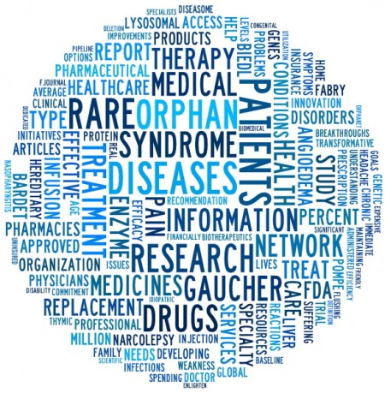
Vinnitsa National Pirogov Memorial Medical University
Paediatric Department №2
PEDIATRIC RARE DISEASES
(elective course for 5th year students)
field of knowledge 22 "Health care"
Specialty 222 "Medicine"

Slide 2
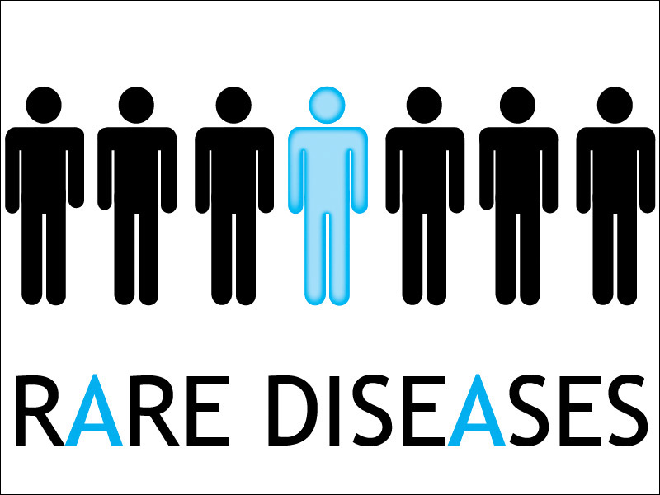
The purpose of the course
to deepen the theoretical knowledge and practical skills for 5th year students in early diagnosis, the principles of treatment of rare and orphan diseases.

Slide 3

Course objectives
To establish a probable nosological or syndromic preliminary clinical diagnosis of orphan disease according to standard methods, using preliminary data of the patient's anamnesis, data of the patient's examination, knowledge about the person, his organs and systems
Collect information about the general condition of the patient
Ability to describe the phenotype, assess the psychomotor and physical development of the patient, collect information about hereditary history, condition of organs and systems

Slide 4

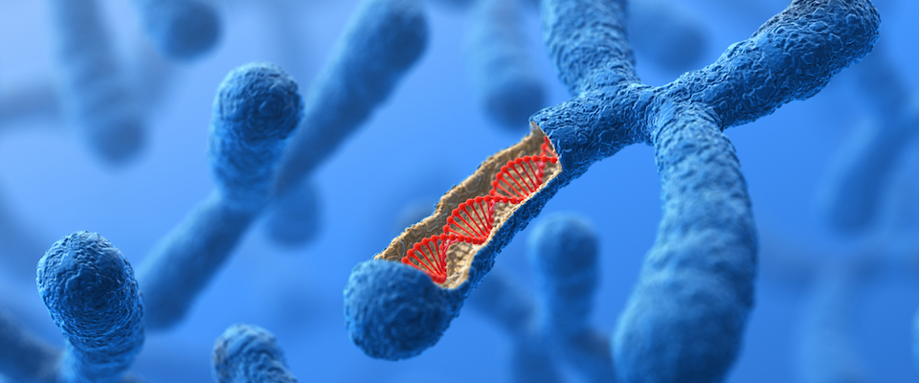
Course objectives
Ability to compile a pedigree of the patient
Evaluate cytogenetic examination data
Evaluate biochemical survey data
Evaluate the data of molecular genetic tests

Slide 5
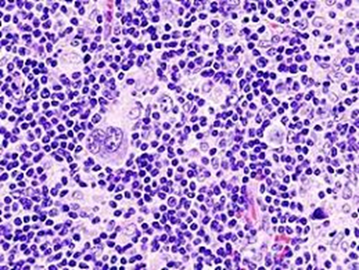
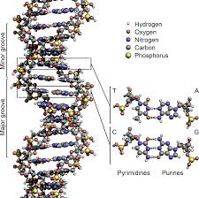
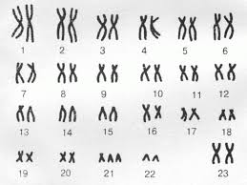
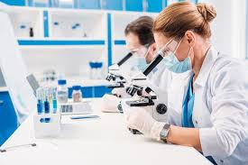
Parts of the subject
to make the plan of inspection and to analyze the data of laboratory and instrumental tests at a typical course of orphan and rare diseases

Slide 6
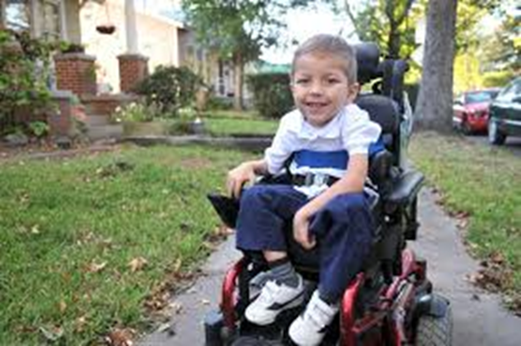
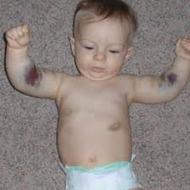
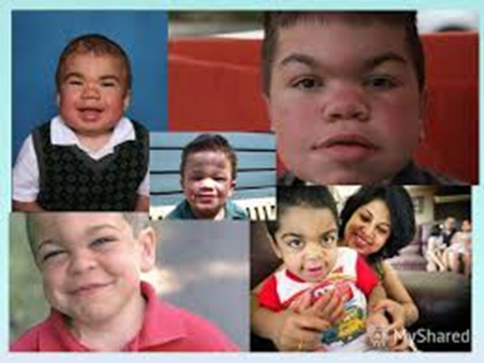
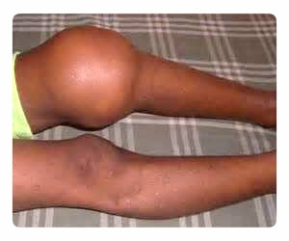
Parts of the subject
to carry out differential diagnostics and to make the preliminary diagnosis at a typical course of rare and orphan diseases

Slide 7
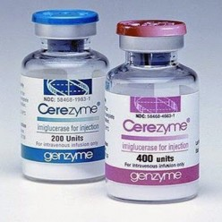

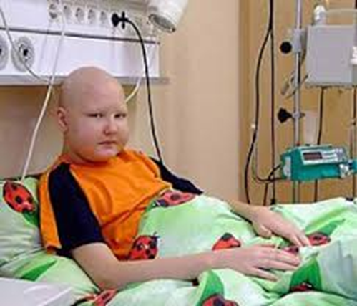

Parts of the subject
possession of the principles of treatment, rehabilitation of patients with rare and orphan diseases

