Slide 1


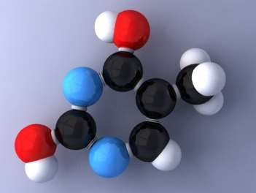
IDENTIFICATION OF ORGANIC
COMPOUNDS
Department of Pharmaceutical Chemistry
https://www.vnmu.edu.ua/кафедра- фармацевтичної-хімії#

Slide 2
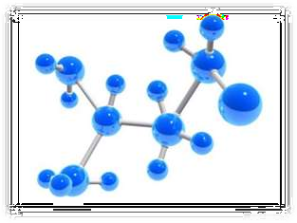
DESCRIPTION OF THE COURSE
Elective course "Identification of organic compounds" is devoted to the study of methods and approaches to establish the chemical structure and purity of organic compounds, the relationship between their chemical structure and properties, the formation on this basis of creative chemical thinking necessary for successful learning of disciplines and practice.
The main task of the course is to provide a scientific approach to solving such problems as pharmaceutical, phytochemical and chemotoxicological analysis, quality assessment and technology of drug production and storage condition.

Slide 3
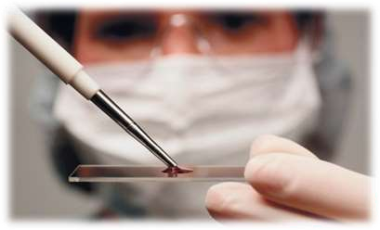
COURSE OBJECTIVE
mastering by higher education students the laws of the relationship between the structure and properties of organic compounds
acquaintance with the basic physical and physicochemical methods of analysis of organic compounds as the main prerequisite for understanding the principles of their identification in biomedical and clinicaldiagnostic tests
study of basic approaches for the identification of organic compounds based on the analysis of analytical and functional groups
acquisition of practical skills that will help to further master the methods of standardization and quality control of drugs and the principles of laboratory diagnosis

Slide 4
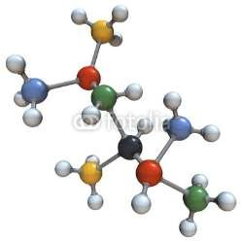
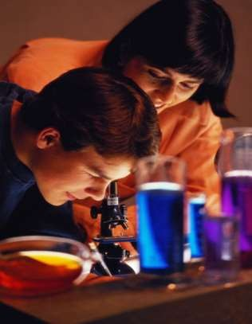
COURSE TASKS
study of the structure of organic molecules (both natural and synthetic, includingnumber of medicinal substances, their metabolites andendogenous compounds)
study of the nature of functional groups
  detection of the relationship between the structure of organic compounds and methods of analysis
  study of aspects of separation, isolation, purification and analysis of organic compounds

Slide 5
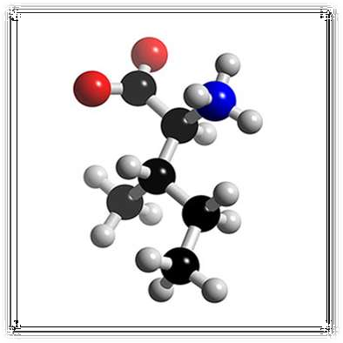
SUBJECT OF STUDYING:
structure of organic moleculescompound
sphysical and chemical properties of organic compounds
reactivityfunctional classes of organic compounds
methods of identification of organic compounds
methods of separation, selection and purification

Slide 6
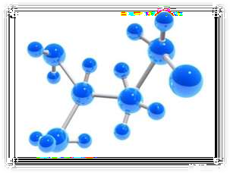
STRUCTURE OF THE COURSE
Structure of organic compounds.
The most important classes of organic compounds are the basis for the identification of organic compounds.
Relationship "structure - property (activity)".
Methods of separation, isolation and purification of organic compounds.
Sensitivity and selectivity of chemical reactions.
Approaches to the analysis of organic compounds :
-determination of physical properties (boiling point,melting point, refractive index, specific rotation);
-elemental analysis (qualitative, quantitative);
- structural analysis (chemical methods, physical and physical-chemical methods)
Analysis of classes of organic compounds.

Slide 7
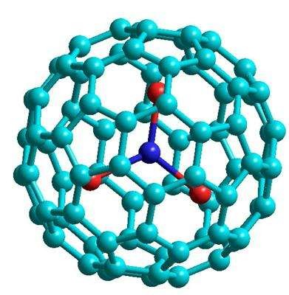
PHYSICAL and PHYSICAL
CHEMICAL METHODSANALYSIS
NMR spectroscopy
IR spectroscopy
UV spectroscopy
Mass spectroscopy Chromatographic methods Diffractometry
CHEMICAL METHODS OF ANALYSISORGANIC COMPOUNDS
Identification of the structure of the carbon skeleton (heterocyclic nucleus)
Identification and position of functional groups
Destructive oxidation
Ozonolysis Hydrogenation Aromatization

Slide 8

TEACHING METHODS
Methods of organization and implementation of educational activities are:
lectures
seminars and laboratory classes
independent work of
students
The methodological basis of seminars is the performance by students of various educational exercises of a search nature, solving situational problems, analysis of literature data, use of chemical programs necessary for experiments.

Slide 9
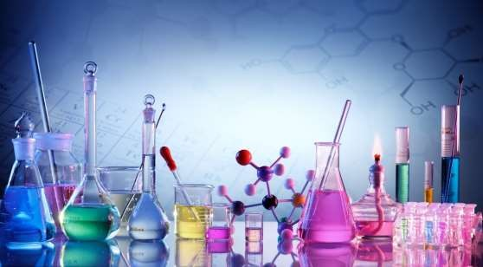
Laboratory classes include discussion and performance of laboratory studies to study certain classes of organic compounds on the properties of their functional groups, conducting qualitative reactions, isolation and purification of organic compounds, the establishment of physicochemical constants.

Slide 10

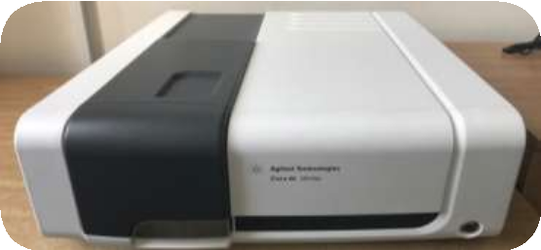

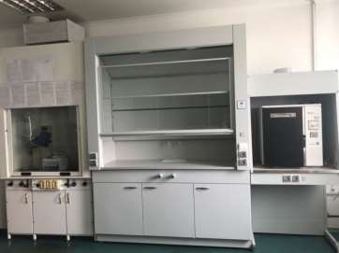
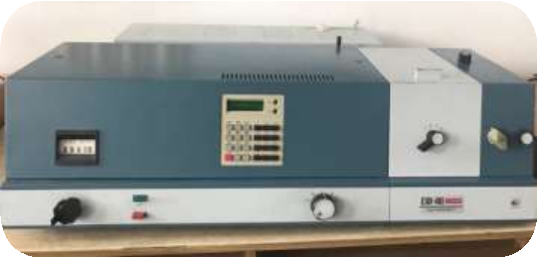
In 2017, with the assistance of the university administration at the Department of Pharmaceutical Chemistry, an educational and scientific laboratory was establishedchemical and pharmacognostic research, equipped with modern equipment
During laboratory classes, students have the opportunity to work in this laboratory, gaining practical skills in chemical and instrumental methods of analysis of organic compounds

Slide 11
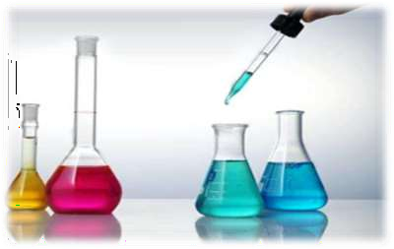
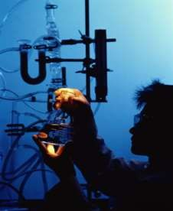
Looking forward to seeing You
at the Department of Pharmaceutical Chemistry!

