Slide 1
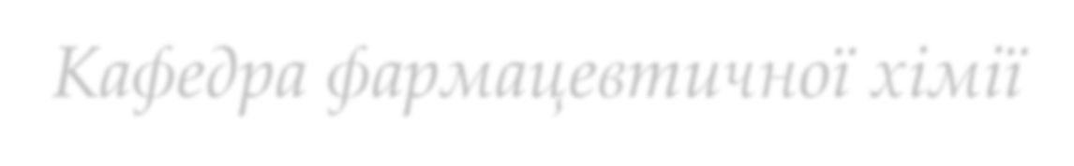



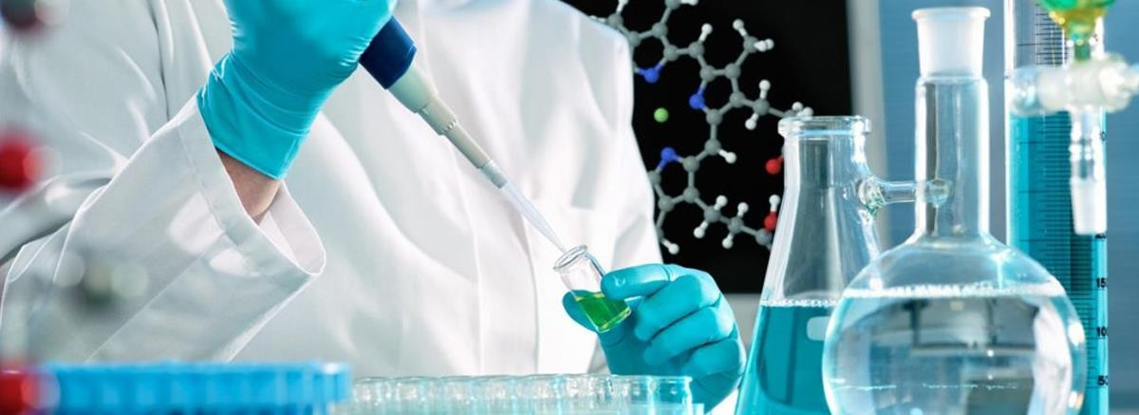
Effective and Safe Methods of Chemical Research
Department of Pharmaceutical Chemistry
https://www.vnmu.edu.ua/кафедра фармацевтичної хімії

Slide 2
In the general system of pharmacist training "Effective and safe methods of chemical research"- is a laboratory discipline, knowledge of which is necessary and important for the fruitful, practical activities of specialists in the field of pharmacy, as they enable future professionals to learn safe rules in the laboratory and master practical skills in laboratory chemical and measuring utensils, chemical reagents, measuring instruments, equipment and techniques for laboratory work in the chemical laboratory.

Slide 3
The Main Task of the Course :
formation of the initial level of knowledge in students, which allows to obtain skills and practical skills necessary for further study of such special disciplines as "Organic Chemistry", "Analytical Chemistry", "Modern Analytical Laboratory Practice", "Drug Technology", "Pharmacognosy" , "Standardization of drugs", as well as for future independent work of a specialist in a chemical laboratory.

Slide 4



Effective and safe methods of chemical research
Study period - 1 course, 2 semesters
Volume - 3 credits, 90 hours, incl. lectures - 10 hours,practical training -40 hours, independent work - 40 hours.
The subject of studydiscipline is
formation of skills and abilities for effective, professional and safe work in the chemical laboratory
The final form of control- credit
The purpose of studying the discipline
formation of students' theoretical andapplied competencies, which will allowto acquire skills and abilities that are necessary for further study of certain special disciplines, as well as forfuture independent and professionalwork of a specialist

Slide 5

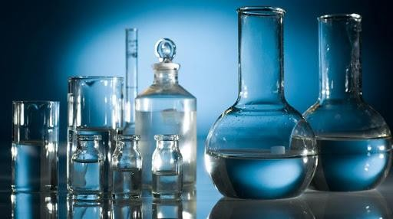
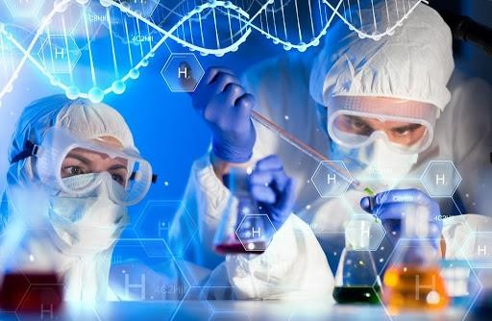

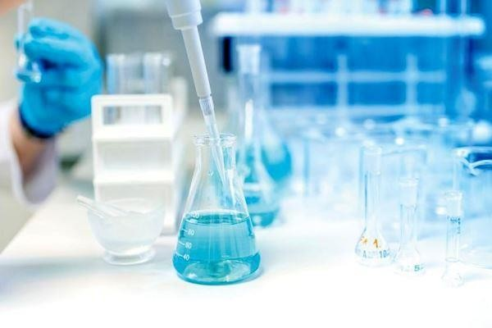
PROFESSIONAL COMPETENCES
The student must know :
rules of safe work in the laboratory;basic provisions for organization and equipmentchemical laboratories;safety rules, labor protection,fire safety, anti-epidemic regimein laboratories;types and purpose of laboratory equipment andutensils, its disinfection and sterilization;classification of chemical reagents and rulesuse them;structure of scales and rules of their use;types of solutions and methods of their preparation;essence and technique of titration;structure and principle of operation of measuring devices: refractometer, pH m.
The student must be able to :
prepare scales for work depending on their type;to measure liquids by means of measuring ware;follow the rules of work with toxic and potent substances, as well as with flammable and easily explosivesubstances;select laboratory utensils and equipment forappointment;to conduct a systematic inspection of the working condition of the equipment,instruments, laboratory glassware and auxiliary material;prepare the workplace, auxiliary materials (sterile, cottontampons, gauze napkins, filters, etc.), utensils, appliances;to make solutions of various concentrations;perform calculations related to different methodsexpression of solution concentration;guided by appropriate techniques, using the necessary reagents, laboratory equipment and adheringsafety rules, conduct laboratory tests;to calculate the obtained results

Slide 6

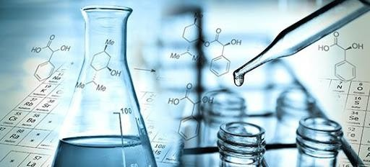
Educational-methodical, informational and personnel support
Ph.D., Associate Professor TI Yushchenko
Ph.D., assistant Sidoruk TI

Slide 7


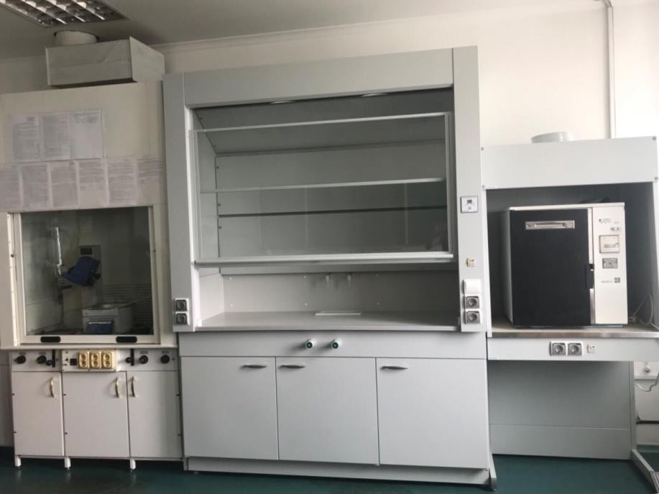
In 2017, with the assistance of the university administration at the Department of Pharmaceutical Chemistry, an educational and scientific laboratory of chemical chemistry was established.pharmacognostic studies
During the practical classes students have the opportunity to get acquainted with the organization of work in the laboratory, as well as to conduct analytical research.

Slide 8

The laboratory is equipped with modern equipment
Agilent Cary 60 spectrophotometer;
Rotary evaporator RV 8c;
Binocular microscope Leika DM750;
ABBE laboratory refractometer AR4;
Aquadistillator electric DE-10M;
Scales analytical VIBRA of the HTR-220CE series;
Drying cabinet;
Muffle furnace;
Colorimeter photoelectric concentration KFK-2.

Slide 9


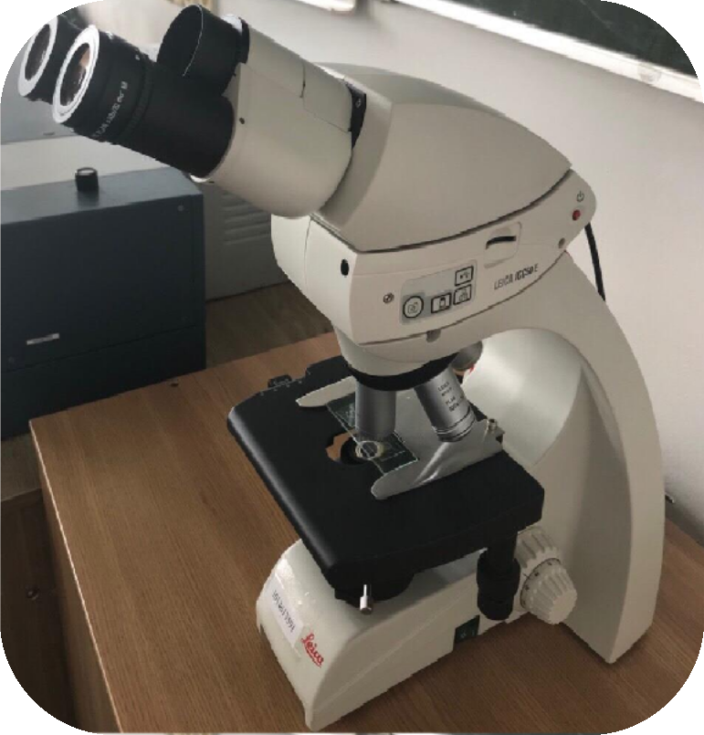
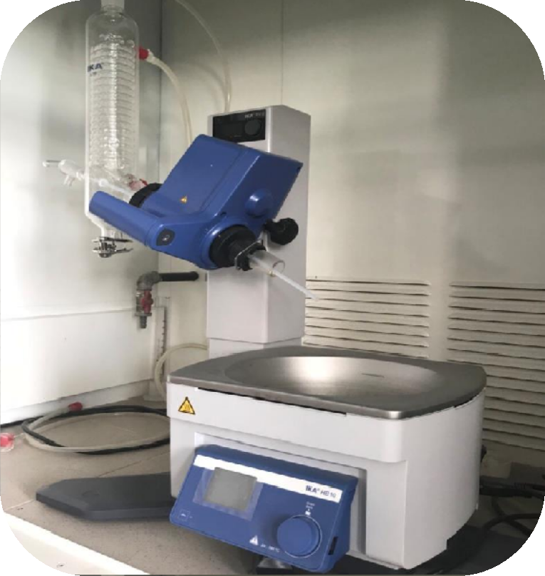
Research methods offered by the laboratory:
extraction of biologically active substances (BAS) from medicinal plant raw materials (LRS) with the followingremoving the extractant under vacuum;- microscopic analysis

Slide 10

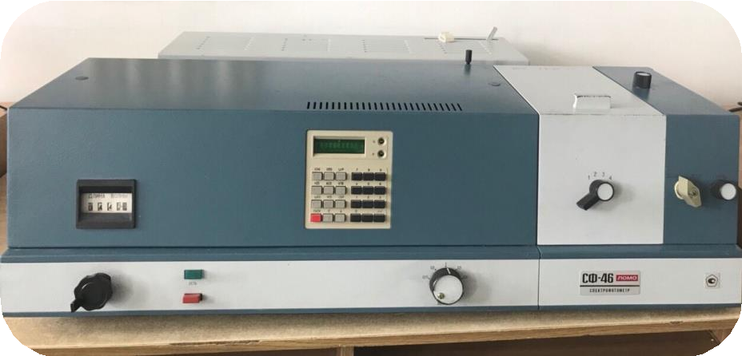

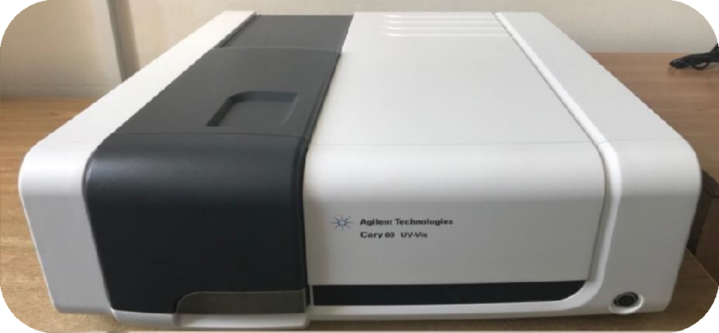
- spectrophotometric studies
spectral range 190-1100 nm);
- photoelectrocolorimetry;

Slide 11

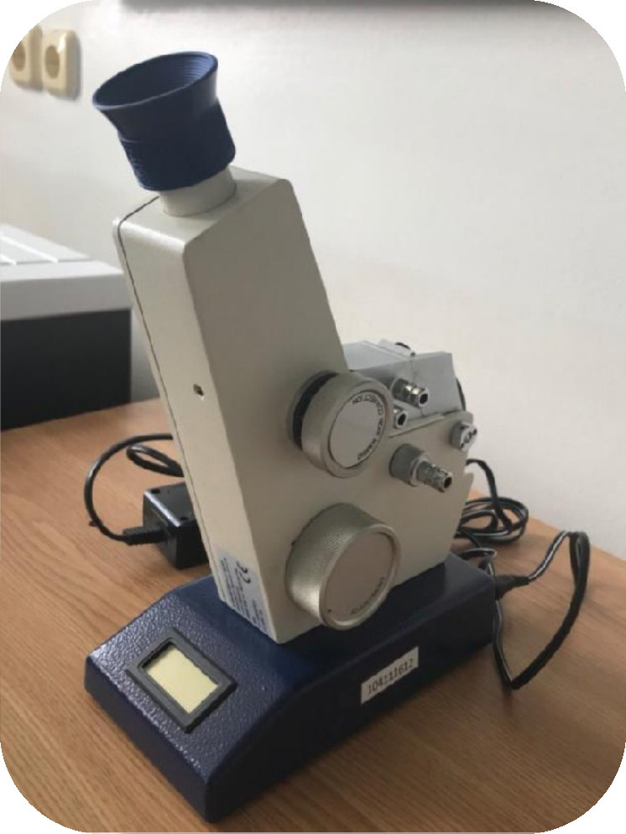

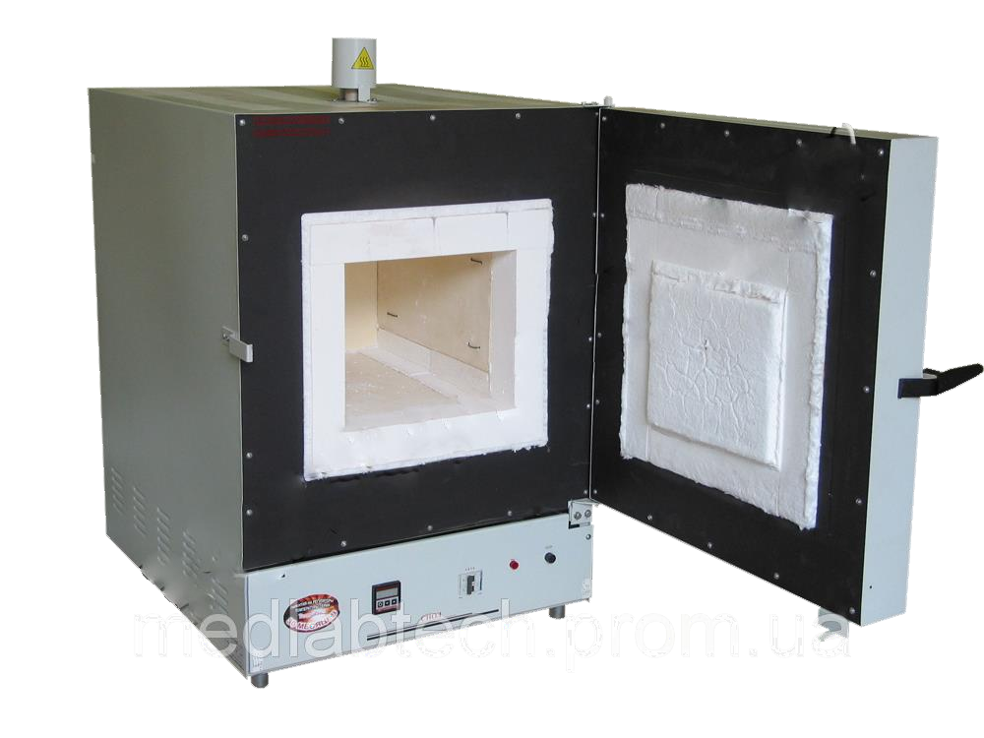
- refractometry;
determination of weight loss during drying;
- dry ashing.

Slide 12


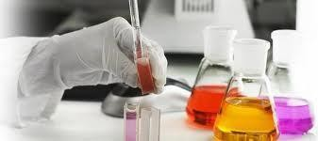
Looking forward to seeing You at the Department of Pharmaceutical Chemistry!

