Slide 1
Good Practices in Pharmacy
DEPARTMENT OF PHARMACEUTICAL CHEMISTRY https://vnmu.edu.ua/en/department/department/8

Slide 2
Annotation. The modern concept of pharmaceutical education is based on the principle of expanding the scope of scientific and practical knowledge of a pharmaceutical specialist, taking into account the multifaceted pharmaceutical activities (development, production, storage of drugs, wholesale and retail drugs) and its close connection with preclinical studies and clinical trials. drugs, pharmacovigilance. Reflecting different aspects of a single concept of quality, efficacy and safety of a medicinal product, the standards of good practice are closely linked; they are based on a comprehensive consideration and prevention of those factors that can adversely affect the quality of the drug at any stage of the life cycle.

Slide 3
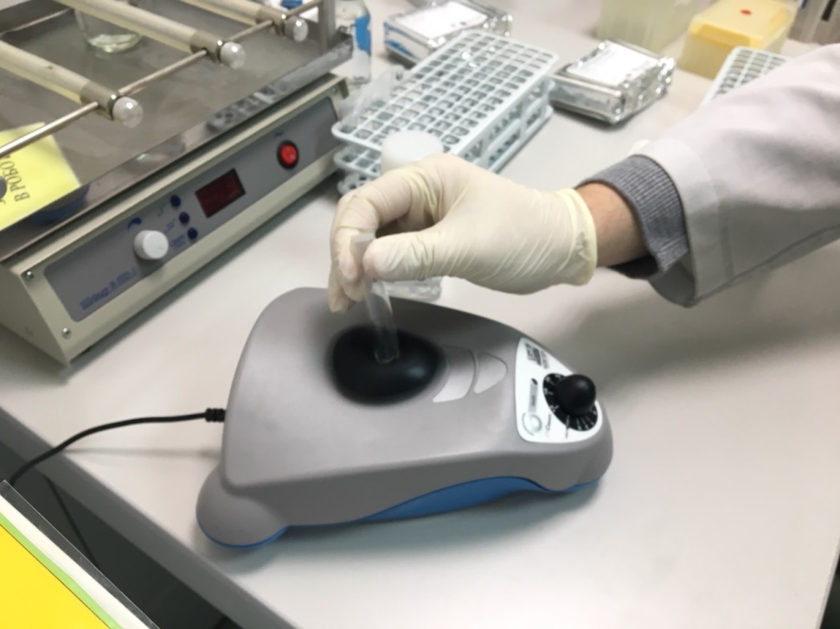
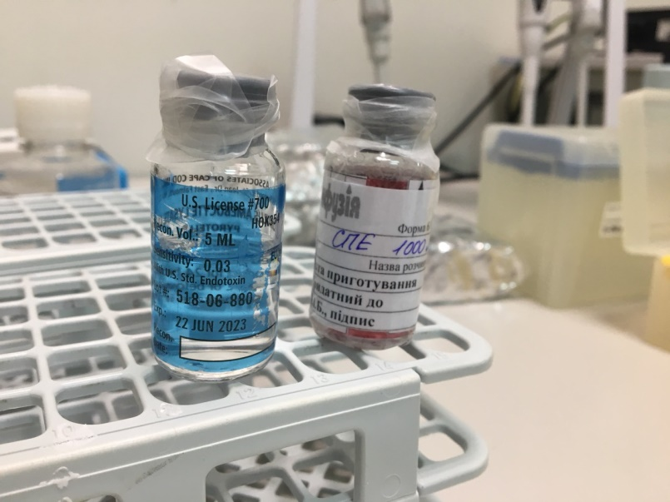
«Sperco Ukraine»
LAL-Lysate Amebocute Lumilus TEST

Slide 4

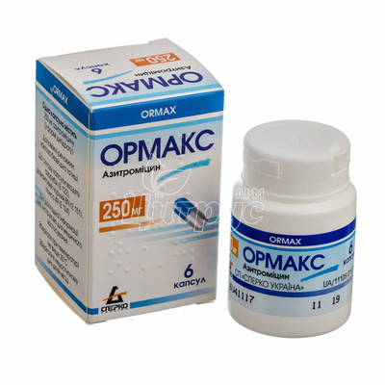
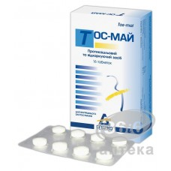
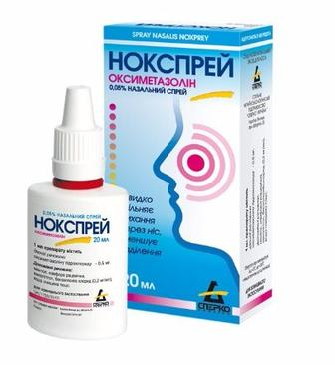
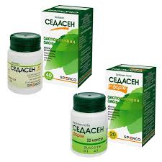
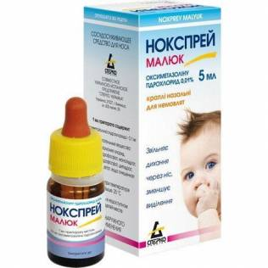
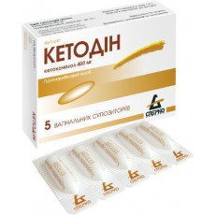

Slide 5
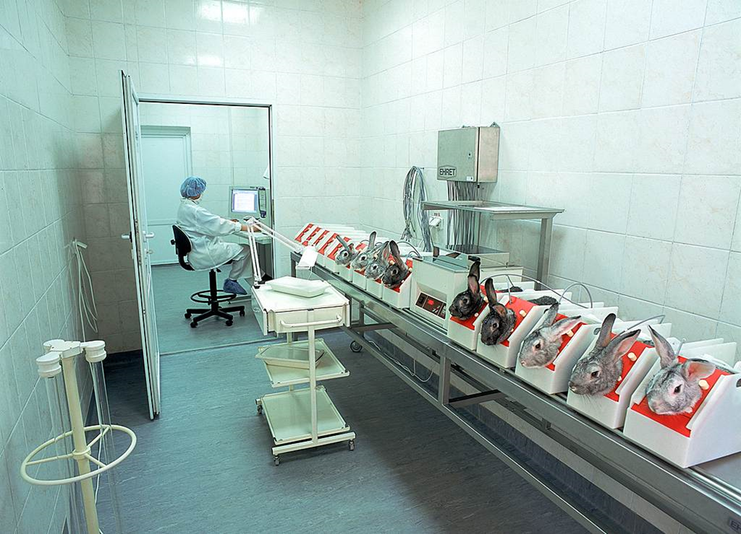
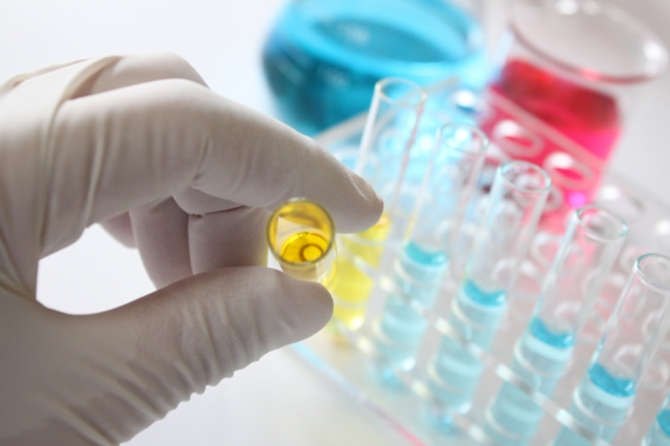
PRIVATE JOINT STOCK COMPANY "INFUSION«
Test for pyrogens (Triple thermometry (after 1 hour) of rabbits after injection of the drug)

Slide 6
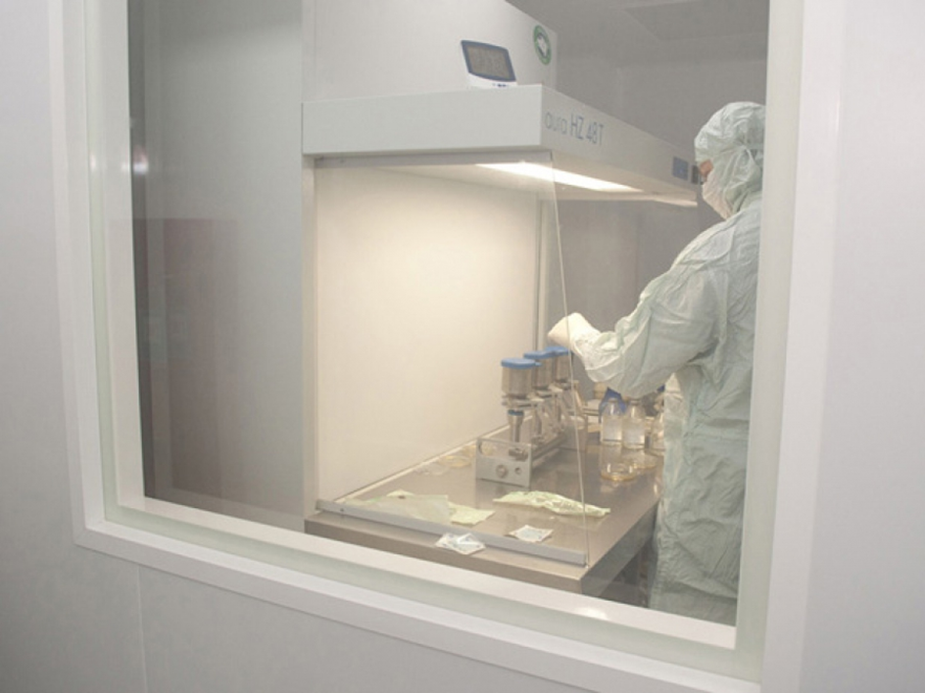
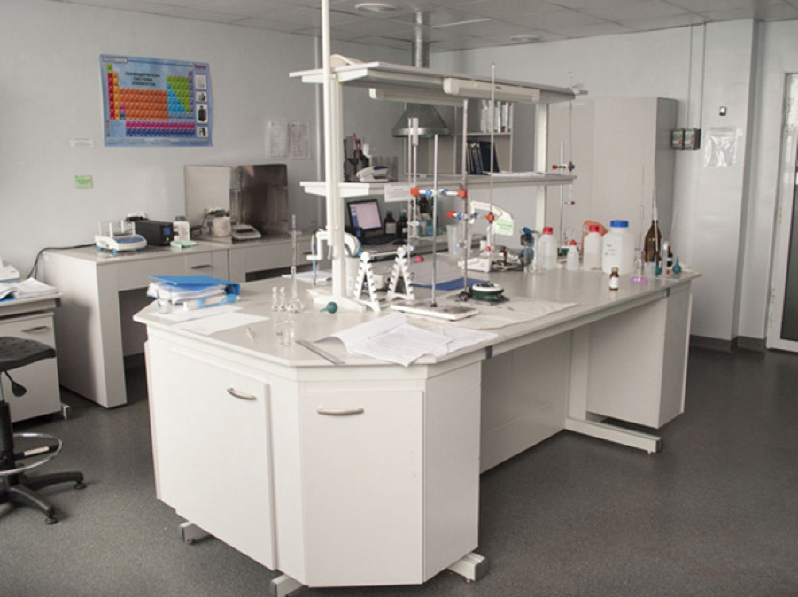
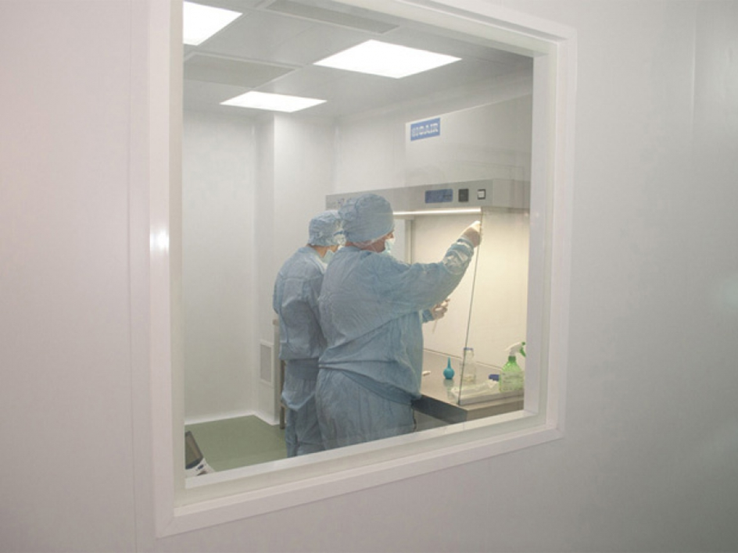
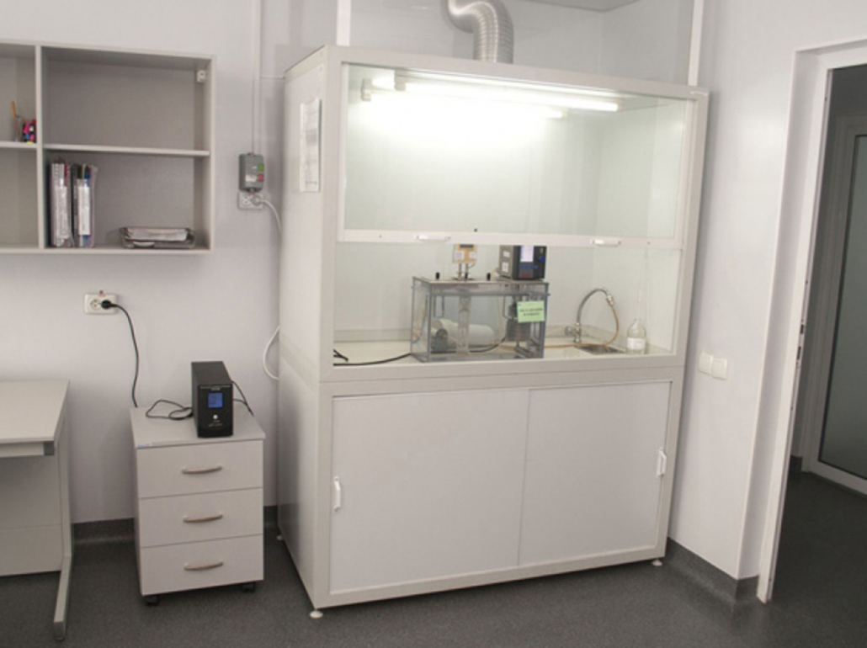
Testing of drugs for sterility: Methods of measurement and testing:

Slide 7
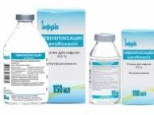
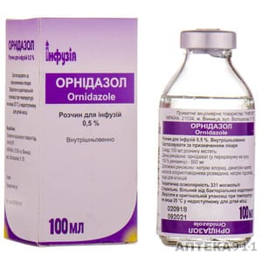
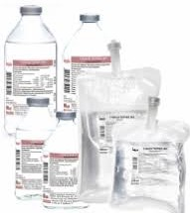
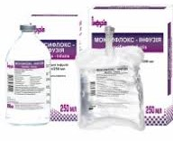
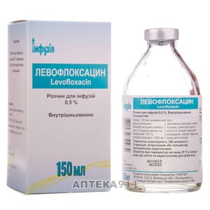
INFUSION

Slide 8
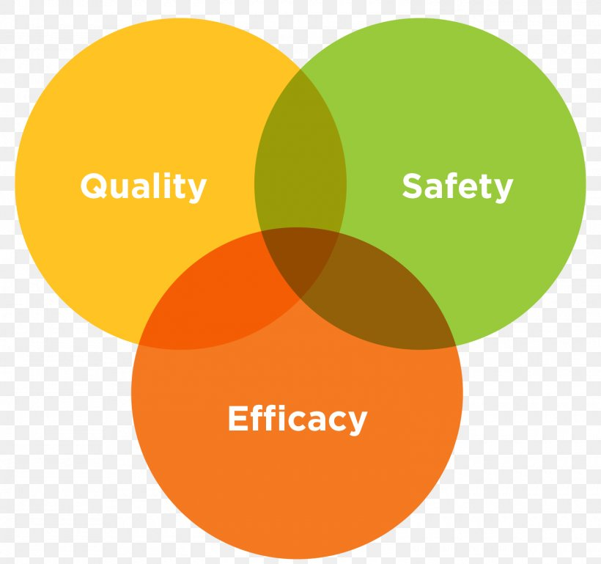
The purpose of the discipline: to provide future professionals with a set of knowledge and skills on the general principles and basic methods of ISO quality management and good practices in pharmacy; to provide systematic knowledge on quality control of medicines taking into account the current stage of development of the pharmaceutical industry; to acquaint future specialists with the legislative and regulatory documentation that regulates the quality of medicines.

Slide 9
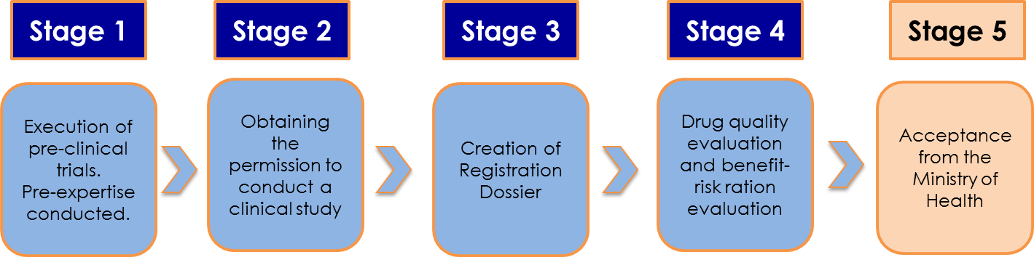
The format of the discipline (lectures, practical classes and independent work of the student) contributes to the expansion of worldview, accumulation of knowledge and understanding of the internal work of pharmaceutical companies, laboratories, pharmacies, the State Medical Service

Slide 10
Program learning results for the discipline:
Know the concept of good practices in pharmacy, their goals, procedures, tasks and requirements.
Be able to apply in practice the knowledge of the requirements of regulatory documents governing the process of pharmaceutical development of drugs.
Prepare current and reporting documentation based on the results of preclinical studies and clinical trials of drugs.
Structure the procedure for licensing, registration and re-registration of medicines in Ukraine.
Control the process of production of medicines in accordance with the requirements of good manufacturing practice.
Ensure the wholesale supply of medicines in accordance with the requirements of good distribution practice.
Carry out retail trade in medicines in accordance with the requirements of good pharmacy practice.
Ensure the storage process of medicines in accordance with the requirements of good storage practice.
Provide information on detected adverse reactions to the Department of Pharmacological Supervision of the SEC of the Ministry of Health of Ukraine.

Slide 11
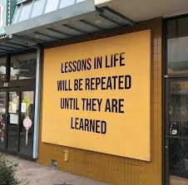

Slide 12

We are waiting for you all at the Pharmaceutical Chemistry department!

