Slide 1

Сhemical interaction of drugs
NATIONAL PIROGOV MEMORIAL MEDICAL UNIVERSITY
Вибіркова дисципліна за спеціалізацією
Pharmaceutical Chemistry
Department
https://www.vnmu.edu.ua/кафедра фармацевтичної хімії

Slide 2
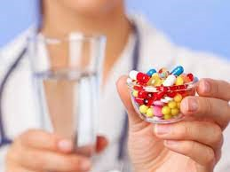
“Chemical interaction of drugs” is a very interesting and useful discipline. At simultaneous appointment of several medicines their interaction among themselves is possible that can lead to change of expressiveness and character of the main effect, its duration, and also to strengthening or weakening
of side and toxic effects
of some drugs, or to full loss of their pharmacological activity.

Slide 3

During the studing of the discipline, each student
learns:
what medications cannot be taken at the same time and why;
how to properly take medication while taking it;
how the effectiveness of drugs will change under the influence of food;
and much more interesting…..

Slide 4
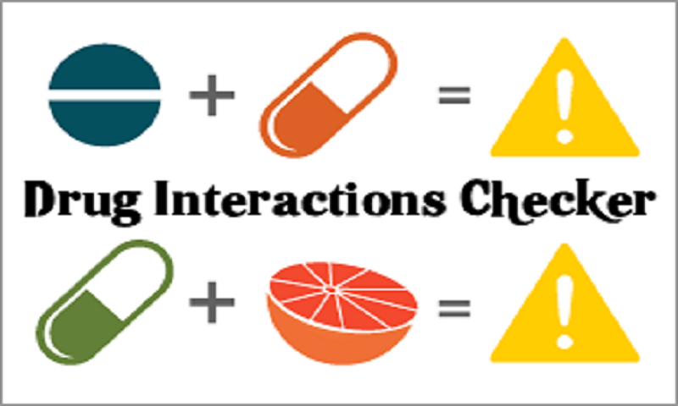
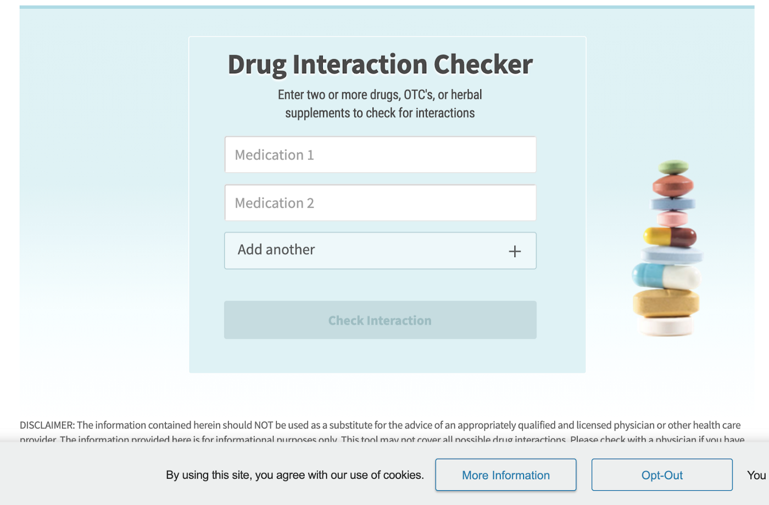
And we will also learn to work with electronic resources, which can be used to determine whether certain drugs or substances that are part of them interact with each other and how to properly combine drugs !!!

Slide 5


The discipline "Chemical interaction of drugs" will be useful in future professional activities
And it will be useful for everyone personally!

Slide 6
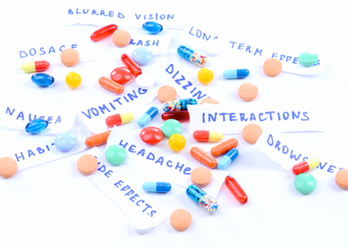
We are waiting for you at practical classes!
It will be interesting!

