Slide 1

QUALITY CONTROL OF MEDICINES
https://vnmu.edu.ua/en/department/department/

Slide 2
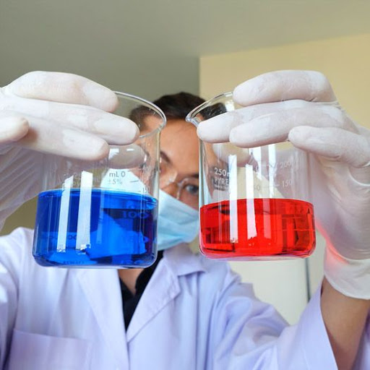
Annotation. The development of the pharmaceutical industry must comply with international standards, in the first place is the quality of the drug and the qualifications of a pharmaceutical worker both in matters of pharmacology and pharmaceutical chemistry. Thus, at the state level, the foundation is being created for the effective work of pharmaceutical manufacturers in matters of quality control of their own production.

Slide 3
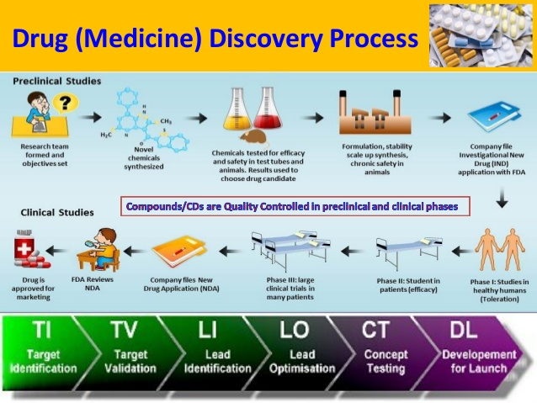
The purpose of the discipline:
The main goal of the course on Quality Control of medicines in a pharmaceutical university is to provide future pharmacists with a set of knowledge on quality control of medicines, taking into account the modern development of the pharmaceutical industry.

Slide 4
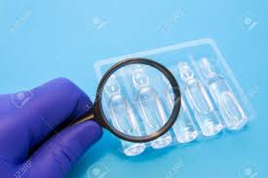
The format of the discipline
(lectures, practical exercises, student’s independent work) to expand the worldview, accumulate and consolidate knowledge and understanding of the inner work of pharmaceutical enterprises, laboratories, pharmacies, the State Medicines Service, etc

Slide 5


Slide 6

We are waiting for you all at the Pharmaceutical Chemistry department!

