Slide 1
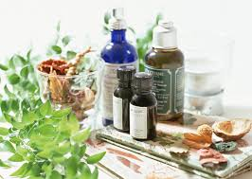
Phytotherapy
National Pirogov Memorial Medical University, Vinnytsya
Elective discipline by specialization
Department of Pharmaceutical Chemistry
https://www.vnmu.edu.ua/department of pharmaceutical chemistry

Slide 2
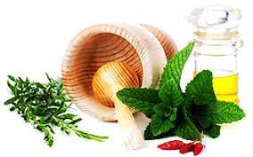
Topicality
The discipline "Phytotherapy" is part of the educational and professional training program for specialists of the second (master's) level of knowledge 22 "Health", specialty 226 "Pharmacy, industrial pharmacy".
This discipline considers methods of treatment and prevention of diseases with the use of phytopreparations, an integral part of complex, preventive and rehabilitation therapy. Modern phytotherapy is an independent medical and biological discipline. According to the WHO (2003), the development of phytotherapy is a priority in improving the health of the population, in the prevention of acute and chronic diseases and improving the quality of life.
Give the opportunity to the future masters of pharmacy not only to acquire the basic theoretical aspects of phytotherapy and use in the process of acquiring knowledge about medicinal plants and diseases of the plant growing, as well as practical skills for prevention and in a comprehensive treatment at various stages of illness, as well as rehabilitation.

Slide 3
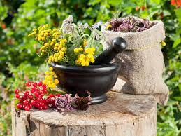
The object of study of the academic discipline are:
medicinal plants,
medicinal plant raw materials,
certain products of plant and animal origin,
herbal preparations,
herbal medicinal products (infusions, decoctions, tinctures, extracts, etc.)
medicinal herbs species and teas.

Slide 4
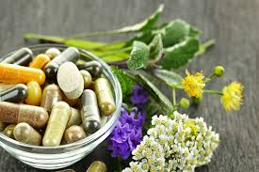
Phytotherapy ( from Greek phyton - plant, therapi - treatment) - a system of specific methods of treatment and prevention of diseases using phytopreparations; an integral part of complex, preventive and rehabilitation therapy. The term was introduced by the French physician Henri Leclerc (1870–1955).
Phytotherapy is based on three sources:
folk traditional medicine;
experimental pharmacology and toxicology of medicinal plants;
clinical pharmacology.

Slide 5
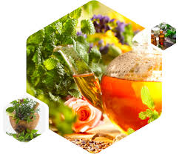
Goal and tasks
The goal of the discipline: the formation of the applicant's holistic view of the possibilities, forms and methods of phytotherapy, understanding of its place and role in pharmacy and comprehensive treatment and prevention of various diseases. To study the key concepts of phytotherapy as a discipline; to interpret the relationship between the content of biologically active substances of medicinal plants and their pharmacological action; master the method of manufacturing basic dosage forms from plant raw materials and the use of herbal remedies; to choose phytomedicines of general and specific action depending on the available functional disorders in patients of different profiles.
Tasks of the discipline: to teach the applicant the rational use of phytocollections and ready-made medicinal phytotherapeutic forms (infusions, tinctures, potions, capsules, microspheres, tablets) in complex treatment.
Studying the discipline, the applicant must give a qualified clinical assessment of the effectiveness and safety of herbal medicines, have knowledge of harvesting, processing and storage of MPRM, know the possible complications of herbal medicine and contraindications to the use of medicinal plants.

Slide 6

After taking the elective course, the applicant should know:
basics of phytotherapy, its basic principles;
names of plants, MPRM, families in English and Latin;
chemical composition of MPRM;
range of MPRM and drugs based on them;
therapeutic effects of MPRM;
groups of active substances contained in MPRM;
indications and contraindications to the use of MPRM;
requirements for the quality of MPRM;
to give a qualified clinical assessment of the effectiveness and safety of MPRM;
methods of treating diseases with drugs based on MPRM;
a list of the main phytotherapeutic effects and phytomedicines that cause them;
basic rules of formation of phytocompositions.

Slide 7
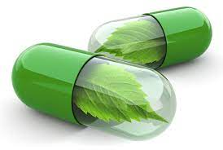
After taking this course the applicant must be able to:
identify MP by herbarium specimens;
determine the indications and contraindications to the use of herbal medicine;
to use in practice the technique and technique of grinding MPRM;
prescribe herbal remedies:
anti-inflammatory action;
antihypertensive action;
to regulate the vitamin balance of the body;
to restore the microelement balance of the body;
for the treatment of respiratory diseases;
for the treatment of diseases of the central nervous system;
for the treatment of diseases of the kidneys and urinary tract;
for the treatment of diseases of the liver and biliary tract;
with antioxidant properties.

Slide 8
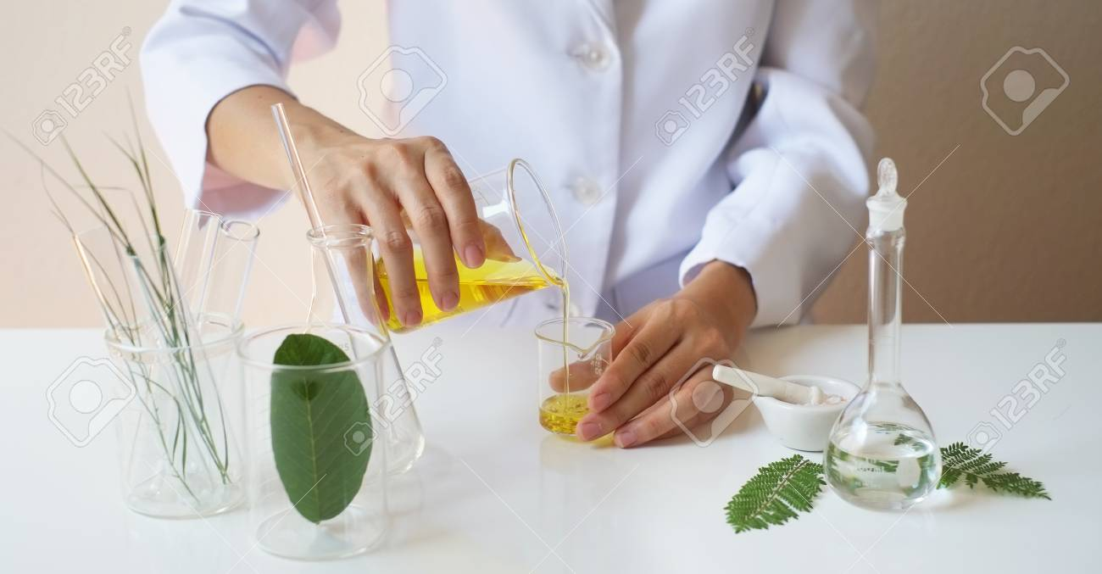
The discipline "Phytotherapy" is necessary for your future professional activity and will be useful for everyone personally!

Slide 9

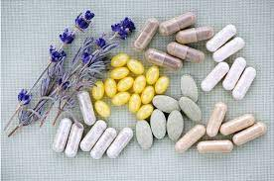
See you at the practical classes!

