Slide 1
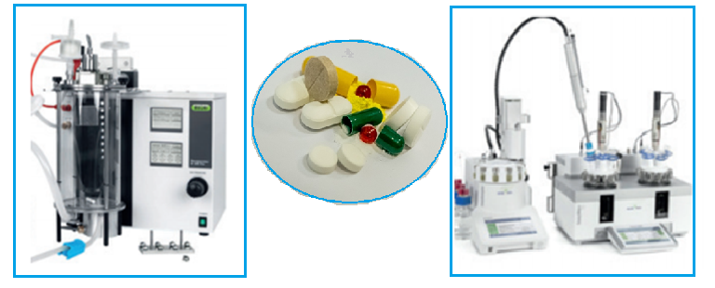
Physicochemical analysis in drug design
Pharmaceutical Chemistry Department
NATIONAL PIROGOV MEMORIAL MEDICAL UNIVERSITY
2022

Slide 2

IMPORTANCE AND RELEVANCE OF PHYSICOCHEMICAL METHODS
FOR PHARMACEUTICAL ANALYSIS
INTERTEK COMPANY
as a world leader provides innovative and bespoke Assurance, Testing, Inspection and Certification services to customers to help ensure the quality and safety of their products, processes and systems
Intertek Pharmaceutical Services
CHALLENGES OF THE DAY:
COVID-19 Vaccine and Therapeutic Testing
COVID-19 Surface Testing and Hygiene Solutions …

Slide 3
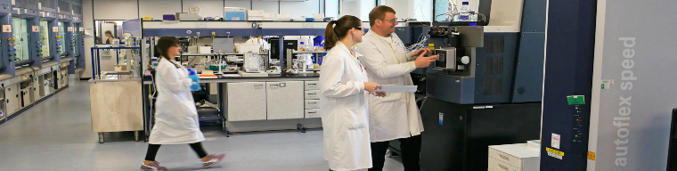
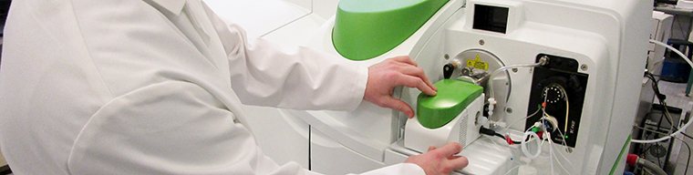
INTERTEK COMPANY provides:
- GMP and CMC Pharmaceutical Laboratory Services
CMC - Chemistry, manufacturing and controls
GMP - Good Manufacturing Practice
Biopharmaceutical Development Support Services: for comprehensive biopharmaceutical bioanalysis, analysis, characterization and potency services addressing the challenges of identity, purity, quality, safety and efficacy for proteins, antibodies, vaccines, antibody drug conjugates, peptides, cytokines, oligonucleotides and biosimilars
- Bioanalytical Services
Pharmaceutical Auditing
Regulatory, toxicology and scientific consulting expertise for the pharmaceutical and medical device industries
Pharmaceutical Analytical Consultancy expertise
Pharmaceutical Manufacturing Support
Intertek capabilities include centres of excellence for:
method development and validation
- analysis
stability studies
extractables and leachables
solid state characterization
impurity testing
elemental impurity analysis
cGMP quality control testing
cGMP batch release testing

Slide 4
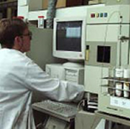
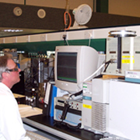
Classification of Physicochemical methods:
Optical methods
Chromatography
Electrochemical methods
Radiometric methods
Thermal methods
Mass spectrometry methods

Slide 5
Methods of Physicochemical Analysis
Optical methods
Радіометричні
Electrochemistry
Хроматографічні
Mass spectrometry
Potentiometry
Thin-layer chromatography (TLC)
Polarograhpy
Gas chromatography
Thermal methods
Conductometry
Liquid chromatography
Differential scanning calorimetry
Coulometry
Gas-Liquid
Thermogravimetric

Slide 6
Physicochemical methods Dictionary
1. Chromatography as a technique for the separation, identification, and purification of the components of a mixture for qualitative and quantitative analysis:
General chromatography terms
- chromatography –
- analyte
- eluate
- eluent
- immobilized phase
- mobile phase
- chromatogram
- retention time
- partition coefficient
Techniques by chromatographic bed shape
- column chromatography
- planar chromatography
- paper chromatography
- thin-layer chromatography (TLC)

Slide 7
1. Chromatography methods:
Displacement chromatography
Techniques by physical state of mobile phase
- gas chromatography
- liquid chromatography
Affinity chromatography
Supercritical fluid chromatography
Techniques by separation mechanism
- ion exchange chromatography
- size-exclusion chromatography
- expanded bed adsorption chromatographic separation

Slide 8
2. Optical methods
- photoсolorimetry
- specrtophotometry
- atomic absorption spectroscopy
- ultraviolet-visible spectroscopy
- infrared spectroscopy
- atomic emission spectroscopy
- fluorometry
- flame photometry (flame emission spectroscopy)
- x-ray fluorescence spectroscopy
- Raman spectroscopy
- nuclear magnetic resonance spectroscopy
- photoemission spectroscopy
- nephelometry
- turbidimetry
- refractometry
- interferometry
- polarimetry

Slide 9
3. Mass spectrometry
4. Electrochemical analysis
- potentiometry
- polarograhpy
- conductometry
- coulometry
5. Thermal analysis
- calorimetry
- thermogravimetric analysis
- differential scanning calorimetry
6. Radiometric analysis

Slide 10
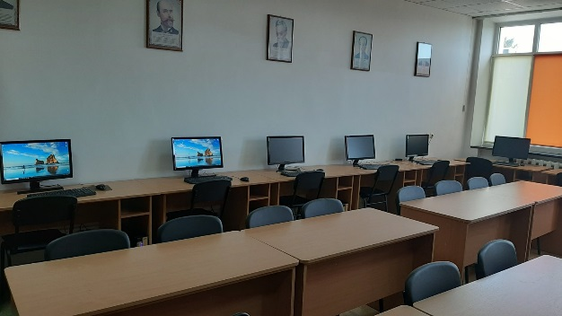
Physicochemical analysis in drug design
The course is based on the individual research work in Drug Design
The students choose the drug of interest and study the physicochemical methods to investigate it
The topic must be presented as a Report
We consider the experience of the leading company in this field - Intretek Company

Slide 11
Intertek Company
www.intertek.com
↓
Industries&Services
↓
Pharmaceutical Services

Slide 12
Contact Information for Ukraine
Intertek Odessa
Intertek Ukraine DP
115 Chernomorskogo Kazachestva
Odessa
Ukraine, 65003
T: +(38) 048 720 2475
F: +(38) 048 778 6868
Division: Commodities
Intertek Kiev
Intertek Ukraine DP
Office 3, 43/11 Moskovskaya Street
Kiev
Ukraine
T: +(38)044 496 46 90
Division: Industry & Assurance

Slide 13
You are welcome
Pharmaceutical Chemistry Department
NATIONAL PIROGOV MEMORIAL MEDICAL UNIVERSITY

