Slide 1
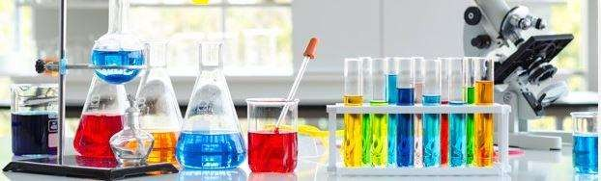
PHARMACEUTICAL ANALYSIS OF MEDICINES
Department of Pharmaceutical Chemistry
https://www.vnmu.edu.ua/Department of Pharmaceutical Chemistry

Slide 2
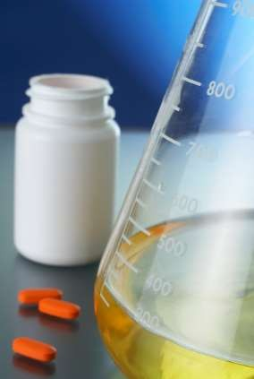
There are special requirements for the quality of medicines, as they are designed to guarantee the effectiveness and safety of the drug, and therefore the health of each person and society as a whole. Pharmaceutical analysis is an important component of drug quality assurance. It is a set of methods that allow to assess the quality parameters of chemical substances at all stages of the existence of medicine.

Slide 3
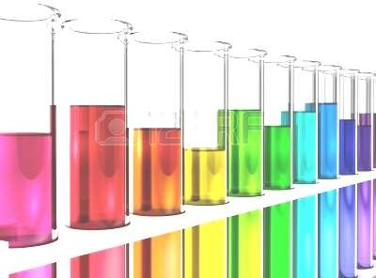
In the structure of pharmaceutical education, one of the leading positions is occupied by pharmaceutical chemistry. Pharmaceutical analysis of medicines as an integral part of pharmaceutical chemistry includes the study of issues on the quality assurance system of medicines, the organization of quality control of medicines in the pharmacy, the organization of work of pharmacist-analyst of the pharmacy, comprehensive assessment of quality of medicines and more. This is necessary in the practice of pharmaceutical professionals.

Slide 4
▶ Types of educational classes according to the curriculum are lectures, practical classes, independent work of students.
▶ The topics of the lecture course reveal the problematic issues of the relevant sections of pharmaceutical analysis.
▶ Practical classes according to the method of their organization are seminar or laboratory, because they provide:
- discussion of the main issues of the topic;
- performance of laboratory practicum (in case of impossibility of performance of laboratory work - consideration of situational tasks on the topic of the class,
- solving calculation problems, working with quality control methods and elaboration of other normative documents);
- choice and justification of a method, course of analysis of a substance or dosage form;
- conducting the necessary calculations to assess the quality (including quantitative analysis) of research objects;
- formation a conclusion about the compliance of research objects with the requirements of the methods of quality control (at quality control on separate indexes).

Slide 5
▶ Assimilation of the topic is controlled in practical classes in accordance with specific goals, assimilation of material - in practical final classes. The following tools are used to diagnose the level of preparation of students: multiple choice questions (MCQ), performance of situational tasks for self-preparation for classes, filling out of workbooks, interpretation of laboratory tests of analysis, interpretation and evaluation of their results, analysis and evaluation of research results and parameters characterizing the quality of medicine; control of practical skills. The final control of assimilation of material of the section is carried out after its completion. Assessment of student performance in the discipline is a rating and is set on a multi-point scale and is determined by the ECTS system and the scale adopted in Ukraine.

Slide 6


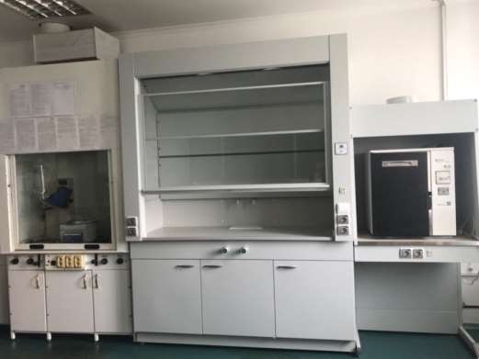
In 2017 with the assistance of the university administration in the Department of Pharmaceutical Chemistry, an educational and scientific laboratory of chemical and pharmacognostic research was created
During the practical classes students have the opportunity to get acquainted with the organization of work in the laboratory, as well as to conduct analytical research.

Slide 7
The laboratory is equipped with modern instruments:
▶ Spectrophotometer Agilent Cary 60;
▶ Rotary evaporator RV 8c;
▶ Binocular microscope Leika DM750;
▶ ABBE laboratory refractometer AR4;
▶ Aquadistillator electric ДЕ-10М;
▶ Analytical scales VIBRA series HTR-220CE;
▶ Drying wardrobe;
▶ Muffle furnace;
▶ Colorimeter photoelectric КФК-2.

Slide 8


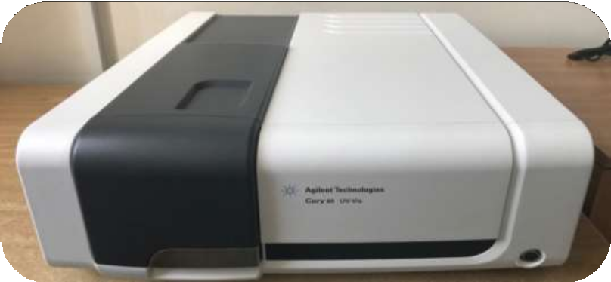
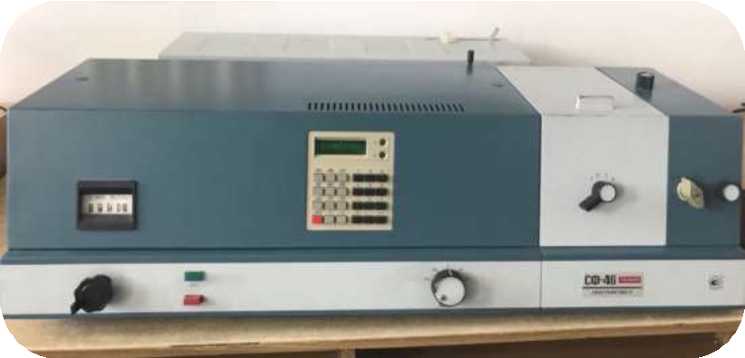
Research methods offered by the laboratory:
- spectrophotometric studies (spectral range 190-1100 nm);
- photoelectrocolorimetry;

Slide 9

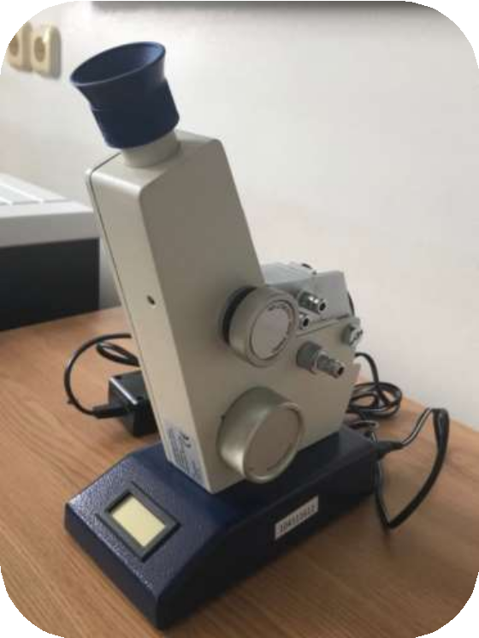

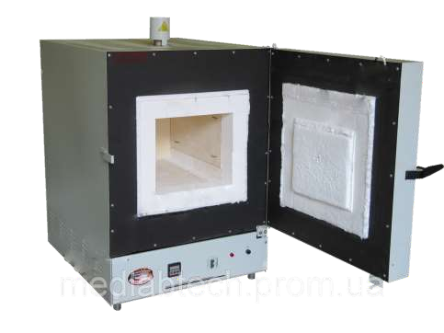
- refractometry;
- determination the loss in weight on drying;
- dry ashing;

Slide 10


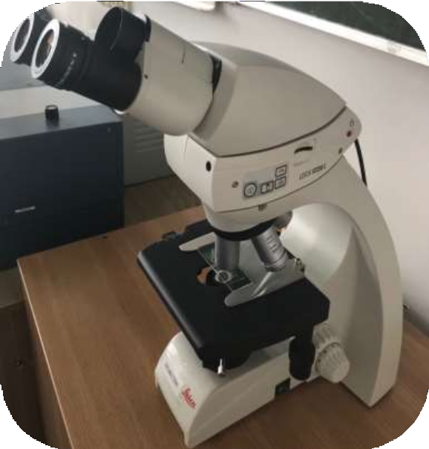
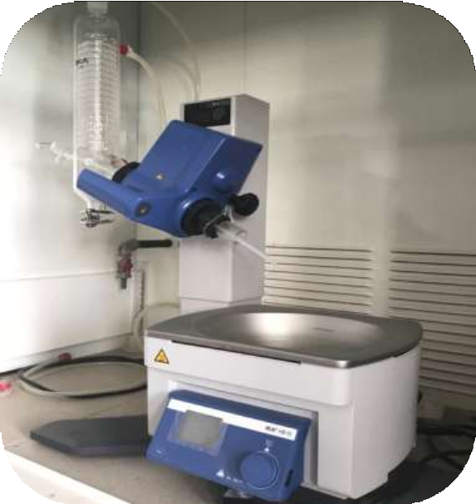
- extraction of biologically active substances (BAS) from medicinal plant raw materials followed by removal of the extractant under vacuum;
- microscopic analysis.

Slide 11
Prerequisites of the discipline
Basic knowledge and learning outcomes are based on the study of the chemical structure of drugs, their physical and chemical properties; the relationship between chemical structure and action on the organism, methods of quality control and changes during storage.
Interdisciplinary communications: general and inorganic chemistry, organic and bioorganic chemistry, analytical chemistry, biophysics, biology, physical and colloidal chemistry, pharmaceutical chemistry, pharmacology, toxicological chemistry, pharmacognosy, technology of medicines, clinical pharmacy.
Postrequisites of the discipline
Knowledge, skills and abilities acquired after the completion of the study of pharmaceutical analysis of medicines are necessary for the correspondence and full-time cycles of internship in the specialty "Pharmacy", as well as successful and highly professional pharmaceutical activities.

Slide 12
The aim of education in the discipline pharmaceutical analysis of medicines:
to fix of theoretical knowledge, practical skills and abilities obtained in the educational process for solving specific tasks of practical activities of pharmacist-analyst in a pharmacy, control and analytical laboratories of the State Service of Ukraine for Medicines and Drug Control, development, consolidation and deepening of practical skills in pharmaceutical chemistry, standardization and quality control of medicines.

Slide 13
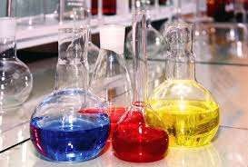
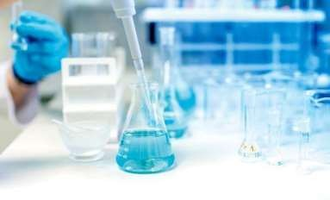
Learning objectives in the discipline pharmaceutical analysis medicines:
study of the duties of a pharmacist-analyst in the workplace; acquaintance with organization and technical equipment of the workplace of pharmacist-analyst; quality control of medicines and preparation of relevant documentation.

Slide 14
The content of the discipline pharmaceutical analysis of medicines:
History of creation of modern system of quality control of medicines in Ukraine.
Organization of quality control of medicines in a pharmacy. Organization of work of the pharmacy-analyst.
Quality control of purified water and water for injections.
Quality control of in-pharmacy preparations and concentrates.
Quality control of ophthalmic dosage forms manufactured in a pharmacy.
Quality control of parenteral dosage forms manufactured in a pharmacy.
Quality control of extemporaneous dosage forms manufactured in a pharmacy.
Organization and conditions of storage of medicines and medical devices in a pharmacy.
Organization of incoming quality control of medicines in a pharmacy. The role and tasks of the authorized person
to ensure the quality of medicines.
Registration of medicines. Licensing of medicines in the EU.
Certification of pharmaceutical products and quality systems in Ukraine.
Validation of analytical methods of analysis of medicines.

Slide 15
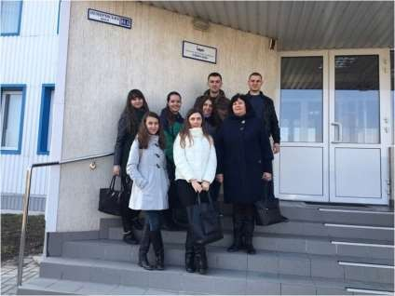
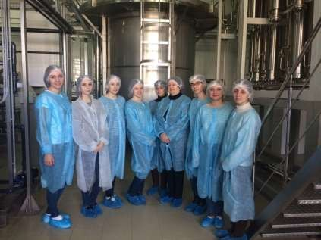
During the study of the discipline students have the opportunity to visit pharmaceutical companies in Vinnytsya:
- PJSC "Infusiа«

Slide 16
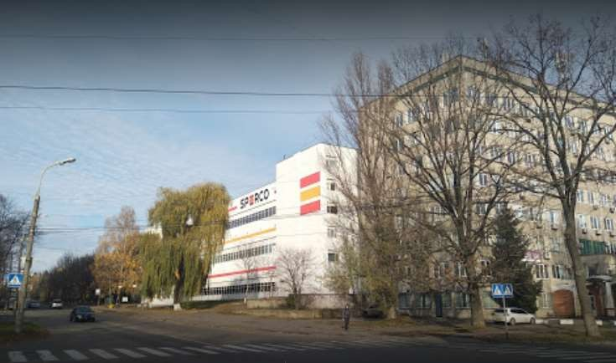
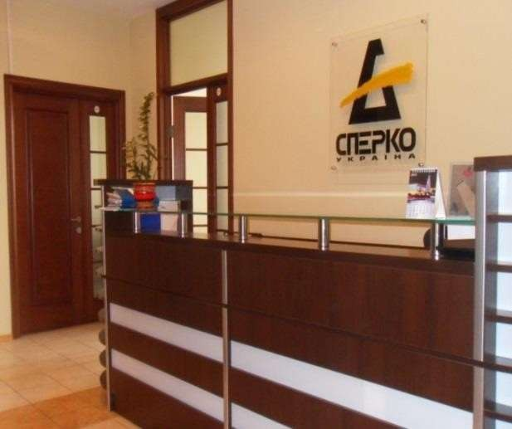
- joint Ukrainian-Spanish enterprise
Ltd. «Sperko Ukraine»
At these enterprises students get acquainted with modern methods of pharmaceutical analysis in practical conditions

Slide 17
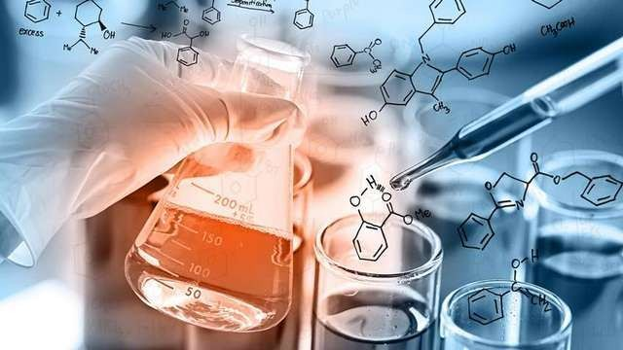
IF YOU WANT TO GET THE BEST PRACTICAL KNOWLEDGE OF YOUR FUTURE PROFESSIONAL ACTIVITY, WE INVITE YOU TO THE DEPARTMENT OF PHARMACEUTICAL CHEMISTRY

