Slide 1


Ukrainian Ministry of Health
National Pirogov Memorial Medical University, Vinnytsya
Department of Philosophy and Social Sciences
For first year students
«HISTORY OF WORLD CULTURE»

Slide 2



ACTUALITY OF THE DDISCIPLINE
The course "History of World Culture" is aimed at the development of analytical and artistic thinking of students, awareness of the complex processes of modern cultural and artistic life. Thorough knowledge of world culture is one of the most important components of formation of scientific world outlook and education of high moral qualities of modern student's youth.

Slide 3

Purpose : acquaintance with the main theoretical principles of culture and cultural heritage of specific historical and cultural epochs, awareness of the unity of cultural diversity of the world, the importance of culture in the life of subjects and humanization of social relations, understanding the trends of modern sociocultural transformations in world culture.
The main objectives:
to acquaint with the theoretical principles of culture, the main cultural heritage of historical and cultural epochs and patterns of historical and cultural development;
to form the ability to systematize, generalize, critically comprehend and adequately evaluate the accumulated cultural experience;
to ensure awareness of the complex processes of modern cultural and artistic life of the world;
to educate students to respect the spiritual achievements of mankind, to develop skills of tolerant attitude to ethno-national and social diversity of cultural forms of modern human space;
formation of moral and aesthetic worldview of future doctors, the ability to formulate and actively defend their own point of view, the system of aesthetic values ​​and priorities;
to use cultural values, works of art culture and the received knowledge at studying of other disciplines, in professional and social activity.

Slide 4
We will get acquainted with the main cultural heritage of historical and cultural epochs:
INDICATIVE COURSE PLAN
1. Introduction to the course. The essence of culture.
2. Culture of primitive times and the Ancient East.
3. Ancient culture.
4. Culture of the Middle Ages (V—XIV с.).
5. Renaissance culture (XIV—XVI с.).
6. Culture of the Enlightenment (XVII—XVIII с.).
7. Culture ХІХ с.
8. Culture ХХ с.
9. World culture of the XXI c. in the context of globalization
and with different models of the world and man in different historical types of culture

Slide 5
The following topics will also be covered:
World culture as a phenomenon of universal unityї
Interaction of cultures and cultural identity of peoples in the context of globalization. The idea of equality of cultures
Unity and interdependence of world and national cultures
Problems of cultural identification and self-identification
Opposites of modern world culture: freedom and violence; elitism and mass; pluralism and unification; traditions and innovation; individualism and collectivism
Ideologization of culture. Totalitarianism and culture
Anthropocentrism and humanism in the European cultural tradition
Ideological and spiritual challenges of the twentieth century. The crisis of humanism.
The essence of the current global socio-cultural crisis
Culture shock and its negative and positive consequences
The phenomenon of cultural and ethical pessimism and its causes
Cultural diplomacy
Crimes against culture
Art and war
Culture as a factor in the national security system
Mass culture as a means of cultural war
The role of information technology in the development of humanity and society
The influence of social and technological progress on spiritual culture
Environmentalization of culture
Art for ecology
Architecture of the future. Bionics
Optical illusions in art
The culture of everyday life
Symbolism of color in different cultures
Nonverbal communication. Symbolism of gestures
Computer graphics as a form of modern art
Museums: modern concept. Night of museums
Skansens
Youth music subcultures: trends, styles, performers
Globalization of popular music
Westernization and Americanization of popular culture
All for sale or commercialization of art
Who owns the future?
Alternative ways of development of world civilization
The cultural potential of humanity

Slide 6
We will determine the styles of art :
Doric, Ionic, Corinthian warrants;
Romanesque style, Gothic, Magnier, Baroque, Rococo, Classicism, Naturalism, Romanticism, Realism, Impressionism, Post-Impressionism, Art NouveauCurrents of modernism: expressionism, abstractionism, futurism, Dadaism, Fauvism, Cubism, Surrealism, Constructivism
The emergence of new trends, directions, forms and genres of art, subcultures in the late twentieth - early XXI century:street art, social art, pop art, op art, land art and environment, eco-art, bio-art, mail art, body art, psychedelic art, sand animation
Actionism (happening, performance, flash mob), installationLuminography, light graphics, video art, public art, media artNew subcultures: emo, steampunk, goblincore, grandtranscore, cottagecore

Slide 7
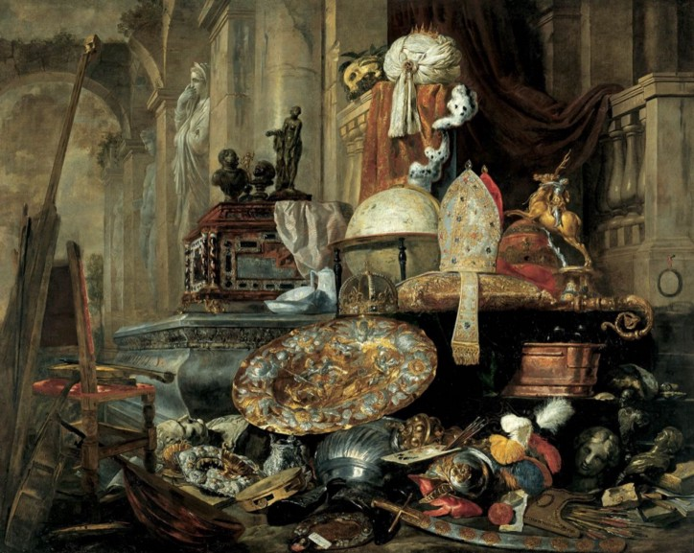
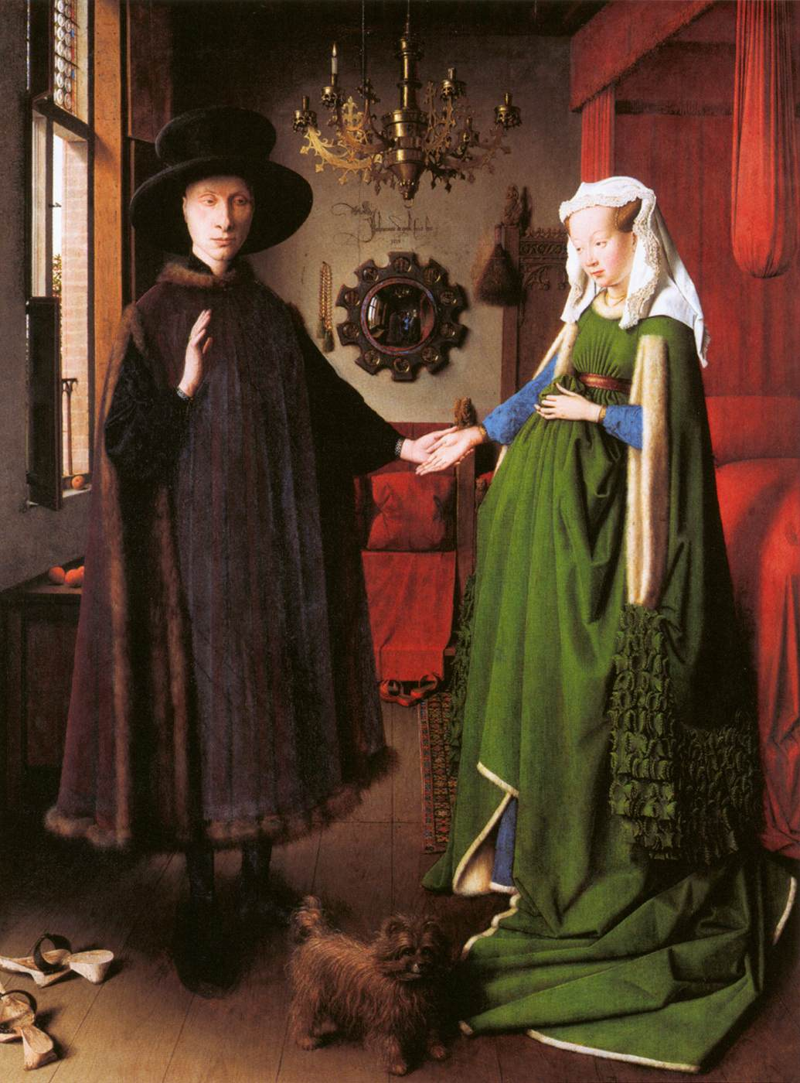
We will find out which characters are encrypted in the pictures:

Slide 8
We will consider the connection between art and medicine:
Medical symbols.
Medical themes in the works of artists of different eras and contemporary art.
Diagnosis by painting: what doctors see in the paintings of famous artists.
Professional and mental illnesses of artists (painters, musicians, dancers).
History of medical technologies and instruments reflected in painting.
The influence of the pictorial image on the psychosomatic state of man.
Art-therapy.
The image of the doctor in the art of cinema.
Art photography for medicine.
The human body as an art object.
Honoring doctors: awards, art events, graffiti, monuments, etc.
The influence of artistic culture on the development of medical care.

Slide 9
Expected learning outcomes of the subject:
Independently determine the essence and content of cultural phenomena in the course of historical development.
To operate by methods of historical and system analysis, to compare features of different cultural epochs.
To substantiate the cultural influences of previous periods on the following ones, to prove the existence of socio-cultural dynamics.
Analyze the causes and consequences of changes in human attitudes to themselves, to society, to nature in different historical periods.
Be able to explain the relationship and interactions of world and Ukrainian culture.
Analyze the features of cultural development of different regions of the world.
Know and describe the creative activities of prominent representatives of world culture.
Identify the species, genre and stylistic diversity of art.
Distinguish artistic and aesthetic directions, substantiate their essence, originality and influence on public life.
To use in the process of studying the subject of knowledge of related disciplines: history of Ukraine, world history, philosophy, sociology, basics of economic theory, ethnography, archeology.
Define the categories and basic concepts of science of culture. Reproduce, interpret and use basic terms and concepts in everyday life.
To form culturological knowledge in speeches, reports, presentations.
Give a review of a work of art (optional).
The student must be able to form a personal system of values, communication skills.
Apply knowledge of the history of world culture to determine the line of personal behavior in a diverse culture.
Assess the importance of the subject for the formation of a modern specialist with a high internal culture.

