Slide 1
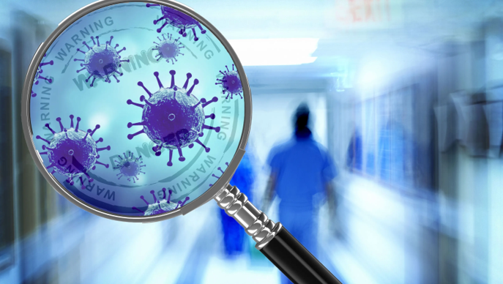
National Pirogov Memorial Medical University
Microbiology Department
Clinical microbiology (an elective discipline)

Slide 2
Do you know that no matter what specialty you choose, you will face diseases of microbial origin?
Do you know that 7-10% of hospitalized patients develop healthcare associated infections?
And that even after a proper-made surgery, you can lose a patient because of an infectious complication?
If you want to know everything about infectious safety in hospitals, pathogens causing infectious complications and why they are noted as real danger to your patient life, as well as communicate professionally with clinical microbiologists, so, you just need our course "Clinical Microbiology"

Slide 3
The subject of study of this discipline are:
Biological properties of opportunistic microorganisms and pathogens causing nosocomial infections;
Disorders of microbiocenosis of the human body that lead to the development of microbial complications in somatic patients, and methods of their prevention;
Features of ethiopathogenesis of opportunistic infections depending on their localization;
Modern diagnostic methods and principles of treatment of microbial complications.

Slide 4
Get knowledge of the biological properties of opportunistic microorganisms and patterns of their interaction with the human body
Identify the causes of opportunistic infections and know measures to prevent their development
To deepen knowledge about the pathogenesis of opportunistic and nosocomial infections, features of the immune response to pathogens of microbial complications
Get ability to choose the correct methods of laboratory diagnostics and interpret their results in case of infectious sequalae
Get acquainted with the principles of ethiotropic therapy of microbial complications, justify the choice of antimicrobial drug for treatment
The learning aim of the discipline "Clinical Microbiology" is:

Slide 5
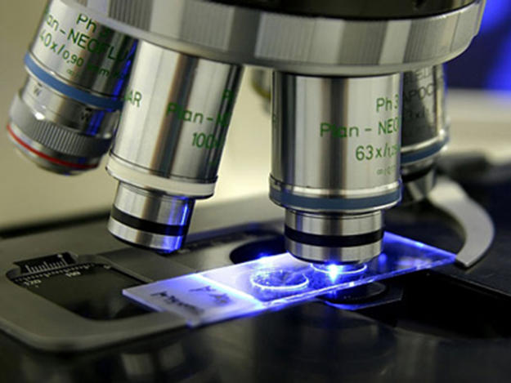
The main tasks of studying the discipline "Clinical Microbiology" are:
Disclosure of problematic issues in clinical microbiology;
Study of biological properties of opportunistic pathogens,
Mastering the methods of correct material collection for bacteriological / virological investigation from different loci of the human body
Selection of an adequate method of laboratory investigation depending on the location and course of microbial complications
Assimilation of knowledge necessary for the implementation of effective interaction of future doctors of non-infectious hospitals with clinical microbiologists
Implementation the principles of infectious safety in practice to prevent microbial complications
Get acquainted with the problem of antibiotic-resistant hospital strains spreading, know the basic principles of rational antibiotic therapy
Get acquainted with alternative methods of treatment (e.i., immunotherapy, phagotherapy) and prevention of microbial complications
Understand the main causes of dysbiosis in various systems of the human body, methods of their diagnosis and correction of such disorders

Slide 6
As a result of training you will get the ability to:
Understand the causes and relevance of opportunistic infections in modern healthcare practice
To analyze the biological properties of opportunistic microorganisms and patterns of their interaction with the host and the environment
Understand the peculiarities of microbial complications in violation of the human body protection
To substantiate methods of microbiological diagnostics, ethiotropic therapy of opportunistic and hospital infections
To substantiate the methods which are used to control the spread of hospital strains in the hospital setting
Interpret the results of laboratory diagnostics methods, including molecular genetic assay, interpret their diagnostic value.

Slide 7
After studying the discipline you will be able to:
Correctly collect and send the material for bacteriological examination to the clinical laboratory;
Conduct a microscopic examination of pathological material;
Select appropriate nutrient media to isolate the pathogen of opportunistic infection;
Perform inoculation of the material on nutrient media to isolate the pathogen of microbial complications;
Perform inoculation of the material on nutrient media to obtain information about the number of opportunistic microorganisms in the material;
Evaluate the diagnostic value of the results of laboratory tests;
Choose the most rational ethiotropic treatment of opportunistic infection;
Evaluate the results of sanitary-bacteriological research of medical and diagnostic equipment from the point of view of epidemiological safety.

Slide 8
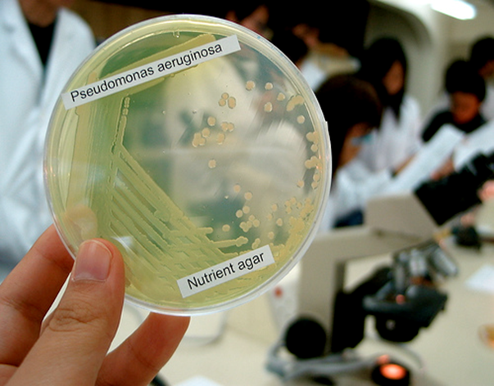
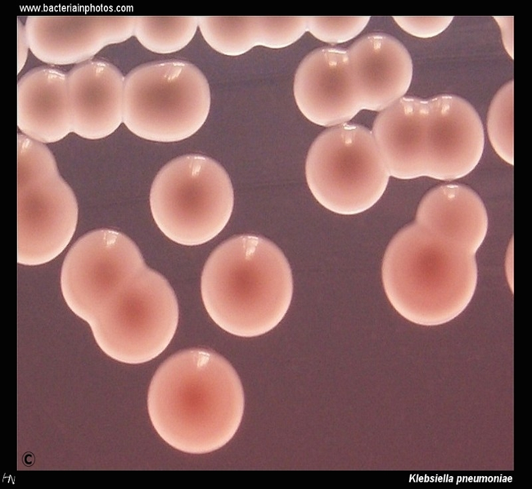
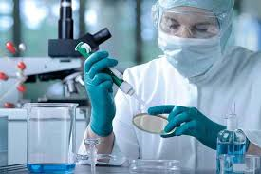
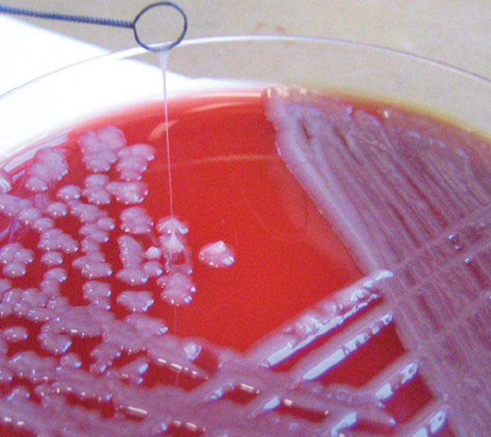

Slide 9

We are waiting for you at our department!

