Slide 1

Ministry of Education and Science of Ukraine Ministry of Health of Ukraine
NATIONAL PIROGOV MEMORIAL MEDICAL UNIVERSITY, VINNYTSYA
Department of Philosophy and Social Sciences ​
Logic. Formal Logic
THE ELECTIVE COURSE
training professionals of second level of higher education
educational qualification «Master of Medicine»

Slide 2
Logic is the study of the principles and methods of reasoning. It explores how we distinguish between good (or sound) reasoning and bad (or unsound) reasoning. An instance of reasoning is called an argument or an inference. An argument consists of a set of statements called premises together with a statement called the conclusion, which is supposed to be supported by or derived from the premises. A good argument provides support for its conclusion, and a bad argument does not.

Slide 3

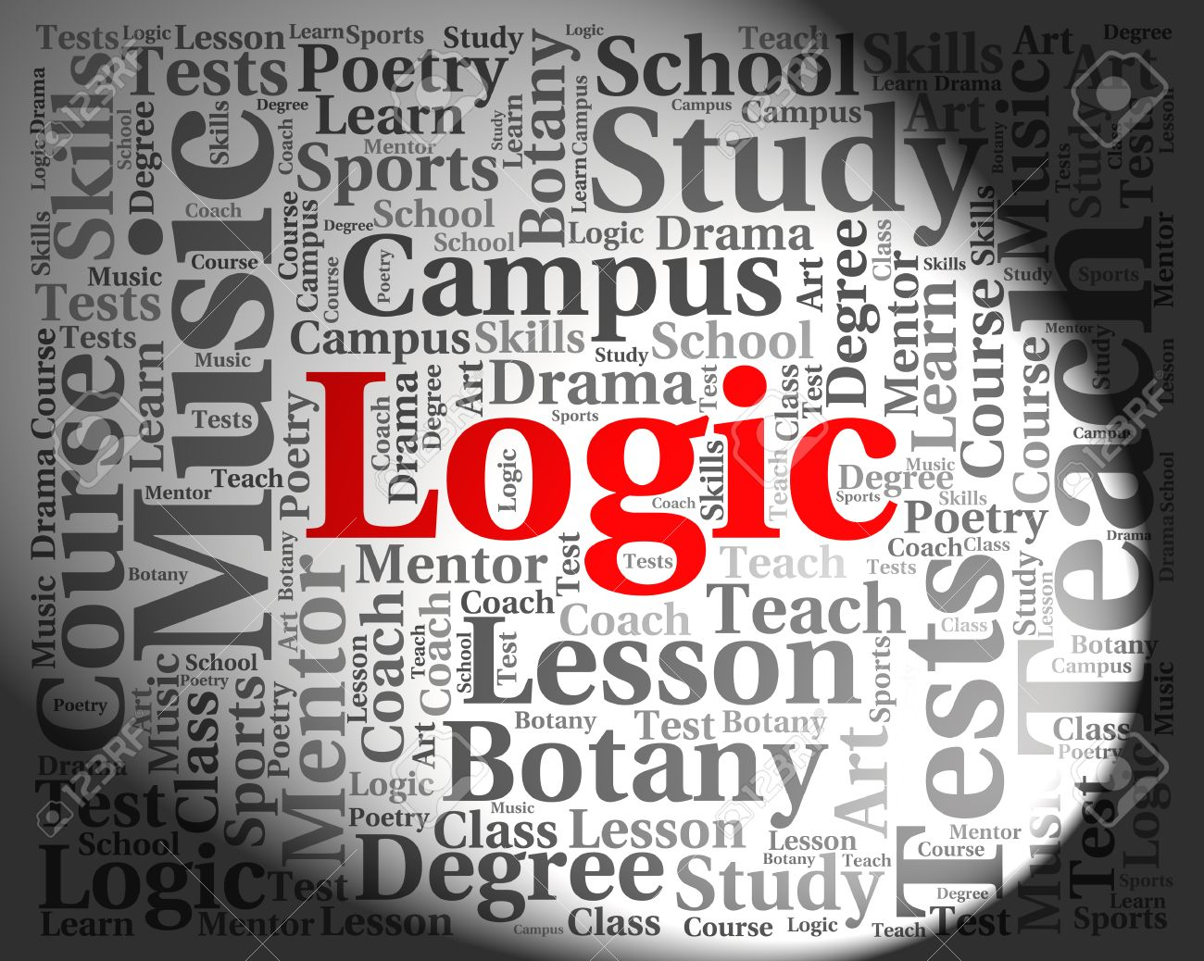
Objectives:
the subject lays the foundations of knowledge of the rules of analytical reasoning, the use of laws and principles of correct thinking, forms the future specialist’s culture of thinking. The discipline explores a way to gain new knowledge in science, professional and everyday thinking.

Slide 4


Main tasks:
to teach students effective means of constructing correct reasoning and means of finding the causes of logical errors and ways to eliminate them; to form knowledge about forms of thinking and laws and explan their practical significance for the professional activity of the future specialist; to create a proper theoretical basis for the young specialist’s outlook self-determination; to involve students in the mankind worldview and methodological culture accumulated throughout the history of existence.

Slide 5
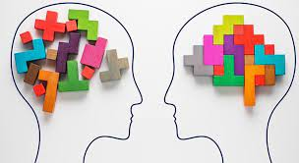

Logic as a discipline is a component of modern higher medical education. The subject is based on the study of fundamental disciplines by students.
The subject forms logical thinking and skills of application of scientific methodology in professional activity.

Slide 6
Studying the course is important for the following reasons:
to develop students' skills of meaningful consistent and evidence-based thinking;
to form the skills of independent and creative thinking;
to create dialectical thinking in order to raise the future physicians cultural level;
to explain the methodological principles of facts’ understanding

Slide 7

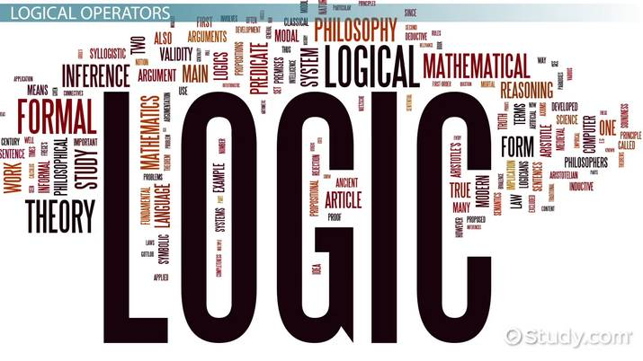
While learning Logic, you’ll achieve knowledge necessary for the successful assimilation of such social and humanitarian subjects as Philosophy, Hygiene and Ecology, Social Medicine, Public Health to provide further training of medical students. This process determines the integration of Logic with these subjects. It also determines the application of acquired knowledge, skills and abilities in the process of further education and professional activities.

