Slide 1

Ethics and Deontology in Medicine
Ministry of Education and Science of Ukraine Ministry of Health of Ukraine
NATIONAL PIROGOV MEMORIAL MEDICAL UNIVERSITY, VINNYTSYA
Department of Philosophy and Social Sciences
THE ELECTIVE COURSE
training professionals of second level of higher education
educational qualification «Master of Medicine»

Slide 2


Medical ethics includes the principles of proper professional conduct concerning the rights and duties of the physician, patients, and fellowpractitioners, as well as the physician's actions in the care of patients and in relations with their families.

Slide 3
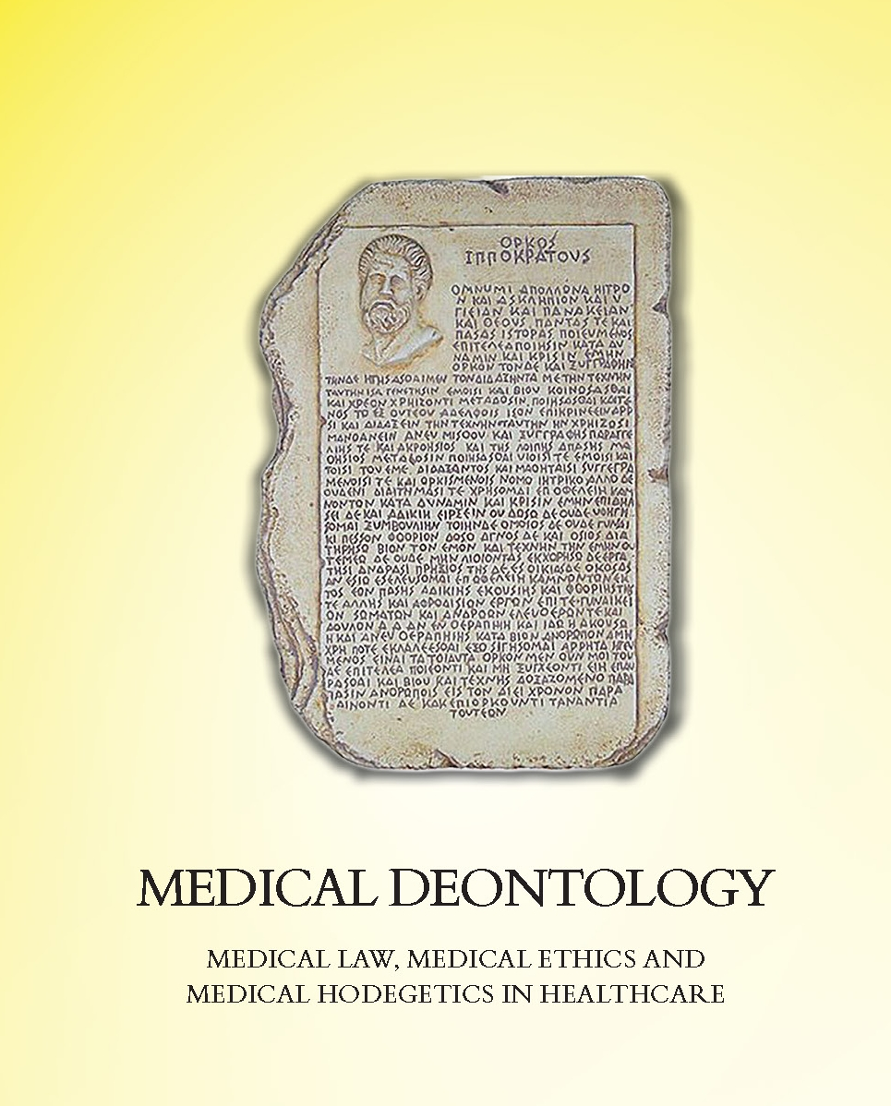

Medical Deontology
is a system of moral principles that apply values and judgments to the practice of medicine. It is a “set of ethical standards and principles of behavior of medical practitioners while executing their professional ethics of medical workers and principles of behavior of medical personnel, directed toward maximum benefit of treatment”.

Slide 4

Objectives:
the subject lays the foundations of knowledge of of analytical reasoning rules, the use of laws and principles of correct thinking, forms the future specialist’s culture of thinking. The discipline explores a way to gain new knowledge in science, professional and everyday thinking.

Slide 5

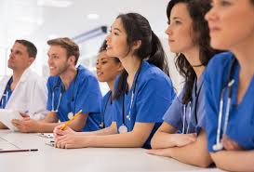
Main tasks:
form intelligent worldview of future healthcare professionals, professional thinking based on the principles of morality and deep professional knowledge and skills. Master the theoretical knowledge necessary for development of optimum behavior model at communication with patients. Provide students with up-to-date information on the legal regulation of a doctor's professional activity. Acquire appropriate skills of professional team communication.

Slide 6
Studying the course is important for the following reasons:
to form integrated ideas about deontology in the field of medicine and understanding of the ethical responsibilities of the physician;
to understand the relationship between the basic documents of medical ethics, the moral criteria of health care workers and their job responsibilities;
to build productive relationships within the workforce, methods of preventing and resolving ethical conflicts while doing professional duties of a doctor;
to build trusting, business, productive, meaningful relationship with the patient and his relatives.

Slide 7
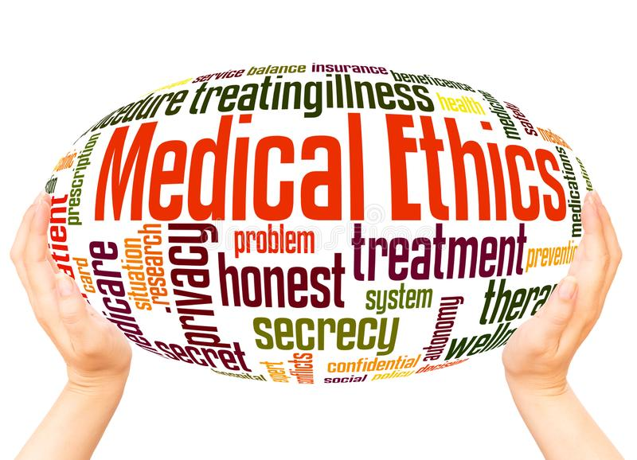

While learning Ethics and Deontology in Medicine, students achieve knowledge necessary for the successful assimilation of such social and humanitarian subjects as Philosophy, Hygiene and Ecology, Social Medicine, Public Health to provide further training of medical students. This process determines the integration of Ethics and Deontology in Medicine with these subjects. It also determines the application of acquired knowledge, skills and abilities in the process of further education and professional activities.

Slide 8
Макет заголовка та вмісту зі списком
Перший рівень
  Другий рівень
    Третій рівень
      Четвертий рівень
        П’ятий рівень

Slide 9
Макет заголовка та вмісту з діаграмою

Slide 10
Макет для двох елементів вмісту з таблицею
Предмет | Група А | Група Б
Предмет 1 | 82 | 85
Предмет 2 | 76 | 88
Предмет 3 | 84 | 90
Перший пункт тут
Другий пункт тут
Третій пункт тут

Slide 11
Макет для двох елементів вмісту з рисунком SmartArt
Перший пункт тут
Другий пункт тут
Третій пункт тут
Група А
Завдання 1
Завдання 2
Група Б
Завдання 1
Завдання 2
Група В
Завдання 1
Завдання 2

