Slide 1
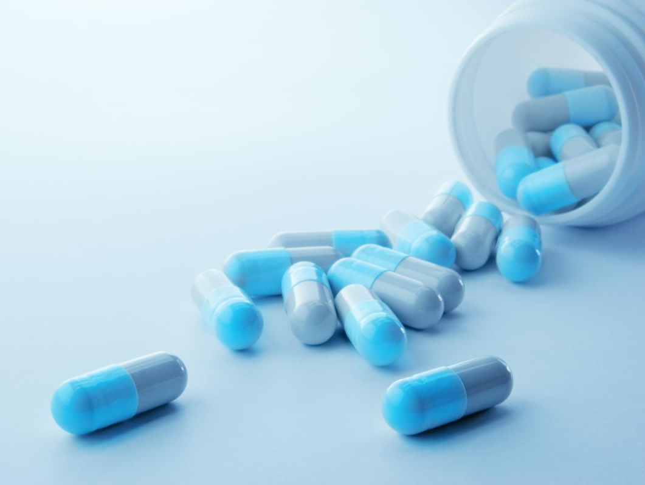
National Pirogov Memorial Medical University, Vinnytsia
Pharmacology department
Essentials of pharmacokinetic and pharmacodynamic of drugs
Elective course for 3rd year medical students

Slide 2
Formation of students' theoretical knowledge and practical skills on the basic concepts and parameters of pharmacokinetics and pharmacodynamics to justify the rational and safe use of drugs for human health.
This will contribute to the future quality of professional duties performance such as the rational choice of drug, the development of pharmacotherapy regimens, monitoring the effectiveness and safety of pharmacotherapy, prediction, and prevention of adverse drug reactions.
The aim of the course

Slide 3
As a result of studying the course the student
Has to know:
general principles and patterns of the pharmacokinetics of drugs;
ways of drug administration into the human body and ways of their excretion;
distribution, deposition, and types of drug metabolism and factors that affect these processes;
general principles of drug dosing;
basic principles and mechanisms of action of drugs;
pharmacological effects, the dependence of pharmacological action on the properties of medicinal substances and features of the human body;
types of action of drugs when they are re-introduced;
types of drug interactions with their simultaneous use;
side effects and toxic effects of drugs and ways to prevent them.

Slide 4
As a result of studying the course the student
Must be able:
to determine the dependence of the action of drugs on their physicochemical properties, dosage form, and features of the patient's body;
choose the dosage form and route of administration, taking into account their pharmacokinetic and pharmacodynamic features, as well as the disease and the patient's condition;
сalculate a single dose of the drug depending on age, body weight, or body surface area of ​​the patient;
determine, depending on the pharmacokinetics of drugs, the frequency of drug administration, its daily, course dose in patients of different ages following comorbidities and the use of other drugs;
predict the consequences of the interaction of drugs in their combined administration, drugs and food components, drugs and alcohol;
assess the benefit/risk ratio of drugs;
make judgments about the possibility of adverse drug reactions to prevent them.

Slide 5
The course structure:
Section І. Pharmacokinetics
1. Routes of administration of drugs (enteral and parenteral), their varieties, and characteristics.
2. Types of absorption and their main mechanisms (active transport, passive and facilitated diffusion, filtration, pinocytosis).
3. The concept of bioavailability and bioequivalence of drugs. Distribution and deposition of drugs in the body. The concept of barriers (blood-brain, placental, etc.)
4. Biotransformation. The main ways of drug metabolism in the human body, their characteristics. Inducers and inhibitors of liver microsomal enzymes, their significance. Genetic factors influencing the pharmacokinetics of drugs.
5. Ways of excretion of drugs from the body.
6. The main pharmacokinetic parameters, their characteristics. The concept of elimination factor and drug clearance. The concentration of the drug in the dosage form or biological fluid.
7. Features of the pharmacokinetics of drugs in their single and long-term use.
8. External and internal factors influencing the pharmacokinetics of drugs.
9. Dose determination, types of doses: single, daily, course, threshold, shock, crushed, maintenance, prophylactic, medical, average and higher therapeutic, toxic and lethal. The breadth of therapeutic action.

Slide 6
The course structure:
Section І. Pharmacokinetics
1. The concept of pharmacodynamics.
2. The main types of action mechanisms of drugs. The role and types of receptors in the manifestations of pharmacodynamic effects. Types of transporter proteins, basic enzymes, and secondary messengers and their role in the mechanisms of action of drugs.
3. Types of the pharmacological action of drugs.
4. Genetic factors influencing the pharmacodynamics of drugs.
5. Types of drug interactions in the human body with their simultaneous use. The concept of polypragmatism and polytherapy.
6. Synergism, additive action of drugs, potentiation.
7. Antagonism: physical, physicochemical, physiological, biochemical, pharmacological. Direct and indirect antagonism, it's meaning.
8. Relationship between pharmacokinetics and pharmacodynamics.
9. The concept of chronopharmacology.
10. The concept of drug safety. Side effects of drugs. Types of side effects. Absolute and relative overdose (toxic effects). Intolerance. Allergic reactions. Mutagenicity, teratogenicity, embryotoxicity, fetotoxicity, carcinogenicity. Individual sensitivity of the body to drugs.

Slide 7
Forms and methods of teaching:
lectures
Practical classes
Independent work
Control methods:
Current control - oral examination, test control, solution of pharmacotherapeutic and situational problems, the performance of an individual task.
Final control – credit test.

Slide 8
Literature:
Basic & Clinical Pharmacology / Bertram G. Katzung, Susan B. Masters, Anthony J. Trevor. – McGraw Hill Lange. 2019
Lippincott’s Illustrated Reviews: Pharmacology. Seventh Edition / editor Karen Whalen. – Wolters Kluwer – 2019.
First aid to the UMSLE STEP 1 / Tao Le, Vikas Bhushan, Mattew Sochat, Vaishnavi Vaidyanathan. McGraw-Hill Education, 2020.
Medical pharmacology / K.D Tripathi. – Jaypee Brothers Medical Publishers (P) LTD, 2008
Pharmacology. Eight edition / H. B. Rang, J. M. Ritter, R. J. Flower, G. Henderson. – Elsevier LTD, 2016.

Slide 9
Information resourses
Websites of professional publications, electronic international databases (РubМed - http://www.ncbi.nlm.nih.gov, etc.)
FDA - https://www.fda.gov
Index to Drug-Specific Information - https://www.fda.gov/drugs/postmarket-drug-safety-information-patients-and-providers/index-drug-specific-information
Drugs.com https://www.drugs.com/alpha/a.html

