Slide 1
IMMUNOPROPHYLAXIS OF INFECTIOUS DISEASES IN CHILDREN
(elective course for 6th year students)
Field of Study: 22 "Healthcare"
Specialty: 222 "Medicine"
National Pirogov Memorial Medical University, Vinnytsya
Head of Pediatric Infectious Diseases Department:
prof., D.S., Nezgoda I.I.
Responsible for implementation:
assoc. prof., PhD in Medicine, Onofriichuk O.S.

Slide 2
RELEVANCE
An important place in the doctor activity of any specialization belongs to the prevention of the most common infectious diseases, the main way of which is vaccination against them according to preventive vaccination calendar and patient's age.
According to the WHO, 24.7% of deaths in the world are caused by infectious diseases and such diseases include 63% of infant mortality.
In Ukraine, compulsory vaccination is carried out against ten diseases, although the list of recommended and permitted epidemiological indications is much wider. Immunization is not only the most effective means of overcoming infectious diseases, it ensures the realization of the inalienable human right to a healthy and full life. However, even today, more than 22 million infants in the world are not fully vaccinated, and more than 1.5 million of them under the age of five die from diseases that can be prevented with existing vaccines.
In Ukraine, over the years there has been an unfavorable situation with the level of immunization coverage of prescribed categories of the population, which has complicated the epidemiological situation in the country and provoked a threat to the security of its population.
Prevention is a priority strategy in the fight against infectious diseases. Today, the world's experience in the fight against infectious diseases indicates the undeniable role of immunoprophylaxis.
Vaccinology is a rapidly developing branch of medicine. Modernization and creation of new vaccines, change of approaches and schemes of immunoprophylaxis require systematization of student's knowledge in this field. Therefore, future specialists must have a clear understanding of the process of vaccine prophylaxis and all its currently known aspects to ensure the infectious safety of patients and humanity as a whole.

Slide 3
PURPOSE:
Theoretical knowledge increasing, improvement and mastering of practical skills in vaccine prophylaxis in children to widen the professional level of knowledge in the field of pediatric infectology.

Slide 4
TASKS:
Conduct an objective examination of children before vaccination and interpret the results of research, taking into account the anatomical and physiological characteristics and age norms.
Know the features of the clinical course of infectious diseases against which vaccinations are carried out.
Make a plan for anti-epidemic measures (emergency prevention) in the foci of infections.
Demonstrate the ability to assess the vaccination of a child of different ages.
Plan an individual vaccination schedule for the child, taking into account age, health status and epidemiological situation.
Diagnose and provide emergency care for post-vaccination reactions and complications.
Address the need for hospitalization of the child, provide emergency care for major emergencies resulting from vaccination.

Slide 5
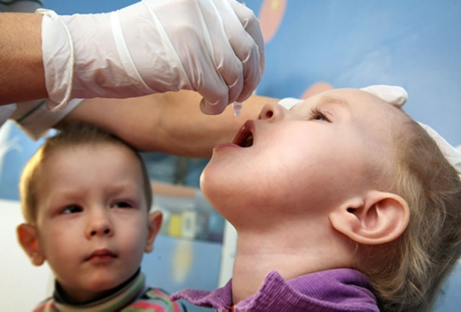
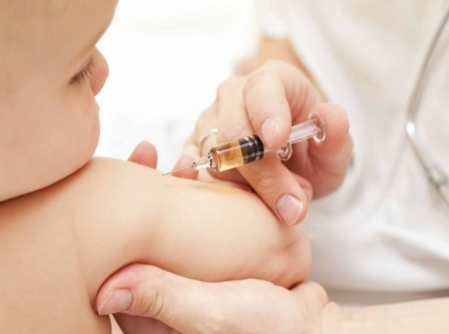
DISCIPLINE STRUCTURE:
Immunity
Understanding the concept of vaccine process, phases of development of post-vaccination immunity;
Introduction to vaccines and the method of their manufacture;
Vaccination methods (intradermal, subcutaneous, intramuscular, inhalation, aerosol).
Hereditary
Acquired
Natural
Artificial (vaccine generated)
Active
Passive
Active
Passive

Slide 6
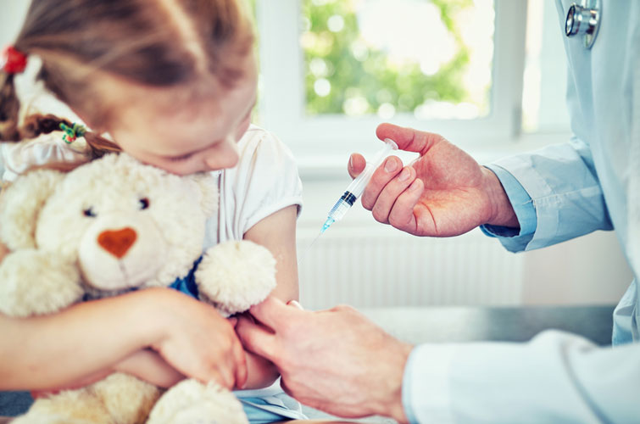
DISCIPLINE STRUCTURE:
Ukrainian immunization schedule
Age | Vaccines
1 day |  | HBV
3 -5 days | BCG
1 month
2 months |  | HBV | DTaP (DTP) | OPV (IPV) | HIB
4 months |  |  | DTaP (DTP) | OPV (IPV) | HIB
6 months |  | HBV | DTaP (DTP) | OPV (OPV)
12 months |  |  |  |  | HIB | MMR
18 months |  |  | DTaP (DTP) | OPV (OPV)
6 years |  |  | DT | OPV (OPV) |  | MMR
7 years
14 years |  |  |  | OPV (OPV)
16 years |  |  | DT
23 years |  |  | DT
26 years |  |  | DT (Booster dose every 10 yr)
Calendar of preventive vaccinations. Vaccination by age. Vaccinations are recommended.
Vaccination for health reasons. Contraindications to vaccination.

Slide 7
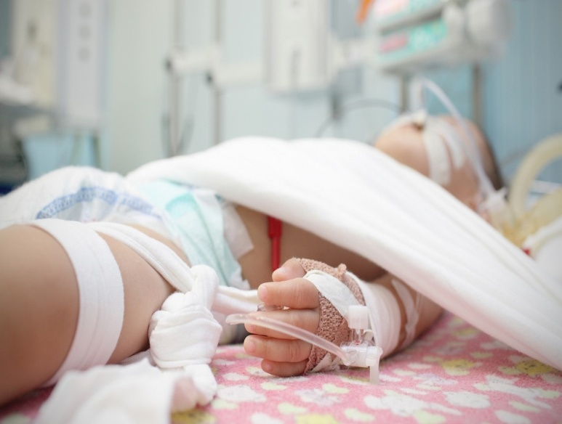
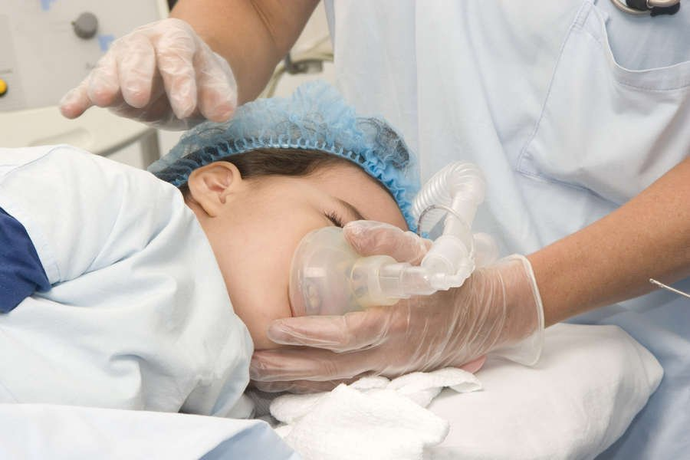
DISCIPLINE STRUCTURE:
Post-vaccination reactions and complications,
their diagnosis and treatment.
Anaphylactic shock, diagnosis and emergency
care.

Slide 8
Material and Technical Base for the Studying Course:
Materials of control of basic preparation of students:
- test tasks
Materials for methodological support of the main stage of the lesson:
- clinical cases of vaccination;
- sets of results of paraclinical research methods;
- individual student work (presentation preparation work of the student's choice)
Materials for the final stage of the lesson:
- a set of test tasks, tasks of the 3^{d} level, sets of paraclinical research methods:
Materials for methodical support of students' self-preparation:
- methodical instructions for students.

