Slide 1
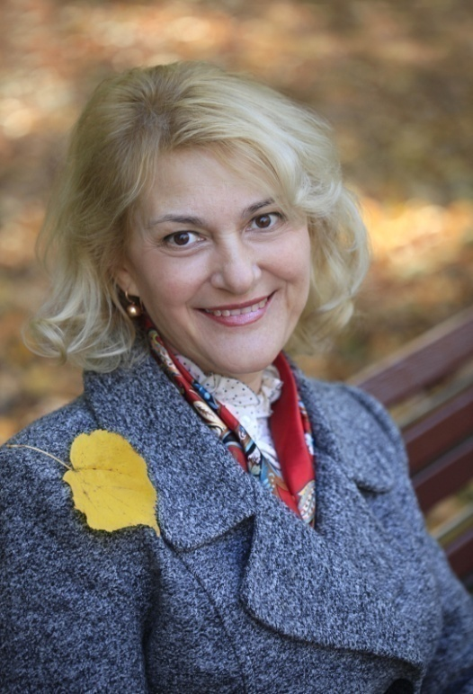
Ministry of Education and Science of Ukraine Ministry of Health of Ukraine
NATIONAL PIROGOV MEMORIAL MEDICAL UNIVERSITY, VINNYTSYA
Department of Philosophy and Social Sciences ​
“SOCIOLOGY AND MEDICAL SOCIOLOGY”
S. L. Trukhmanova , PhD of Historical
Sciences, Senior Lecturer of the
Philosophy and Social Sciences
Department

Slide 2

Topic № 1. Sociology as a science of society
Topic № 2. Methods of sociological research Topic № 3. History of sociology
Topic № 4. Social structure of society
Topic № 5. Social stratification
Topic № 6. Sociological concept of personality. Socialization
Topic № 7. Social behavior
Topic № 8. Medical sociology. Social conditions of the disease
Topic № 9. Sociology of the family
Topics of practical classes

Slide 3

There will be a talk in the classes
about society and it’s
elements, about methods
study of social reality, factors influencing the social behavior of individuals, social statuses and roles, social norms and deviations from them,
medicine as a social institution and the social foundations of medical progress,
current trends in family development,
basic sociological theories, globalization and prospects for society

Slide 4

And also talk about the social structure, the role of the urban community in the development of society, the impact of scientific and technological progress on the state of society…

Slide 5

We can try to conduct our own sociological research.

Slide 6

Literature
Giddens A. Sociology. - 6th edition. Cambridge: Polity, 2009.
Vander Zanden J., Hughes M., Kroehler C. Sociology: The Core. - 10th ed. - McGraw-Hill Education, 2011.
Sociology. A brief introduction. –
10th ed. - McGraw-Hill Education, 2017.
Henslin J. Essentials of sociology. - 12th ed. - Boston : Pearson Education, 2017.
S.L. Trukhmanova, O.I. Trukhmanova Sociology and medical sociology. Teaching Methodical book for the First Year Students of Medical Departments (speciality “medical practice”).-Vinnitsya – 2019, 140 p.

Slide 7

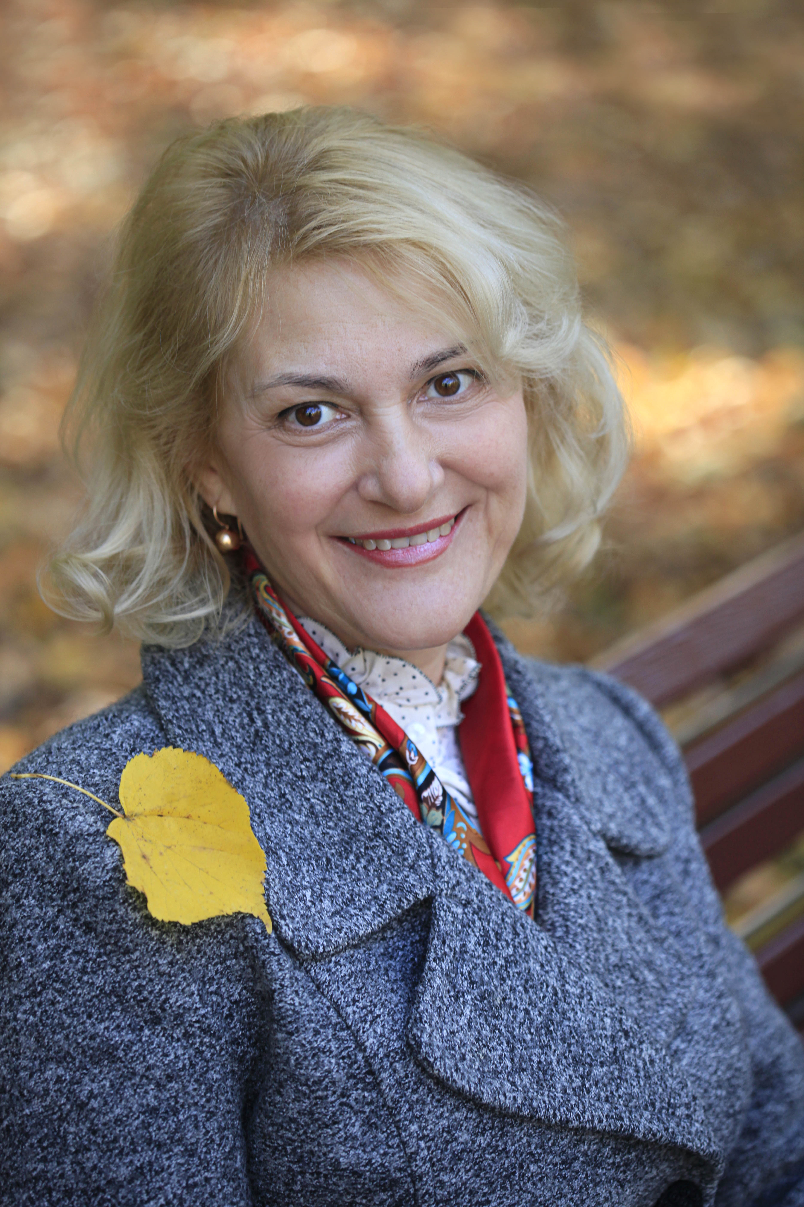
Information resources:
University website
vnmu.edu.ua.
Website of libraries library.vsmu.edu.ua.

Slide 8

Thank you!

